Slide 1
Building Resilience
Learning Experience: Grounding

Slide 2
Checking In

Slide 3
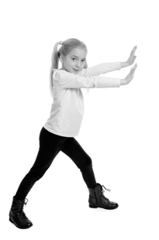
Grounding with One’s Stance
Let’s practice different ways to move our body (like pushing against the wall). Then, we can decide which movements make us feel comfortable.

Slide 4
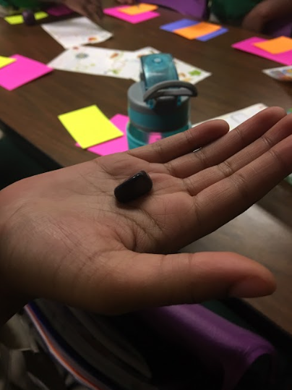
Grounding with an Object
Let’s choose some objects to hold and see how they makes us feel.

Slide 5
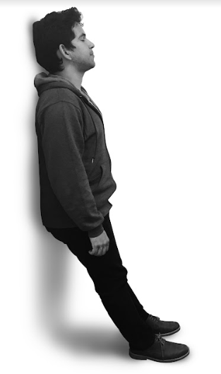
Grounding with a Part of the Body
Let’s move our bodies into different positions like standing and leaning on the wall. Think about how your hands and feet feel when you do these motions.

Slide 6
Debrief
“We have spent some time together trying out different ways of grounding ourselves and noticing sensations within our bodies. Which has been the best one for you (i.e. which has given you pleasant or neutral sensations)? Which one did not work for you?
Does anyone remember a sensation that they felt or heard someone else share?
When do you think you could use grounding?”

