Slide 1
Creating a Compassionate Classroom
Learning Experience: Exploring Kindness

Slide 2
Checking In

Slide 3
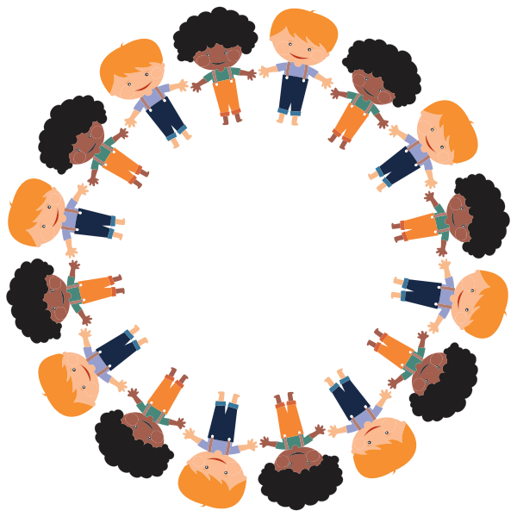
Step In, Step Out
When I say something you like, step in the Circle
When I say something you dislike step out of the Circle

Slide 4
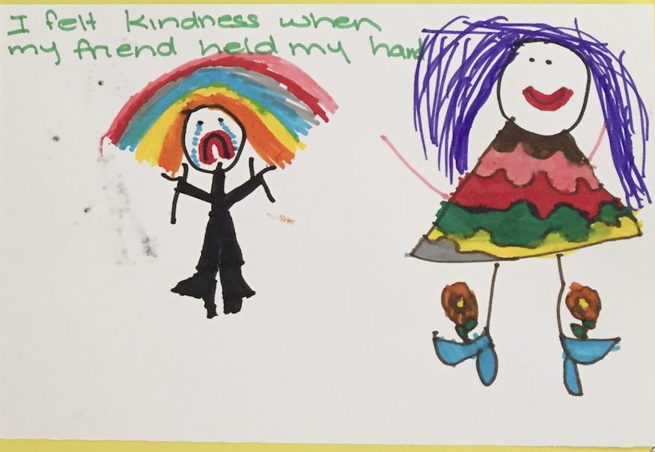
Remembering and Drawing Kindness
Imagine a time when someone was kind to you.
What did it look like? What did it feel like? What did you look like? What did you feel like?
Draw a picture of this memory

Slide 5
Debrief
What do you think: do we all want to be happy?
Do we all like kindness more than meanness?
How do we feel when people are kind to us?
How do we feel when people are mean?
In one word or sentence, is there anything you learned today about kindness?”

