Slide 1
Exploring Needs and Feelings
Chapter 4 Learning Experience 2

Slide 2
Checking In

Slide 3

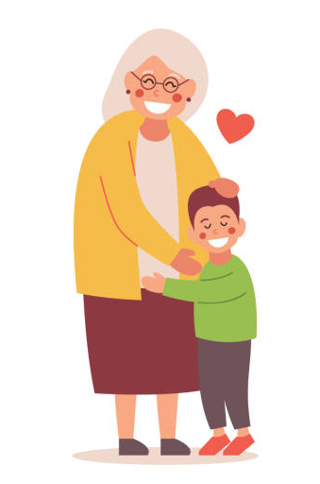
Recognizing Needs
How do you think Nelson is feeling right now?
What sensations might he be having in his body?
What does he need right now?
How do you think he will feel if he gets what he needs?
How do you think he will feel if he doesn’t get what he needs?
Notes:
https://www.istockphoto.com/vector/grandson-hugging-his-grandmother-vector-illustration-gm532975706-94364419
https://www.istockphoto.com/vector/house-with-front-yard-gm487730074-73240923

Slide 4
Debrief
How did Nelson generally feel when he had an unmet need?
How did he feel when his need was met?
Who helped Nelson meet his needs?
How would we find out what someone needs, like in our classroom?

