Slide 1
We’re All in This Together
Events and Systemic Structures

Slide 2
Checking In

Slide 3
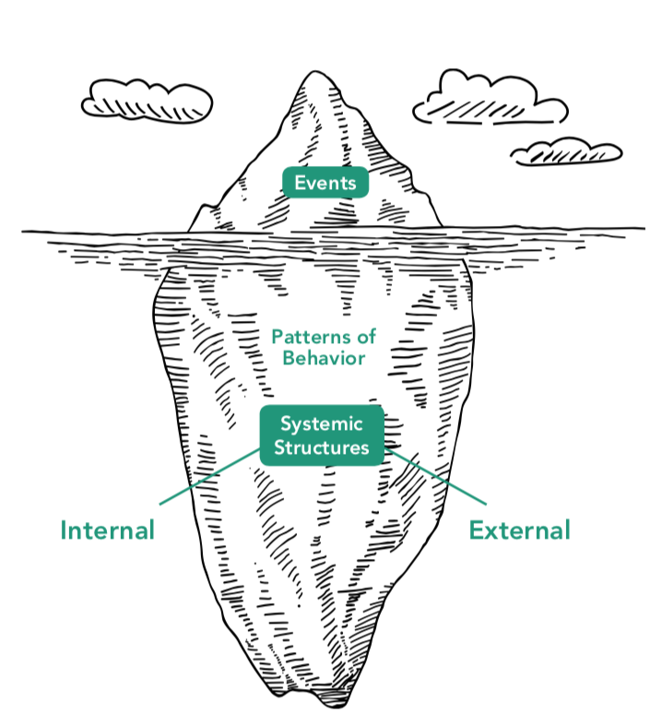
The Tip of the Iceberg
What percentage of an iceberg do you think is typically visible above the water?
Systemic structures explain the patterns of behavior above them
Internal structures: within the person
External structures: environment, parents, etc
How might analyzing events & behaviors help us empathize with others?
How might it help us practice self-compassion towards ourselves?
Notes:
Non copyright: https://unsplash.com/photos/qjs2R1lMMcw

Slide 4
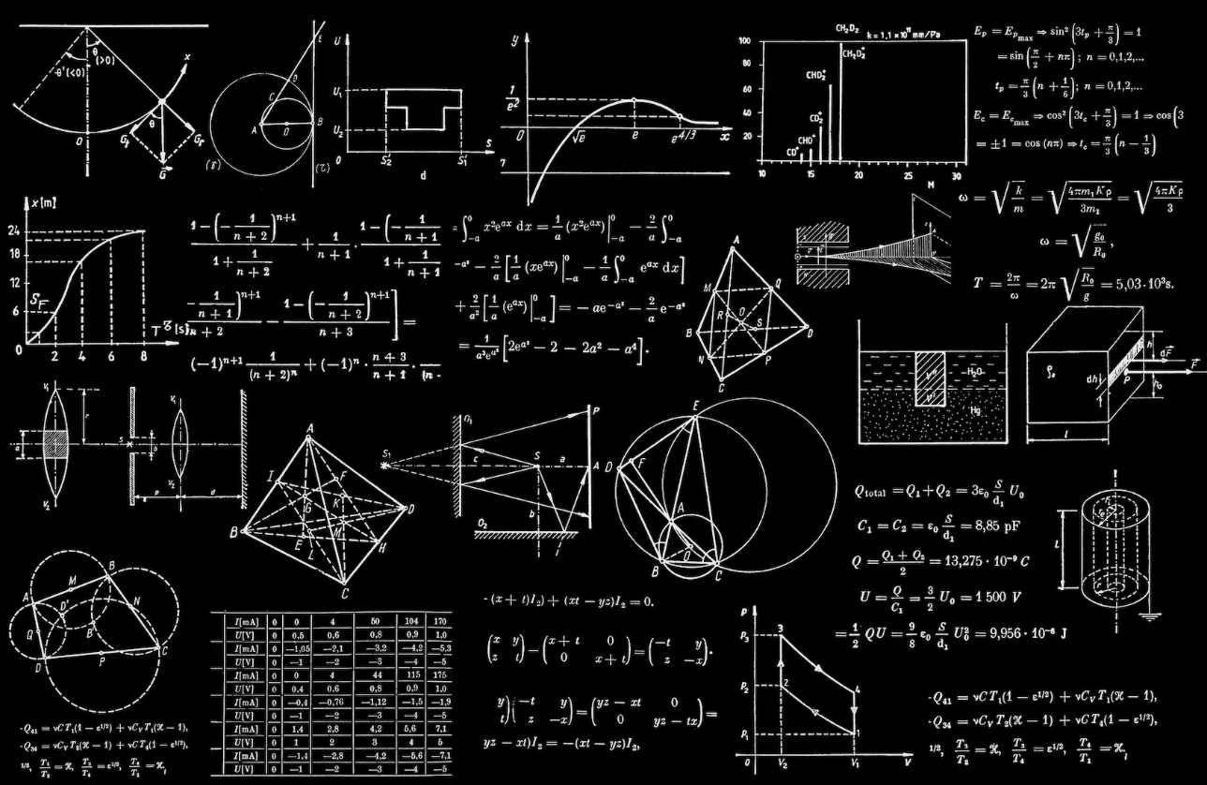
Looking for Systemic Structures
Make two lists
First list: names systemic structures that could have led to Asia doing well on the math
Second list: names those that could have led to Arnav doing poorly
Consider both internal & external structures
Notes:
Non copyright image: https://unsplash.com/photos/h3kuhYUCE9A

Slide 5
Understanding Success through a Systems-Thinking Lens
Recall something you’ve achieved or accomplished
Ex: a friendship, a skill, an opportunity, or anything!
Create an iceberg drawing about your personal accomplishment
Write the accomplishment on the tip of the iceberg (above the water)
Think about any patterns of behaviors that contributed to this accomplishment
What are the systemic structures involved?
Place a star next to the factors that you have control over
Take a moment to thank yourself and others who helped you

Slide 6
Debrief
How might using systems thinking to understand events in our own life affect our thoughts or feelings about that event?

