Slide 1
We’re All in This Together
Exploring Systems Thinking

Slide 2
Checking In

Slide 3
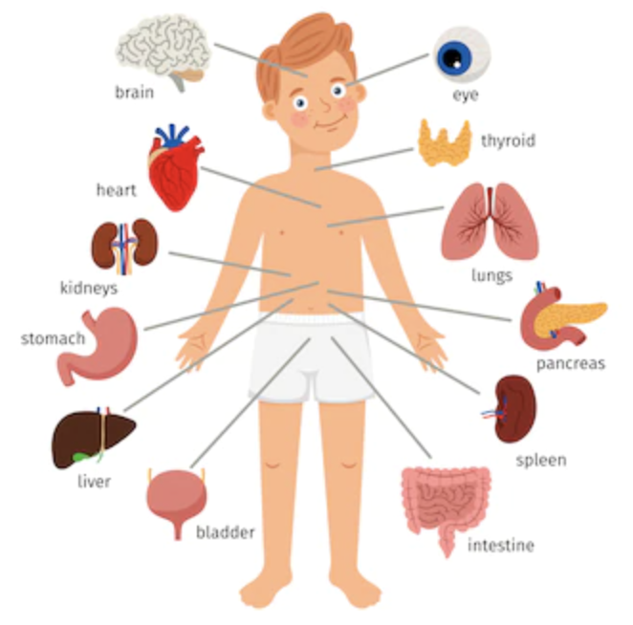
What is Systems Thinking?
Systems Thinking Checklist
Does it have parts and what are they?
Are the parts connected to each other? How?
If we change one part, does it affect other parts? How?
Are the parts connected to other things on the outside?

Slide 4

Systems Mapping Our School and Extending Unintended Consequences
Who are the people who make up our school?
How are the people in this system connected?
  How are teachers and students connected?
What if we were to change one part of this system?
  Break into groups and discuss possible outcomes of the change— positive, negative, & unintended

Slide 5
Debrief
In partners: Thinking about systems helps us realize how important each part is and how important each person is, because each person’s actions affect many other people. What systems are you a part of and who do you impact?
Whole group: What might be different if our class or school used systems thinking more regularly, to consider how our actions might impact others?

