Slide 1
We’re All in This Together
It Takes a Village

Slide 2
Checking In

Slide 3
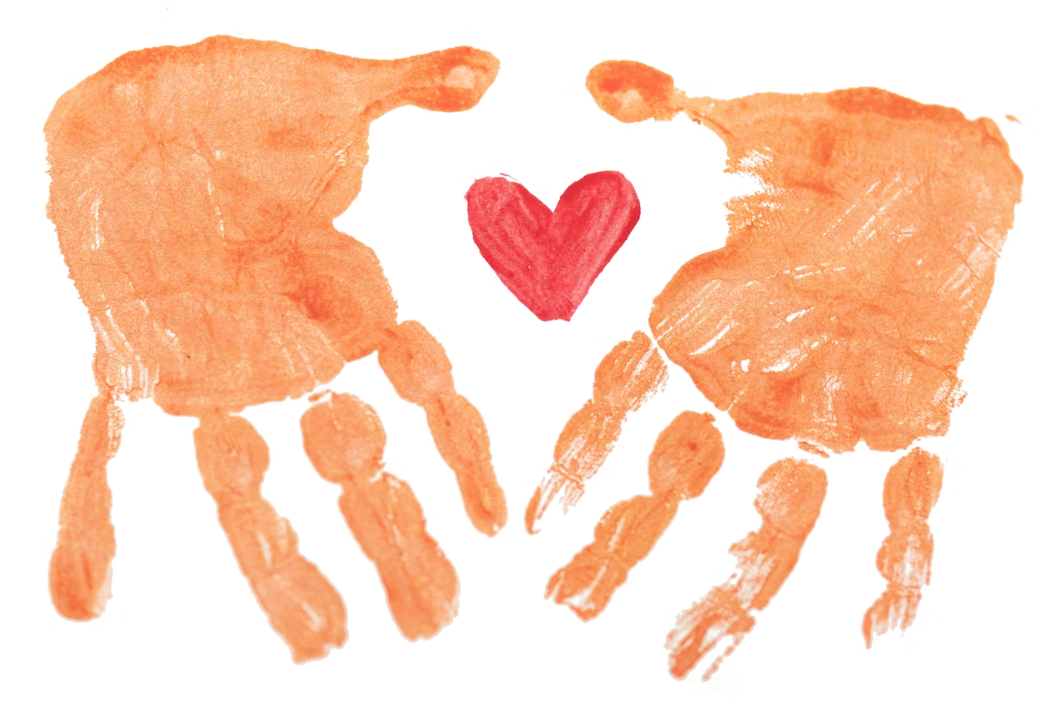
What is Caring and How Have We Experienced it?
What do you think “care” means?
Does anyone have concrete examples of care?
Notes:
Noncopyright image: https://unsplash.com/photos/89bQBucvJdw

Slide 4
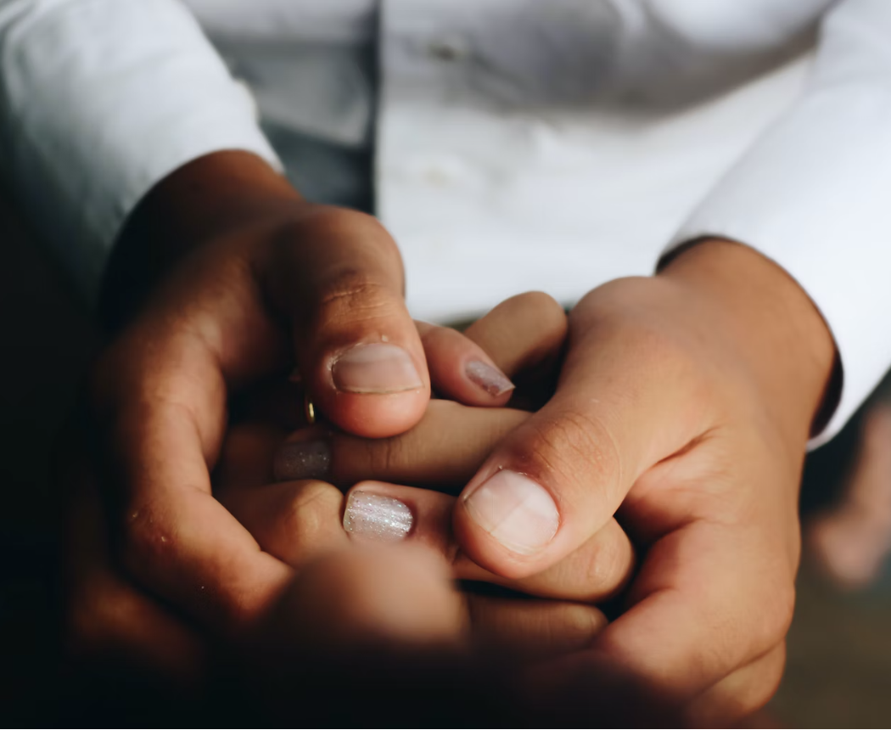
Insight Activity
Draw a child of the age you are assigned
Draw & label all the people that care for the child
Write and draw all the things & experiences you can think of that are needed for the child to be provided for, protected, fed, clothed, and cared for
What is expected back in return from the child for all of this care?

Slide 5
Reflective Practice
Write your name or draw yourself on the center of sheet of paper
Write/Draw all the people who have cared for you
Next to each person, write the kind of care/support each person has provided
Circle/star any kinds of care that you wrote down that you hadn’t recognized fully before you did this activity

Slide 6
Reflective Practice cont.
Consider how many people provided care for you today (or yesterday). How many people have provided care for you in your whole life?
This is your system of care.
Discussion: How did it feel in your body while you did this reflection? What are some benefits to taking the time to recognize the care we’ve received and acknowledge it?

Slide 7
Debrief
Did thinking about the countless ways we’ve received care shift your perspective in any way or lead to a new way of seeing things?
Why might it be important to remember how we have been, and are being, cared for?

