Slide 1
Compassion for Self and Others
Exploring Active Compassion

Slide 2
Checking In

Slide 3

What is Active Compassion?
Can you think of an example of a time when you did something that involved standing up for someone else or did what was best for them?
Can you think of a time when someone did something that helped keep you safe?
Empathy
Compassion

Slide 4
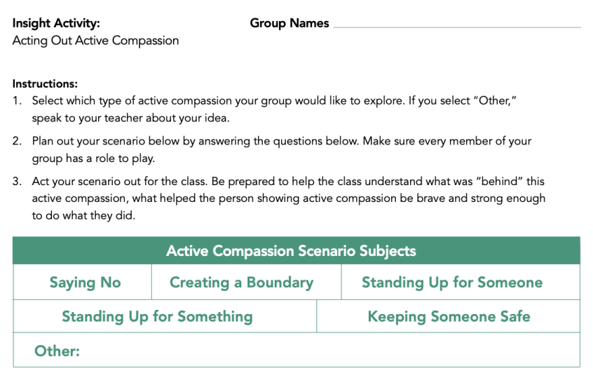
Practicing Active Compassion through Role Play
Create scenarios of active compassion
Get ready to present your group’s scenario!

Slide 5
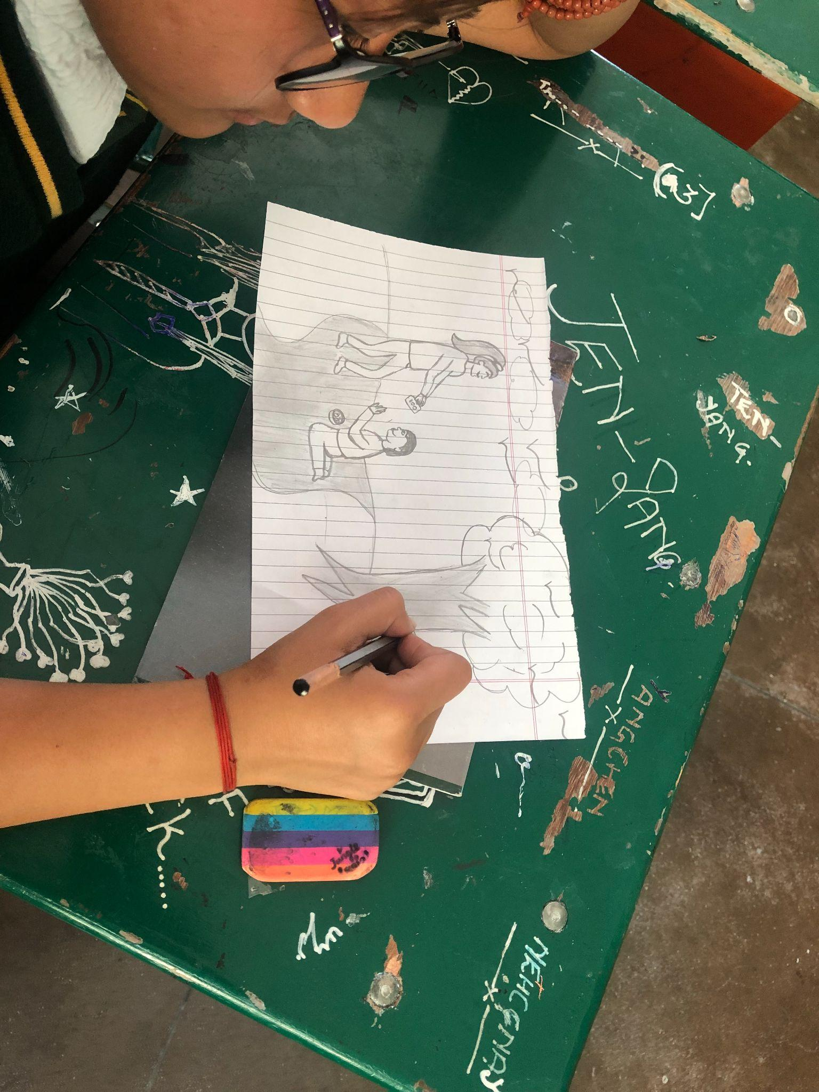
Remembering Active Compassion
Think of an example of active compassion from your own life or an imagined one
Draw or write about it!

Slide 6
Debrief
Why might it be important for us to keep each other safe from harm?
Can you think of a time when you were upset because someone said no to you, but later you realized they were being compassionate and trying to keep you safe?
What have you learned or thought about today that you’d like to remember?

