Slide 1
Compassion for Self and Others
Exploring Attitudes and Expectations

Slide 2
Checking In

Slide 3
Stand by Your Opinion
If you agree stand by “Yes”
If you disagree stand by “No”
Statements
• You can get good at most things if you work hard and practice over a long period of time.
• Being the best at something or finishing in first place doesn’t necessarily make someone happy.
What experiences have you had that make you think or feel the way you do?
• I like to be the best at whatever I do.
• When I’m going through a very hard time, I give myself the care and compassion I need.

Slide 4
Stand by Your Opinion cont.
• It’s okay and natural to not be good at something if you’ve just started at it.
• When I’m feeling down, I tend to feel like most other people are probably happier than I am.
• It’s sometimes good to be below average at something.
• When I fail at something that’s important to me, I tend to feel alone in my failure.
• It’s possible to be perfect. [End the activity with this one, no matter how many statements you use.]
• Failure can be a good way to learn.
• When I fail at something important to me, I sometimes feel embarrassed and disappointed.
• I try to accept things about myself that I don’t like.
• It’s possible to be perfect.

Slide 5

Attitudes and Expectations
Will these things bring lasting happiness?
Do you think if you had any or all of these things, you would be happy?
Could any of these expectations people might have for themselves cause them problems?
How does it feel when people have unrealistic expectations for you that you can’t/don’t want to live up to? What about realistic or helpful expectations?

Slide 6
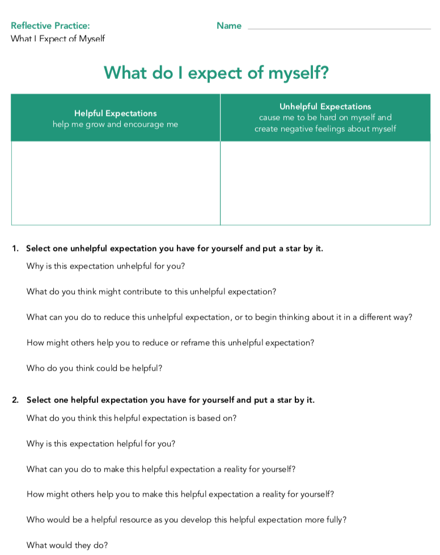
What to Expect of Myself
Examine how expectations you have for yourself can be helpful or unhelpful
]

Slide 7
Debrief
What do you notice about your list of “helpful expectations?
What do you notice about your list of “unhelpful expectations?’’ How do these make you feel?
How do you feel when you think about the expectations you’re holding for yourself today?

