Slide 1
Compassion for Self and Others
Exploring Self-Compassion

Slide 2
Checking In

Slide 3
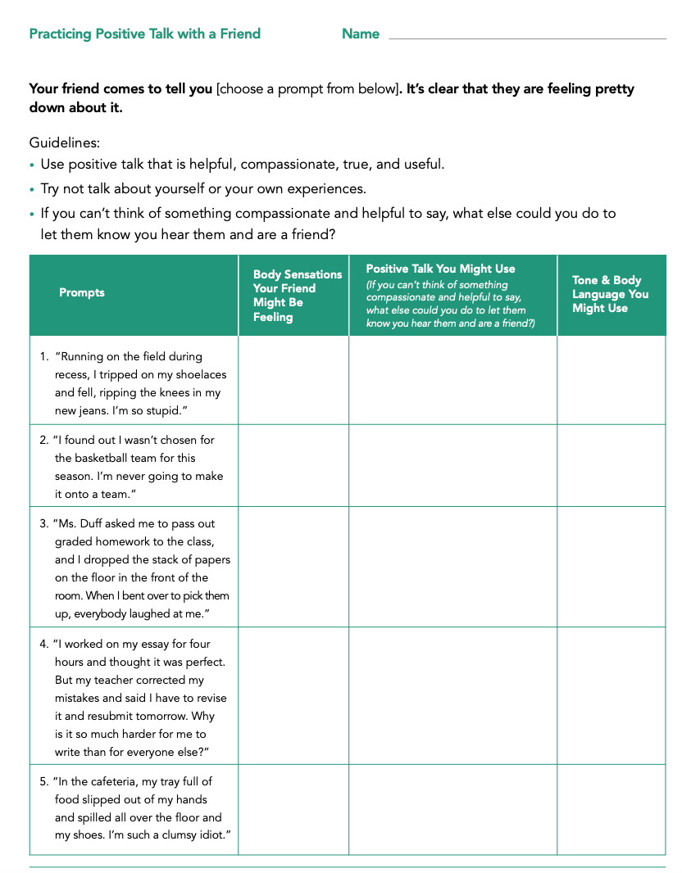
Practicing Compassion with Friends
What is positive talk? What is negative talk?
Guidelines
Imagine the prompt is coming from a friend
Use positive talk that is helpful, compassionate, true, and useful.
Try NOT talk about yourself or your own experiences

Slide 4

Self-Compassion & Positive Talk
What are some examples of positive and negative talk that people sometimes direct towards ourselves
When are some times you say kind or encouraging things to yourself? What might you say?
Self-compassion is when we show kindness and compassion to ourselves

Slide 5
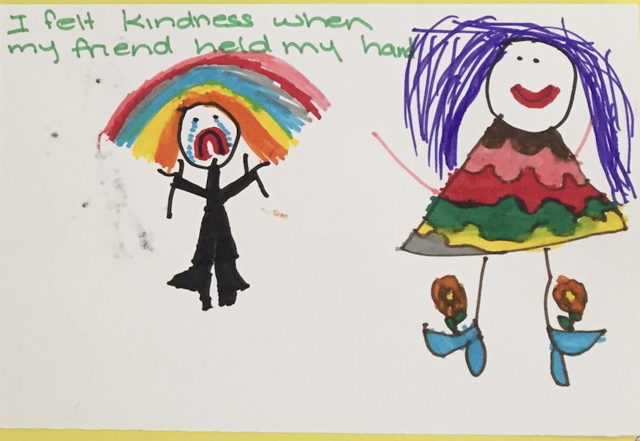
Being Kind to Ourselves
Draw and write the ways you practice self-kindness when you are discouraged
Let’s hear some examples of positive self-talk
After listening to each other share, what other ways of speaking positively to yourself in the future can you add?

Slide 6
Debrief
What are some challenges and benefits of practicing using kind thoughts and words with ourself, as we would to a friend?
What did you learn that you would like to remember?

