Slide 1
Learning About and From One Another
Exploring Empathy

Slide 2
Checking In

Slide 3
What is Empathy?
Does anyone know what empathy means?
Storytime! Characters in the story
1. Tenzin, a new student
2. Nisha, captain of the debate team
3. Coach Kay, team coach and math teacher
4. Mr. Patel, Tenzin’s grandfather
5 & 6. Toni & Desmond, teammates of Nisha
Discussion
Where in the story do you think a misunderstanding occurred?
What do you think Tenzin was needing, thinking, or feeling when talking to Nisha?
What do you think Tenzin was needing, thinking, or feeling when sitting with Desmond and Toni?
Where did you notice moments of empathy or lack of empathy?
How might the characters in the story have improved their perspective-taking or empathic accuracy?

Slide 4
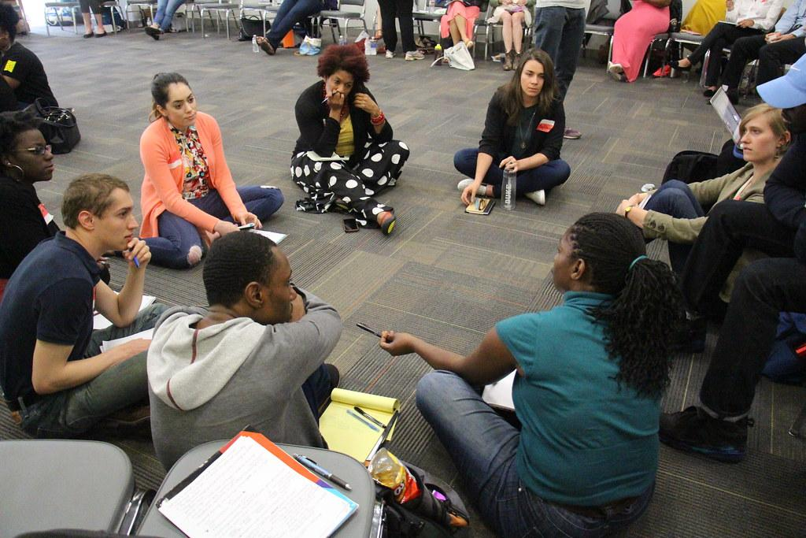
Circle of Truths
Form groups of 6 and pick a piece of paper with your character role
Step 1: Private thinking time about character’s viewpoint
Step 2: Share one sentence from character’s perspective about what was happening and why
Step 3: Switch spots and share another view point
Discussion
How did it feel to step into the shoes of each of the characters?
What did you learn or what surprised you from listening to the perspectives shared by others?
Did you find yourself either judging or feeling more understanding towards a character when someone shared their perspective?
Why is perspective-taking important in friendships and relationships?
Why might people find it difficult to engage in perspective-taking? What are obstacles that might make perspective-taking challenging?

Slide 5
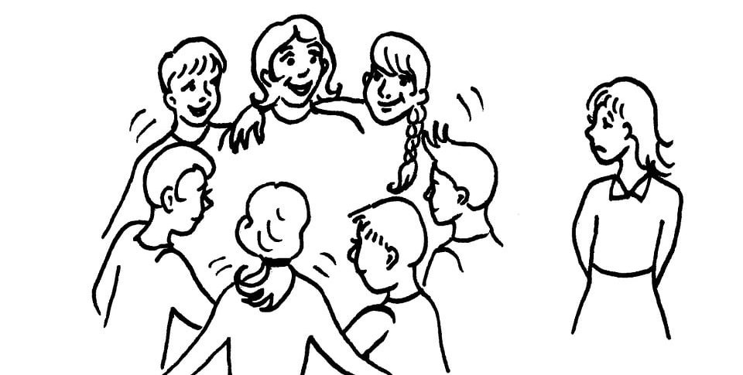
A Time When Empathy Helped
How was empathy or perspective-taking happening or not happening?
What helped or would have helped the people involved be able to empathize better?
Recall a small misunderstanding that you have seen or participated in where perspective-taking helped or could have helped
Let’s draw or write a situation where this has happened to us.

Slide 6
Debrief
When could you practice empathy or perspective-taking over the next week?
What might be helpful about doing so?

