Slide 1
Learning About and From One Another
Appreciating Diversity & Commonalities

Slide 2
Checking In

Slide 3
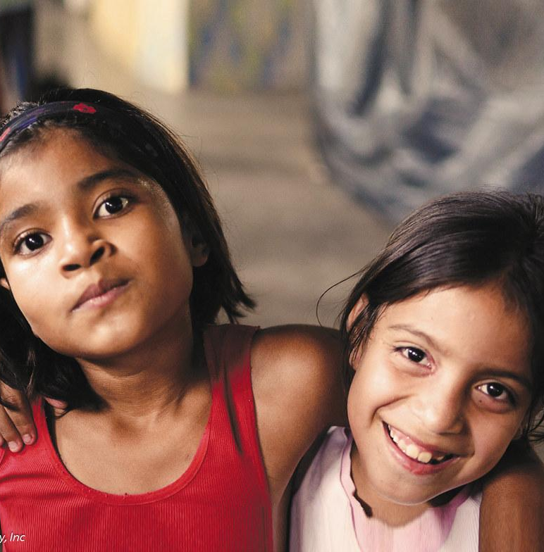
What Do We Have in Common?
Discuss with a partner: What does diversity mean?
What are some other things many people have in common, that are important to their identity?
Group activity: on your paper…
Write “Things We Have in Common” as the title
“With Many People” at top of left hand column & “With Fewer People” on right column
Record things your group has in common in left column & place individual sticky notes with uncommon things about you in the right column

Slide 4
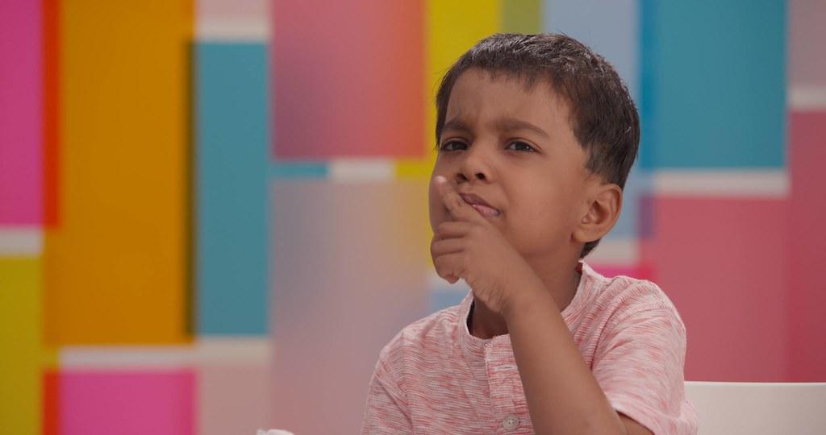
Mindful Dialogue on Diversity and Respect
Think about a time when you realized you were different from others or unique in some way. How did you feel when you realized that?
What would it mean for other people to be respectful of diversity when interacting with you?
What are some things you could do to show respect for other people’s differences and uniqueness?

Slide 5
Debrief
Debrief
How might appreciating diversity help us in our classroom?
How might recognizing that despite our differences, we all want to be happy and treated with kindness, help us in our classroom, and in the world?
In what ways does listening and sharing about our experiences with diversity help us build appreciation and respect for one another?

