Slide 1
Learning About and From One Another
Mindful Dialogues

Slide 2
Checking In

Slide 3
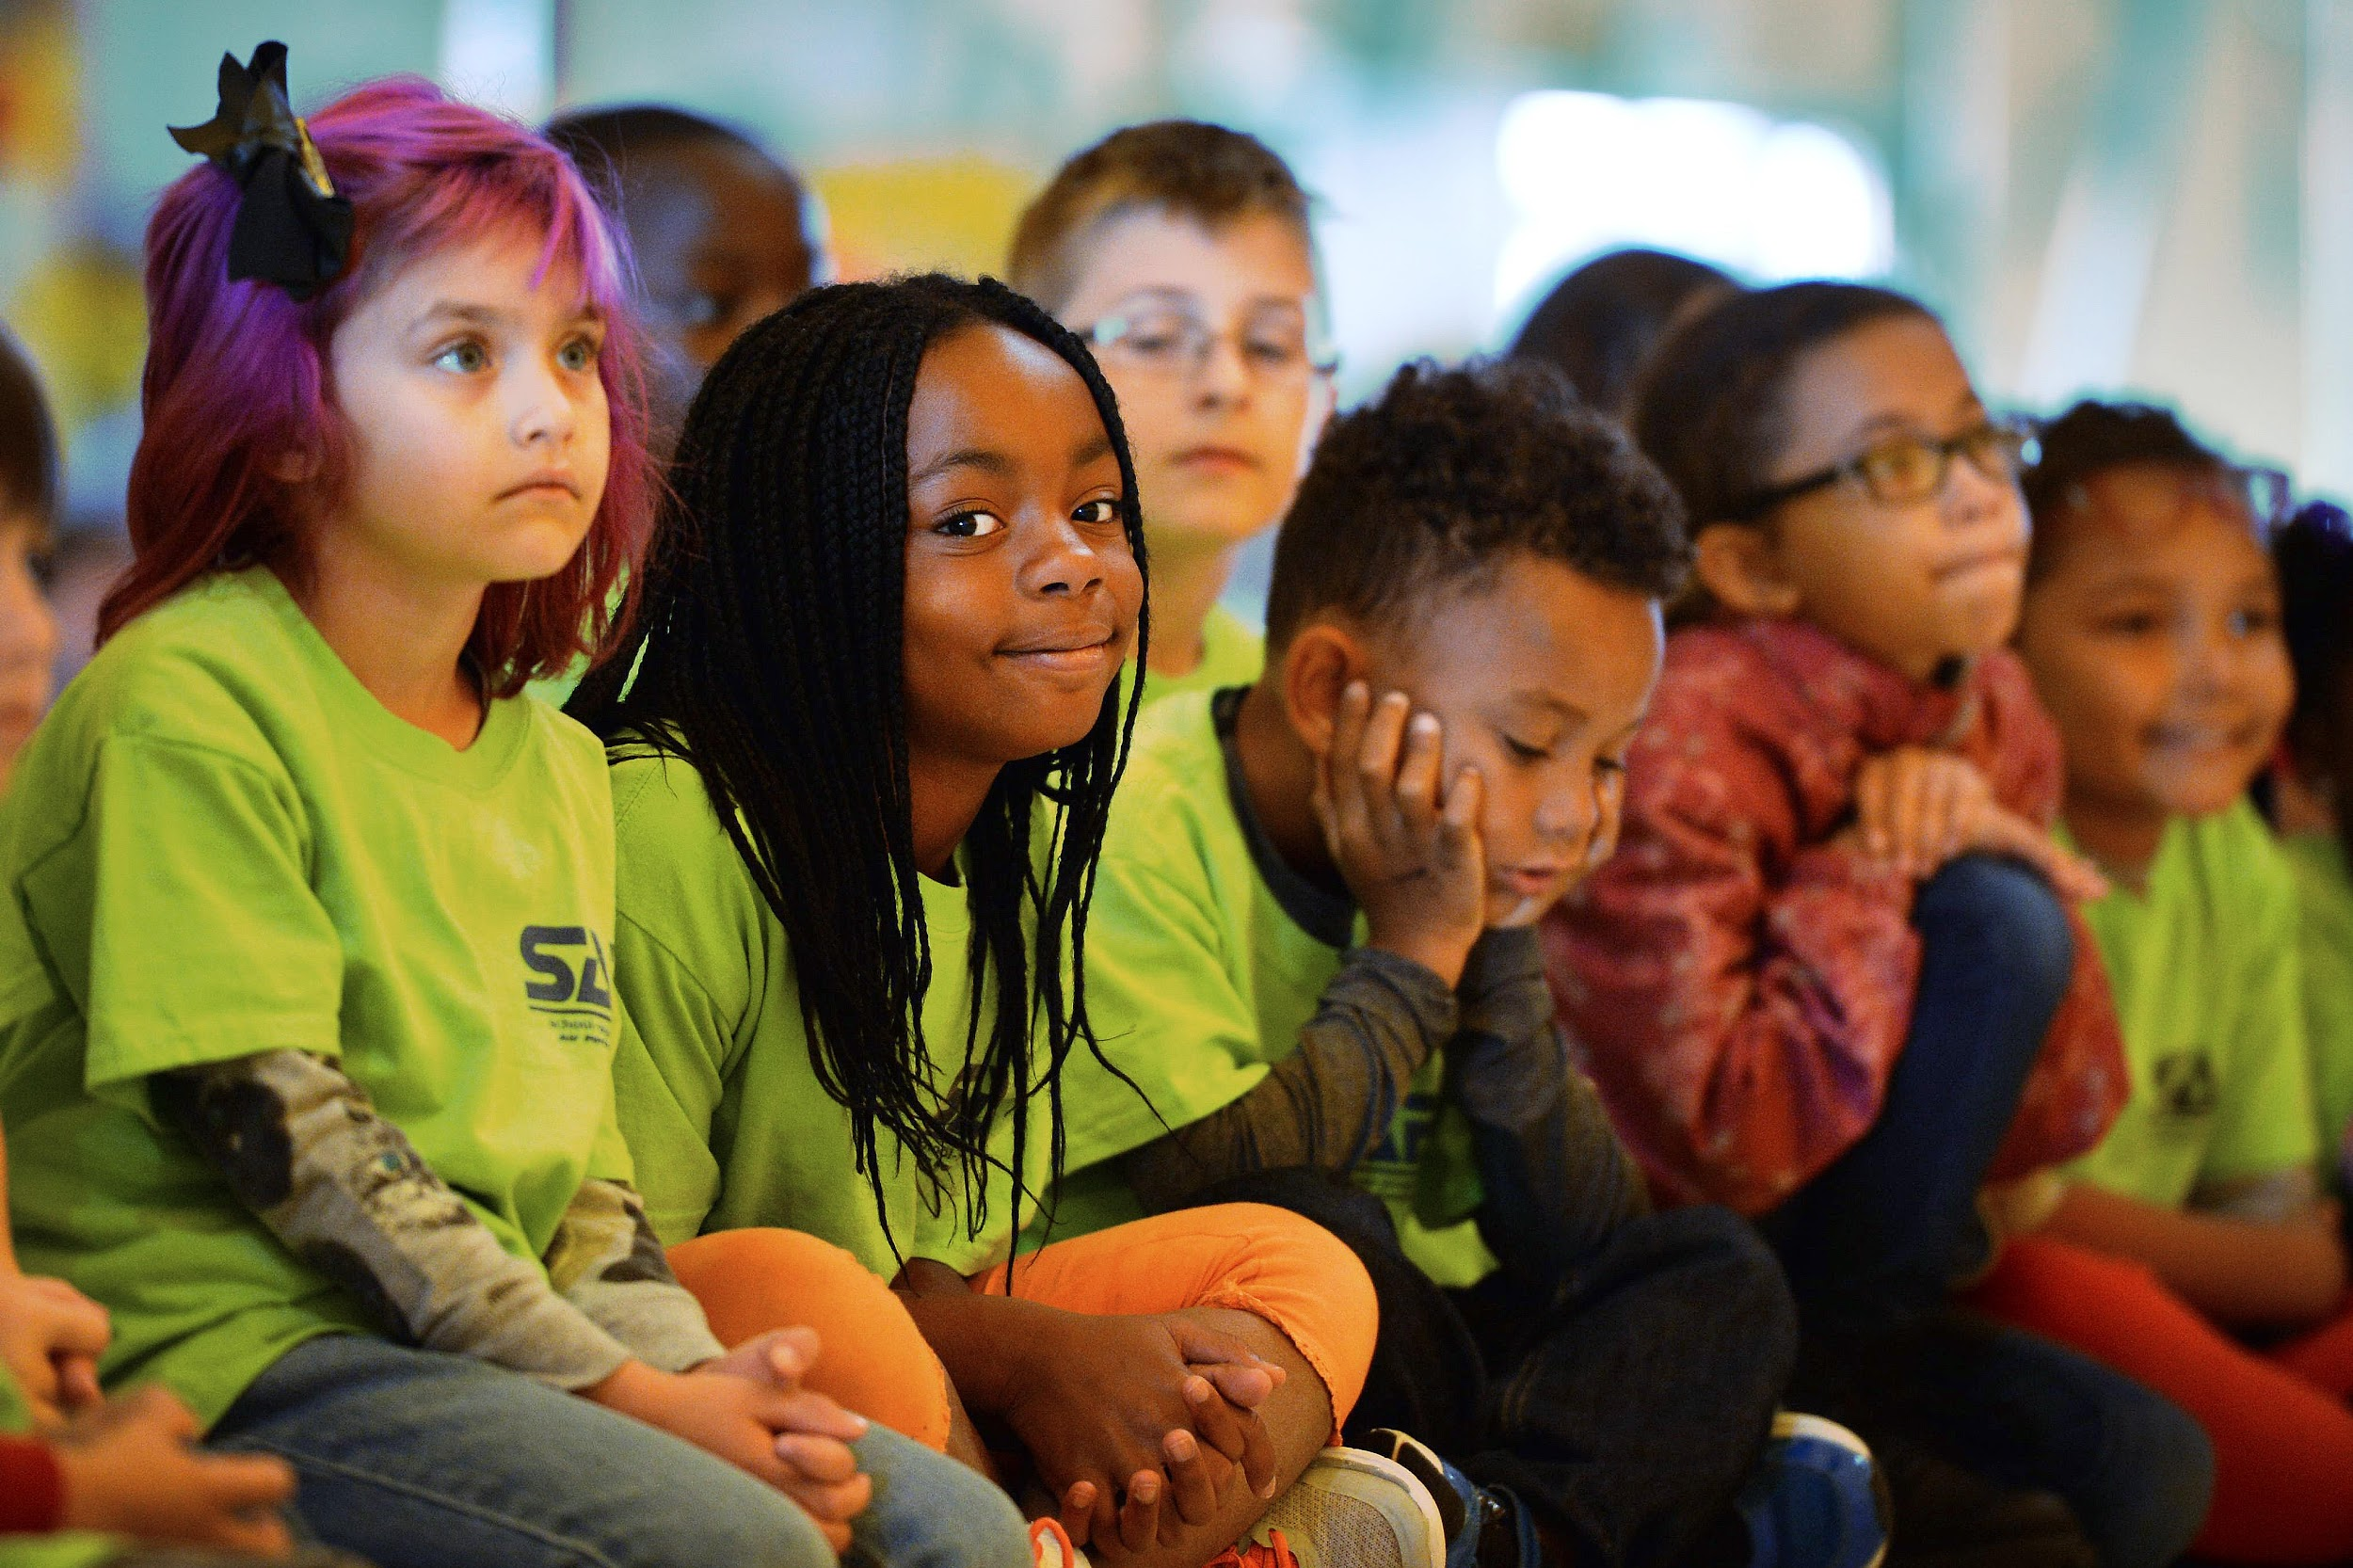
Mindful Listening
Let’s start off by giving some examples of the following times:
“Not Being Listened To Feels Like...”
“Being Truly Listened To Feels Like...”
What do you see different between the two?
What would it be like for us to listen to someone else with full attention?
What would it be like if the whole class were good at doing mindful listening?

Slide 4
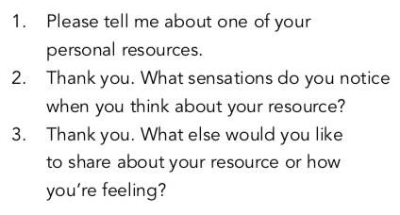
Mindful Dialogues
Questions
Everyone form pairs and sit down side-by-side
Let’s reflect by speaking and listening mindfully with each other.
We will ring the chime to begin and change every 90 seconds.

Slide 5
Mindful Dialogues cont.
What did you notice as you were the listener? What did you notice as you were the speaker?
When during the day do you feel you are listening to someone mindfully?
When do you feel someone else is listening to you mindfully?
What sensations on the inside did anyone notice when they were listening or being listened to?
How or why might being listened to make our bodies feel safer and more in the resilient zone?

Slide 6
Debrief
What did you learn today that you’d like to remember?
When could you practice mindful listening between now and our next time together? Who would you practice with?”

Slide 7
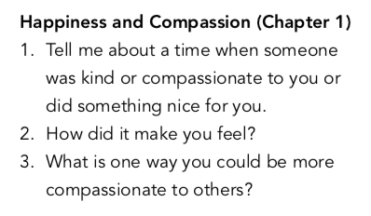
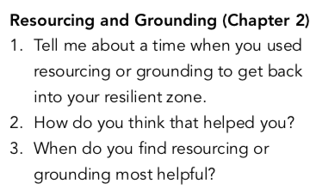
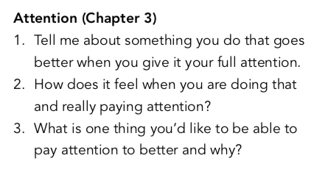
(Optional) Mindful Dialogue Questions

