Slide 1
Navigating Emotions
Dealing with Difficult Emotions and Exercising Restraint

Slide 2
Checking In

Slide 3

Difficult or “Risky” Emotions
• Could this emotion become a dangerous forest fire?
• Does this emotion tend to cause stress for myself or others?
• Could this emotion make me want to harm myself or others?
• What would happen if everyone had a lot more of this emotion? Would it make things better?
• What if everyone had a lot less of this emotion?

Slide 4
Identifying Risky Emotions and Strategies for Dealing with Them
• Were there any strategies that seemed common across the emotions we examined? Which strategies seemed specific to a particular emotion?
• Do we need different strategies for dealing with emotions based on where they are on the core affect chart?
• Can we use opposing emotions to help us? How?

Slide 5
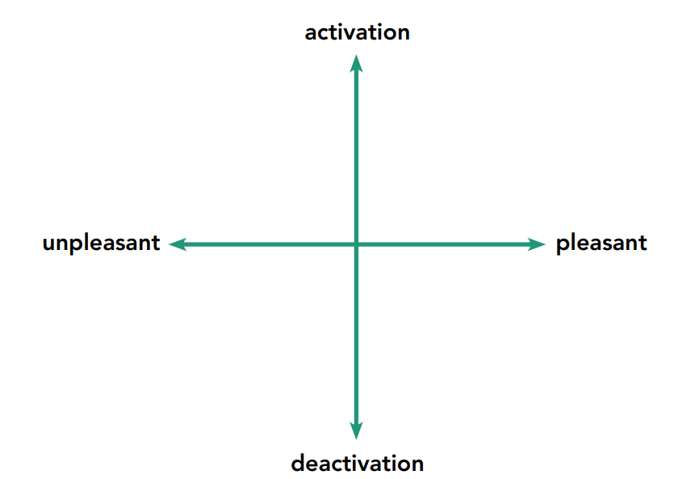
Mapping with Attention Practice
Think about your resource or engage in grounding, what do you feel on the inside?
Now let’s draw on our chart what we are noticing in our body. Where would you draw yourself on the chart?

Slide 6
Debrief
What was familiar about the work we did today?
What surprised you about our work today?
Did we do or discuss something that you feel applies to your own life?
Are there any thoughts or questions you have?

