Slide 1
Navigating Emotions
Mapping Emotions

Slide 2
Checking In

Slide 3
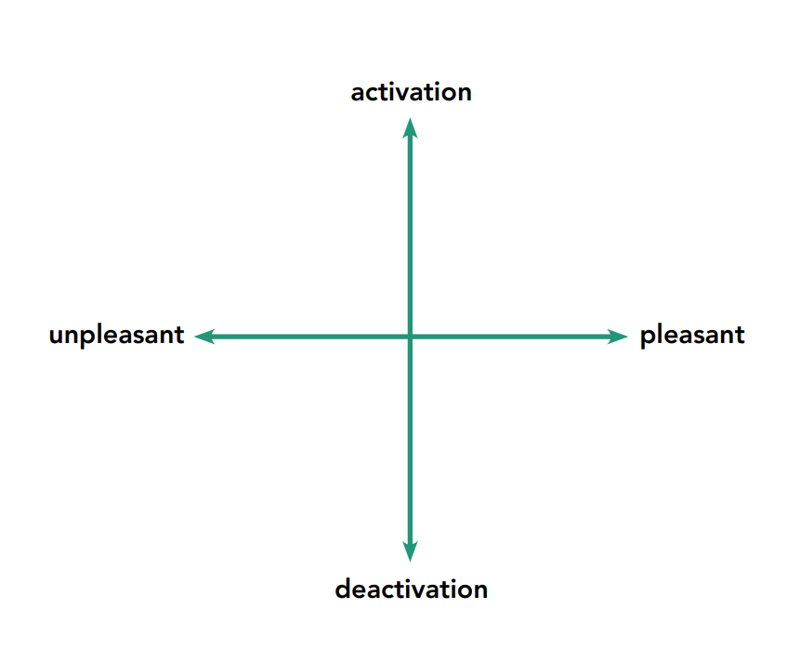
The Activation/Feeling Tone Chart
What emotion might fit in the upper right hand area, where our body is really activated and has lots of energy in it, and we’re feeling pleasant?
What emotion might fit in the upper left area, where our body is really activated but we’re feeling really unpleasant?
Do you think one emotion could be in more than one place on the chart?
Do you think we all experience an emotion the same way?

Slide 4
Mapping Emotions on the Activation/Feeling Tone Chart
Select one emotion term from each emotions family
Make your own chart to show these emotions
Add in opposing emotions

Slide 5
Mapping with Grounding and Resourcing
Think of a time when someone did something kind for your recently, or a time you were kind to someone else…
What do you feel on the inside?
Draw on your chart what you are noticing in your body

Slide 6
Debrief
What stood out for you when we charted our emotional state?
What surprised you?
What more did you learn about emotions?
Are there any thoughts or questions you have about emotions?

