Slide 1
Navigating Emotions
Emotion Timelines in Action

Slide 2
Checking In

Slide 3
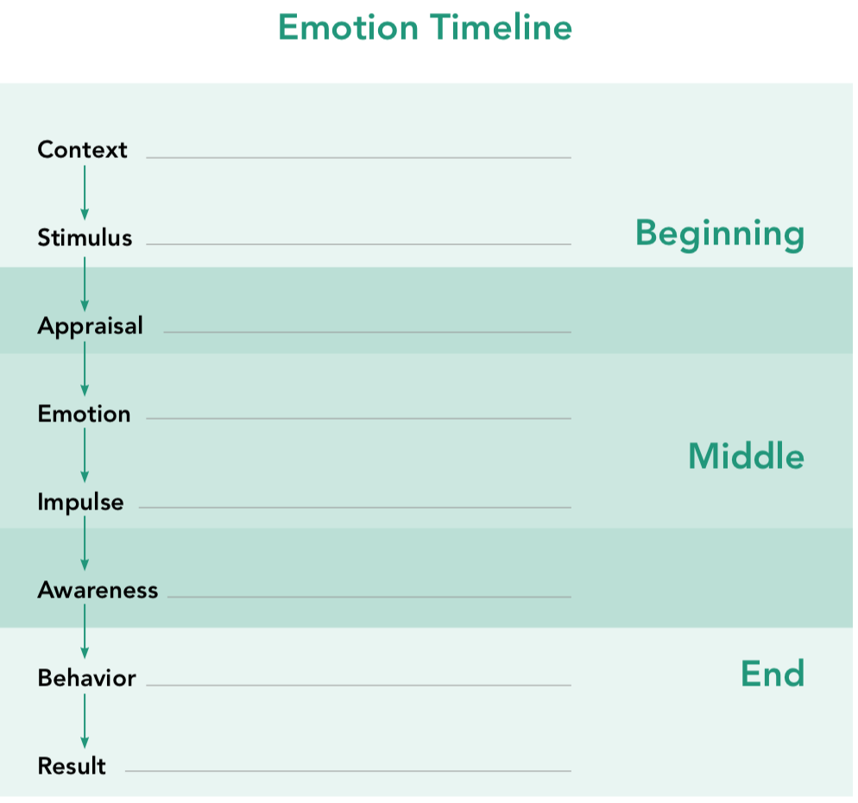
Acting Out Emotion Timelines
Fill out the emotional timeline twice using your scenario
1st time: considering if main character has more awareness of their actions
2nd time: considering if main character has less awareness of their actions

Slide 4
Acting Out Emotion Timelines cont.
Create a skit for your scenario keeping the stages of the timeline in mind
Observers:
What was the stimulus? Context? Appraisal?
Which emotion families were involved?
What physical sensations might the main character have experienced?
What might have happened if the character had less awareness of their emotions?
What emotional state do you think the character was in at the end of the scenario?

Slide 5
Reflective Practice
Recall a challenging time when you experienced a stimulus that could have caused you to act in an inappropriate way but instead you responded in a way that was beneficial to yourself and others
OR try to imagine a scenario in the future in which this happens
Chart this experience on the emotion timeline for 3-5 min

Slide 6
Debrief
• What are we learning about emotions that you might not have thought about before?
• What’s something that you learned today that you’d like to remember later?

Slide 7
(Optional) Creating Our Own Emotion Timeline
Pick an emotion family as a group and create an illustrated emotion timeline
If you wanted to explain to other students what an emotion timeline is for this particular emotion family, how would you do it?
Include each item on the sample (context, stimulus, etc)
Come up with example scenarios that fit the timeline
Examples should show what happens when people employ their tools of mindfulness, awareness, heedfulness, tracking, etc., as well as what happens when people are not using such tools

Slide 8
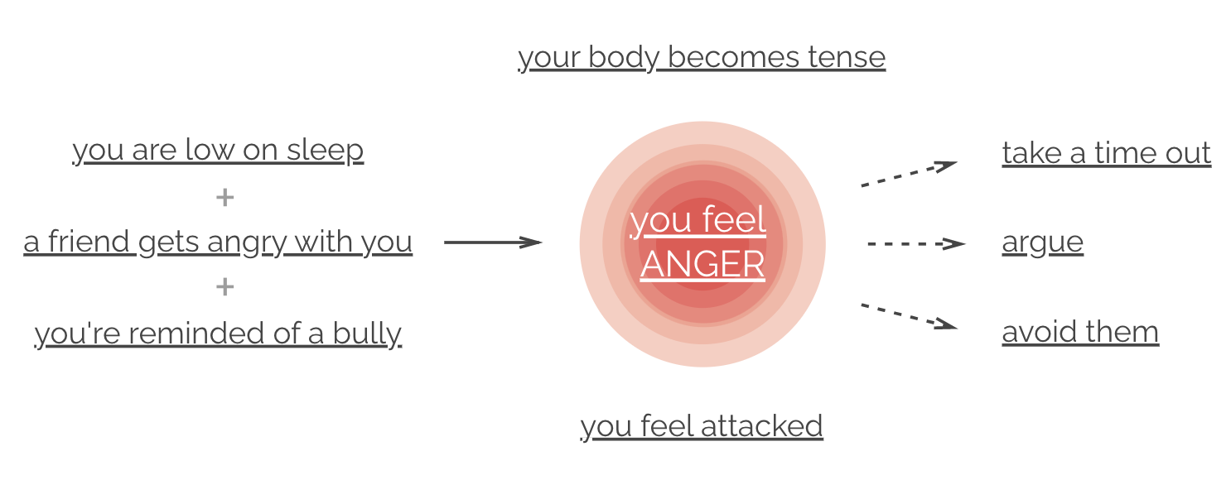
(Optional) Insight Activity
Compare your timeline to the emotion timeline on www.atlasofemotions.org
Is there anything in the Atlas of Emotions timeline that you like? Anything it includes that you did not include?
Anything about your own timelines that you like better than the Atlas? Anything missing from the Atlas that you included?

