Slide 1
Navigating Emotions
Emotion Timelines

Slide 2
Checking In

Slide 3
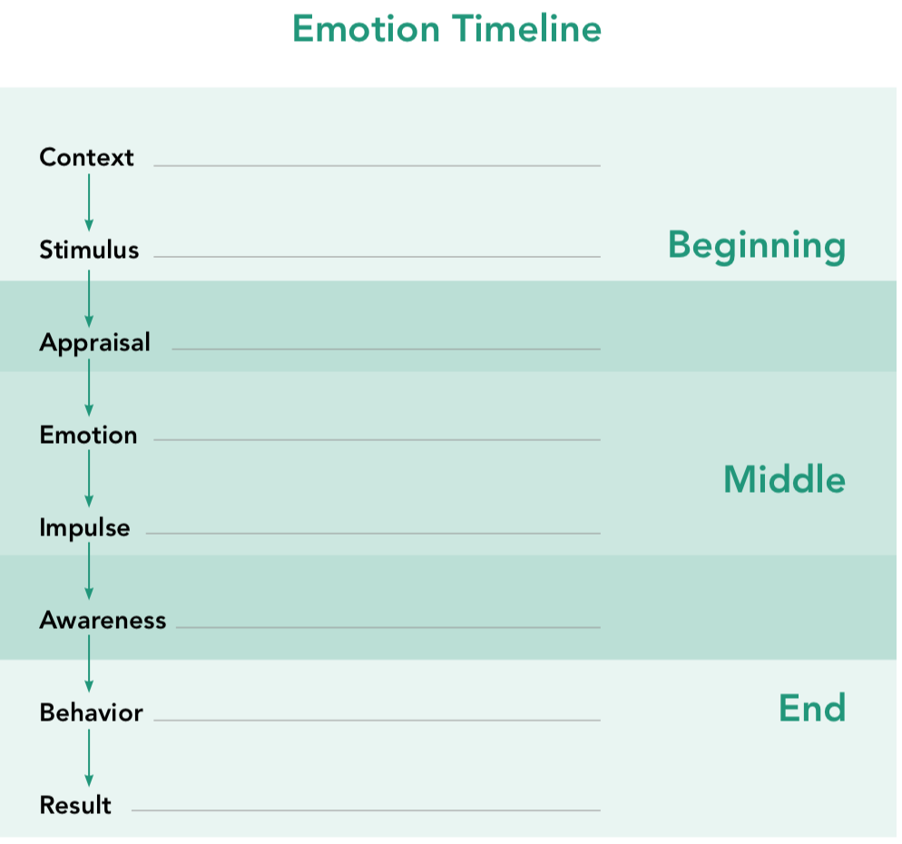
The Emotion Timeline
What do you notice about the diagram of the timeline?
Are there any words that are unfamiliar to you?

Slide 4
The Emotion Timeline cont.
Are there any similarities or differences between the timelines for Albert and Alice?
What role do you think awareness plays in the emotion timeline?

Slide 5
Reflective Practice
Reflect on a time when you experienced happiness, kindness, or compassion.
Now, map this on your emotion timeline.
You can start anywhere you like!

Slide 6
Debrief
• Are we learning about emotions that you might not have thought about before?
• What would happen if people in our society had more awareness and could have more of a gap between stimulus and response?
• What’s something that you learned today that you’d like to remember later?

