Slide 1
Navigating Emotions
Sparks of Emotion

Slide 2
Checking In

Slide 3

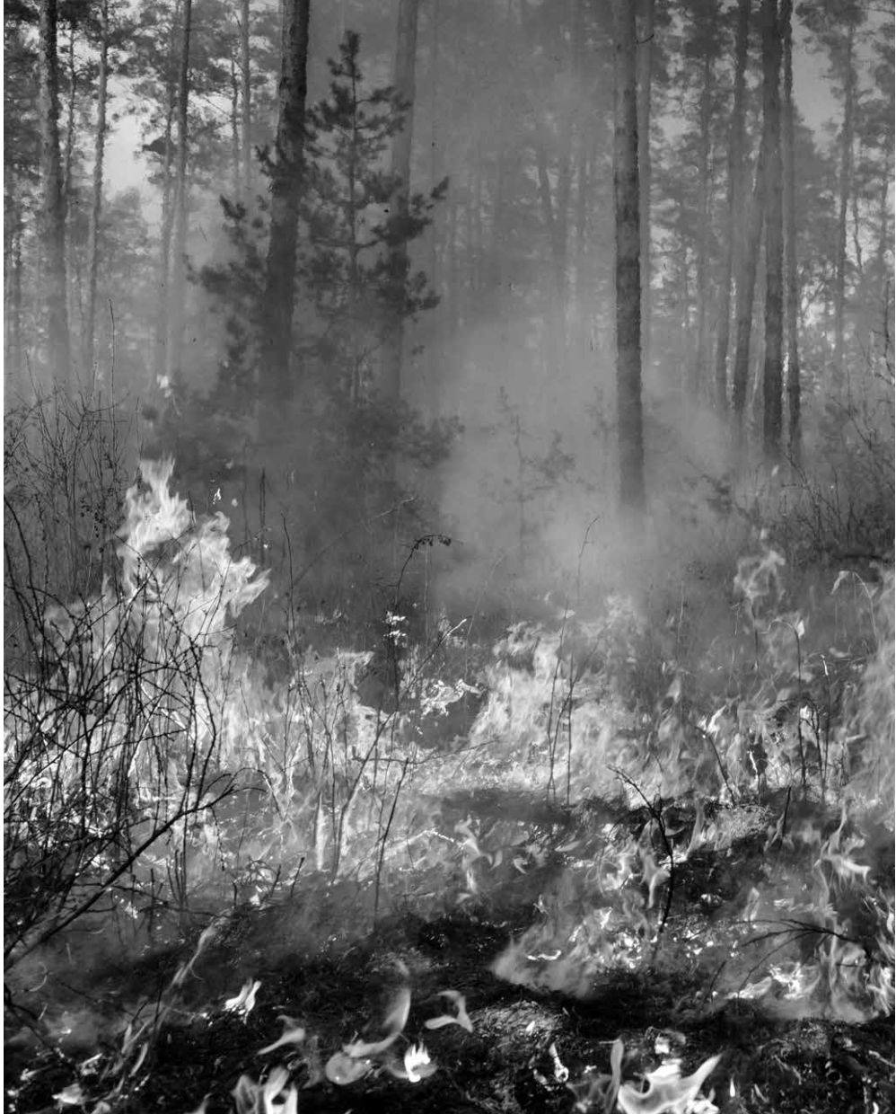
Discussion: Sparks and Forest

Slide 4
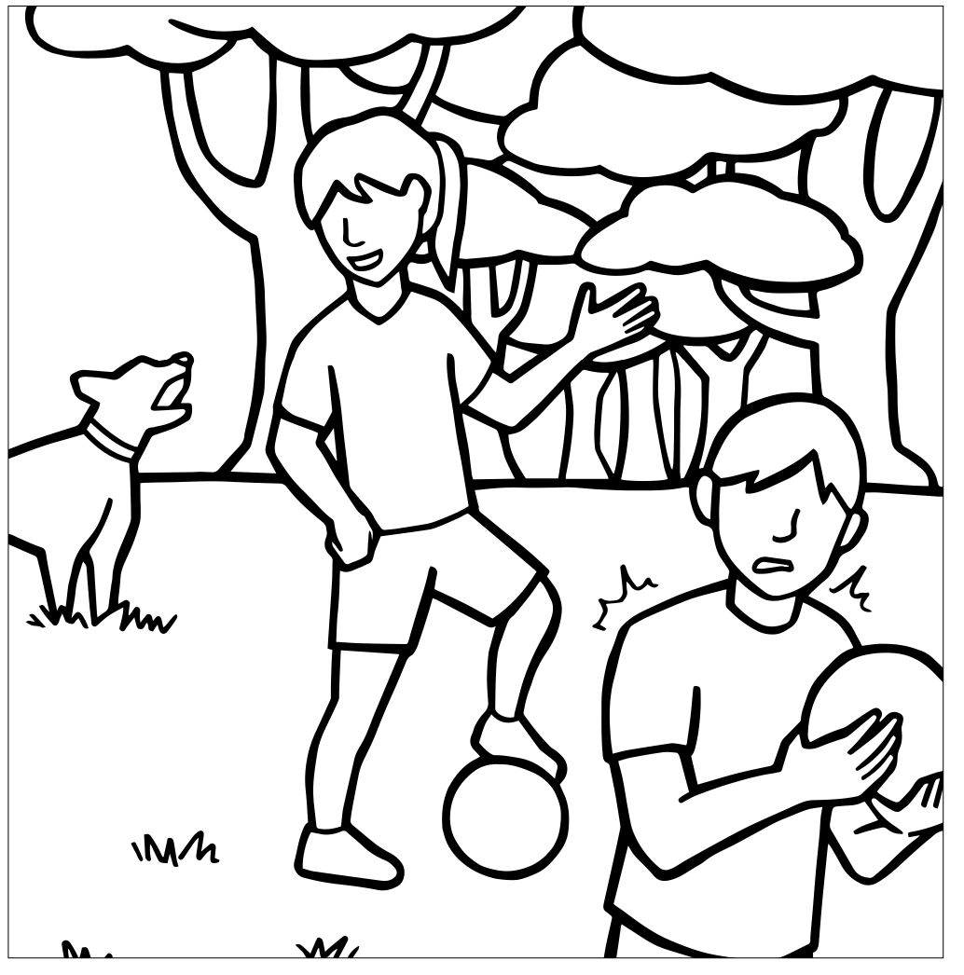
Discussion cont.
What emotion or emotions might Alice be feeling? What about Albert?
If the dog’s barking is a spark for Albert, meaning a trigger for fear, is it a trigger of fear for Alice?
What do you think is happening in Albert’s nervous system? Where might he be in the three zones?
What about Alice?
Appraisal: our nervous systems are constantly evaluating what is going on around us

Slide 5
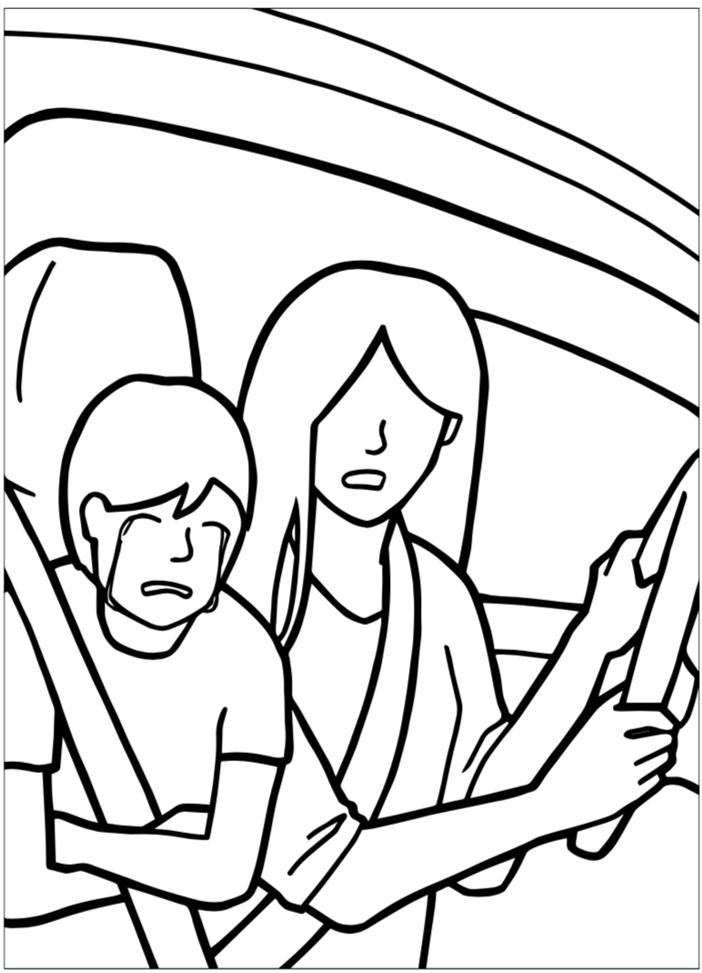
Nelson’s Difficult Day
Snap your fingers or raise your hand when you notice a “spark” in Nelson’s day
Spark = anything that could be an emotional trigger or that could escalate him into a forest fire.
What was the spark?
Why did you chose to stand where you are?
What emotion might Nelson be feeling at this moment?
What might happen if Nelson had more awareness?
Has Nelson helped himself decrease the spark at the moment? If so, how?
What might Nelson be able to do to help himself at this moment?

Slide 6
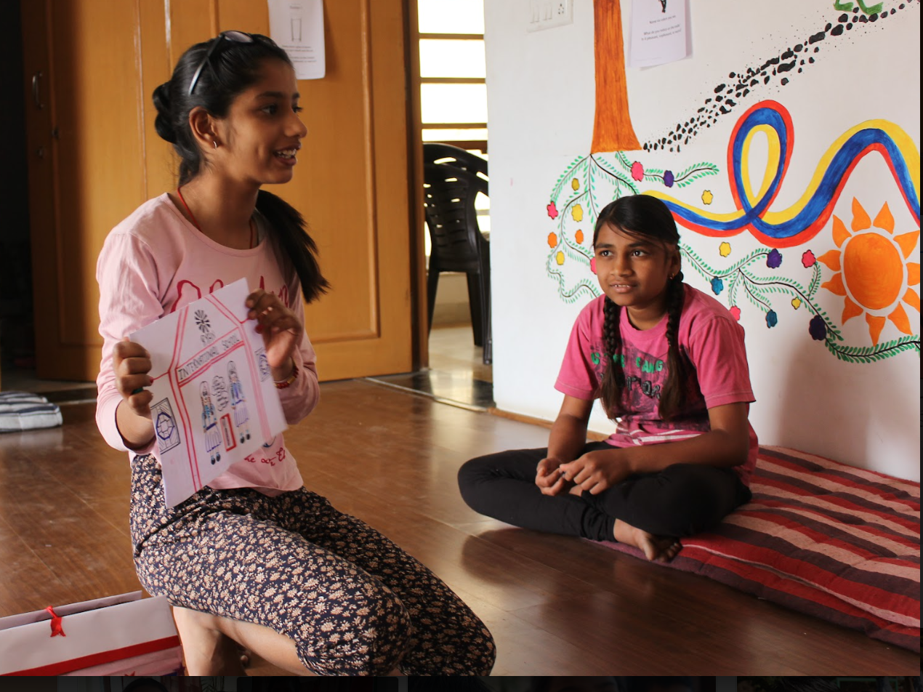
Resourcing and Grounding
We all experience difficult days sometimes.
Practice methods for calming our body and mind:
Resourcing
Grounding
Track pleasant/unpleasant/neutral sensations in your body
What do you notice on the inside?

Slide 7
Debrief
What are some things that were happening for you when we read this story about Nelson? Any sensations in your body at certain times, what?
What about feelings? When and what were some emotions you felt?
Any thoughts that went through your mind as you were hearing this story?
Have you learned anything about emotions that you hadn’t thought of before?”

