Slide 1
Navigating Emotions
Emotion Families

Slide 2
Checking In

Slide 3
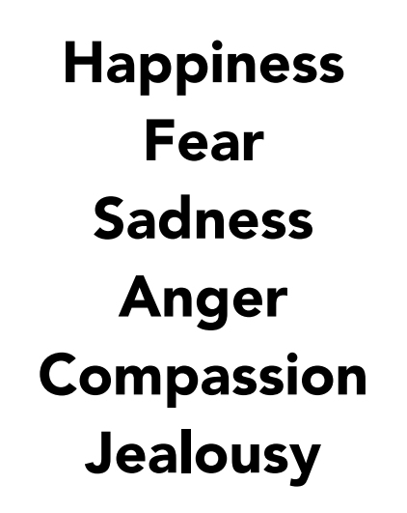
What Are Emotion Families?
How is each emotion word different from another?
Do they have different meanings?
Are some of these emotion words for fear stronger or more intense than others?

Slide 4
Making Our Own Emotion Families
What was your starting emotion?
What other emotions are in that emotion family?
What sensations tend to happen when one feels those emotions?
What surprises you or interests you about what someone else wrote? Explain.
Would anyone like to add an emotion or a sensation to this emotion family?
What thoughts might go through someone’s head if they were feeling these emotions?
Happiness

Slide 5
Debrief
What stood out for you when we made our emotion families?
What surprised you?
What did you learn about emotions?
Are there any thoughts or questions you have about emotions?

Slide 6
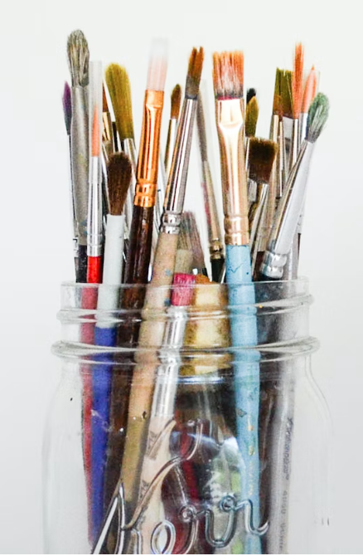
(Optional) Reflective Practice
Pick an emotions family
Discuss as a group how you would like to approach your illustration of this emotion family
Share your illustration!
Notes:
Noncopyright image: https://unsplash.com/photos/MzSqFPLo8CE

Slide 7
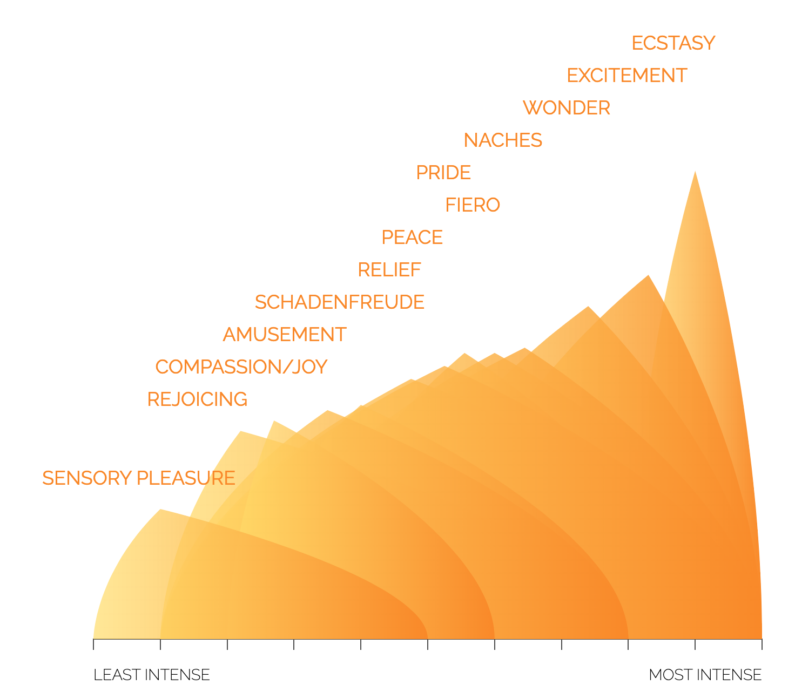
(Optional) Insight Activity
Emotion family for “enjoyment”
Go to www.atlasofemotions.org and click on the “experience tab”
How is your emotion family chart similar to the emotion families on the website?
How is it different?

