Slide 1
Navigating Emotions
Exploring Emotions

Slide 2
Checking In

Slide 3
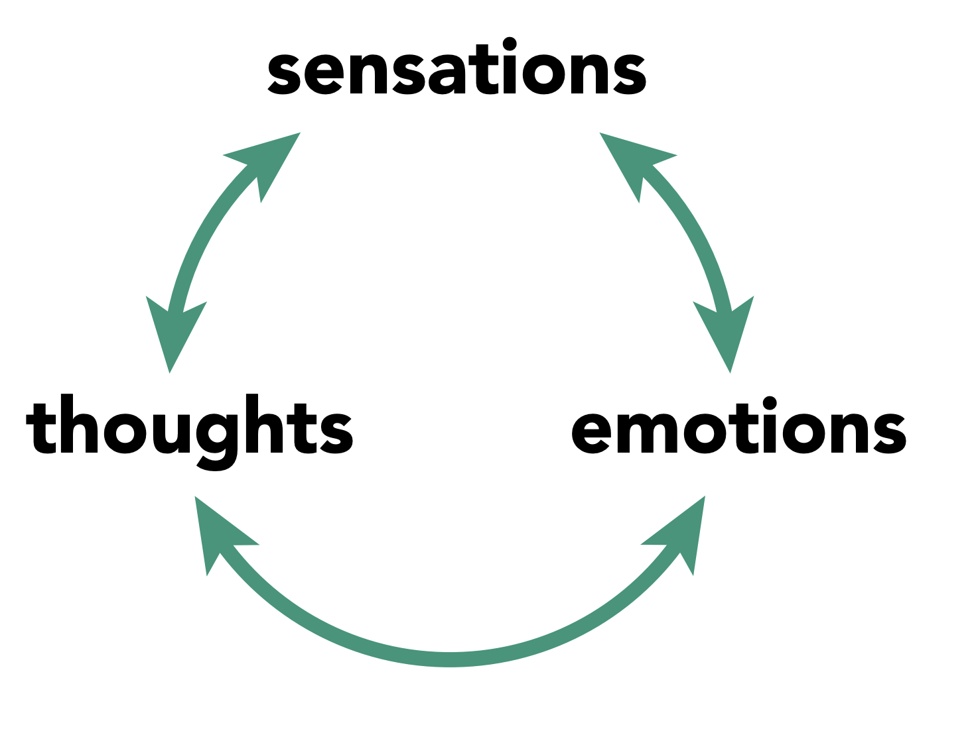
What are Emotions?
What do you notice about this picture?
Walk around until you hear “groups of three”, then form a group.
Let’s make a word map!

Slide 4

Sensations, Emotions, and Thoughts
Make a group of three or work individually
Make a list of 5 words that you agree would fit under each column as examples of a sensation, emotion, or thought.
  If you don’t agree, put the word in the “Unsure” space below the column
Share!

Slide 5
Debrief
How might it help us if we learned to tell the difference between our emotions, thoughts and sensations?
What have you learned about emotions that you find most interesting or most helpful?

