Slide 1
Strengthening Attention & Self-Awareness
Self-Awareness

Slide 2
Checking In

Slide 3

Can We Watch the Mind?
How many thoughts do we have in the same day?
Share about thoughts you have had before.
What if like the clear mind jar, this picture of the sky were a picture of our mind and the thoughts and feelings that come up in it?
What do you think are the thoughts and feelings?

Slide 4
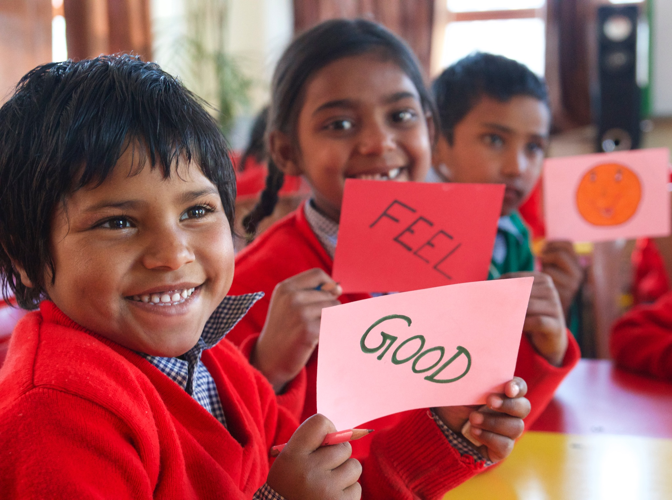
Observing the Mind
Let’s think of one of our resources in silence and then focus on our breath.
What did we notice?
Could anyone watch thoughts coming and going? What was that like?
Did anyone notice a time when there were no thoughts? Maybe a pause or a break or gap between?

Slide 5
Debrief
What have you learned about the mind that you find most interesting or most helpful?
How might it help us if we learned to watch our minds?
Do you think you can spend a moment watching your own mind sometime in the next few days and share what you notice?

