Slide 1
Strengthening Attention & Self-Awareness
Cultivating Attention on an Object

Slide 2
Checking In

Slide 3
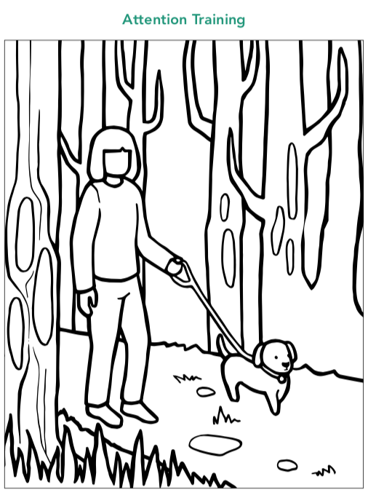
Cultivating Focused Attention
What is the puppy being trained to do?
What is the leash for?
Do you think the compassionate owner has to watch the puppy?
Is training a puppy similar to when we train our attention?
Is it important for the owner to be kind and patient when training the puppy?
If the compassionate owner keeps walking the puppy and keeping it on the path every day, what do you think will happen eventually?
Notes:
https://unsplash.com/photos/mq8QogEBy00

Slide 4
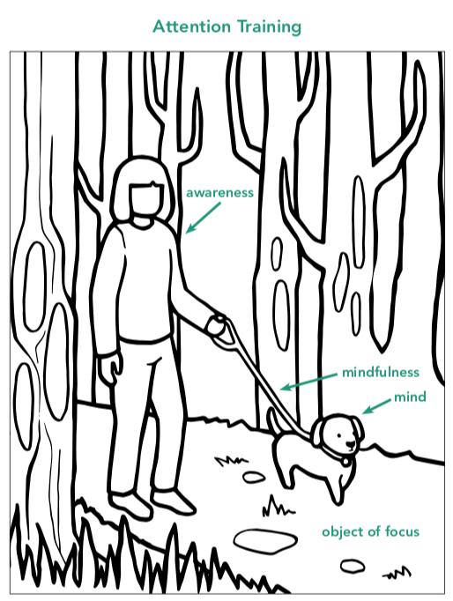
Cultivating Focused Attention

Slide 5
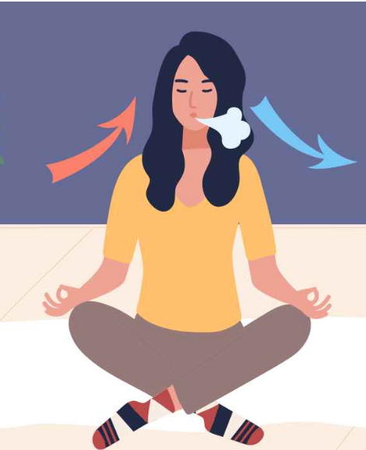
Focused Attention on the Breath
Were you able to keep your attention on the breath with mindfulness?
Were you able to use awareness to notice when you were focused or when you were not focused?
What sensations do you notice in your body now?
https://fitpage.in/breath-awareness-in-yoga-dos-and-donts/

Slide 6

Drawing Attention Training
Let’s draw three images!
Mind in our low zone (sleepy/cloudy/dull)
Mind in our high zone (wandering/excited/lots of distractions)
Mind in our resilient zone (balanced/calm/alert)
How does attention play a role in your drawing?
How is mindfulness, heedfulness, or awareness in your drawings?”
Notes:
Noncopyright: https://unsplash.com/photos/nNe4HwY_iY0

Slide 7
Debrief
Have you learned anything about attention that you think you could use?
Have you noticed any change in your ability to pay attention?
Do you think your attention would grow stronger if we practiced more? Would that be helpful

