Slide 1
Strengthening Awareness & Self Attention
Cultivating Attention in Activities Pt. 2

Slide 2
Checking In

Slide 3

The Spark and the Forest Fire
What happened in the story?
What was the spark for the main character?
What could happen next if he doesn’t catch the spark?

Slide 4
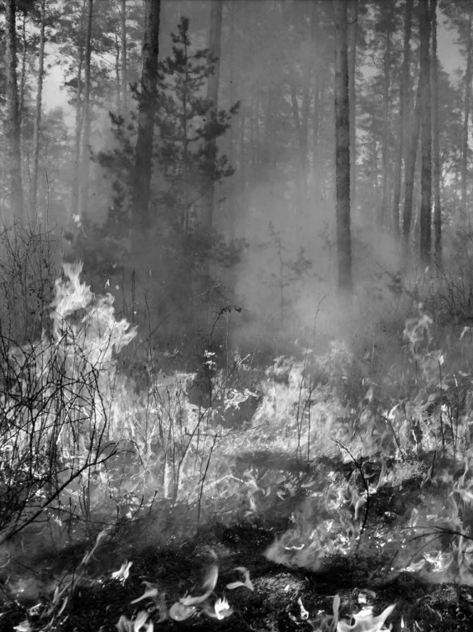
The Spark and the Forest Fire cont.
What might he do to catch his spark?
How can we benefit from catching our sparks?
How can we help others by catching our sparks?

Slide 5


Mindful Listening
What zone do you feel in right now?
What sensations do you notice in your body? Has your breathing changed?
What other activities could we do together mindfully?

Slide 6
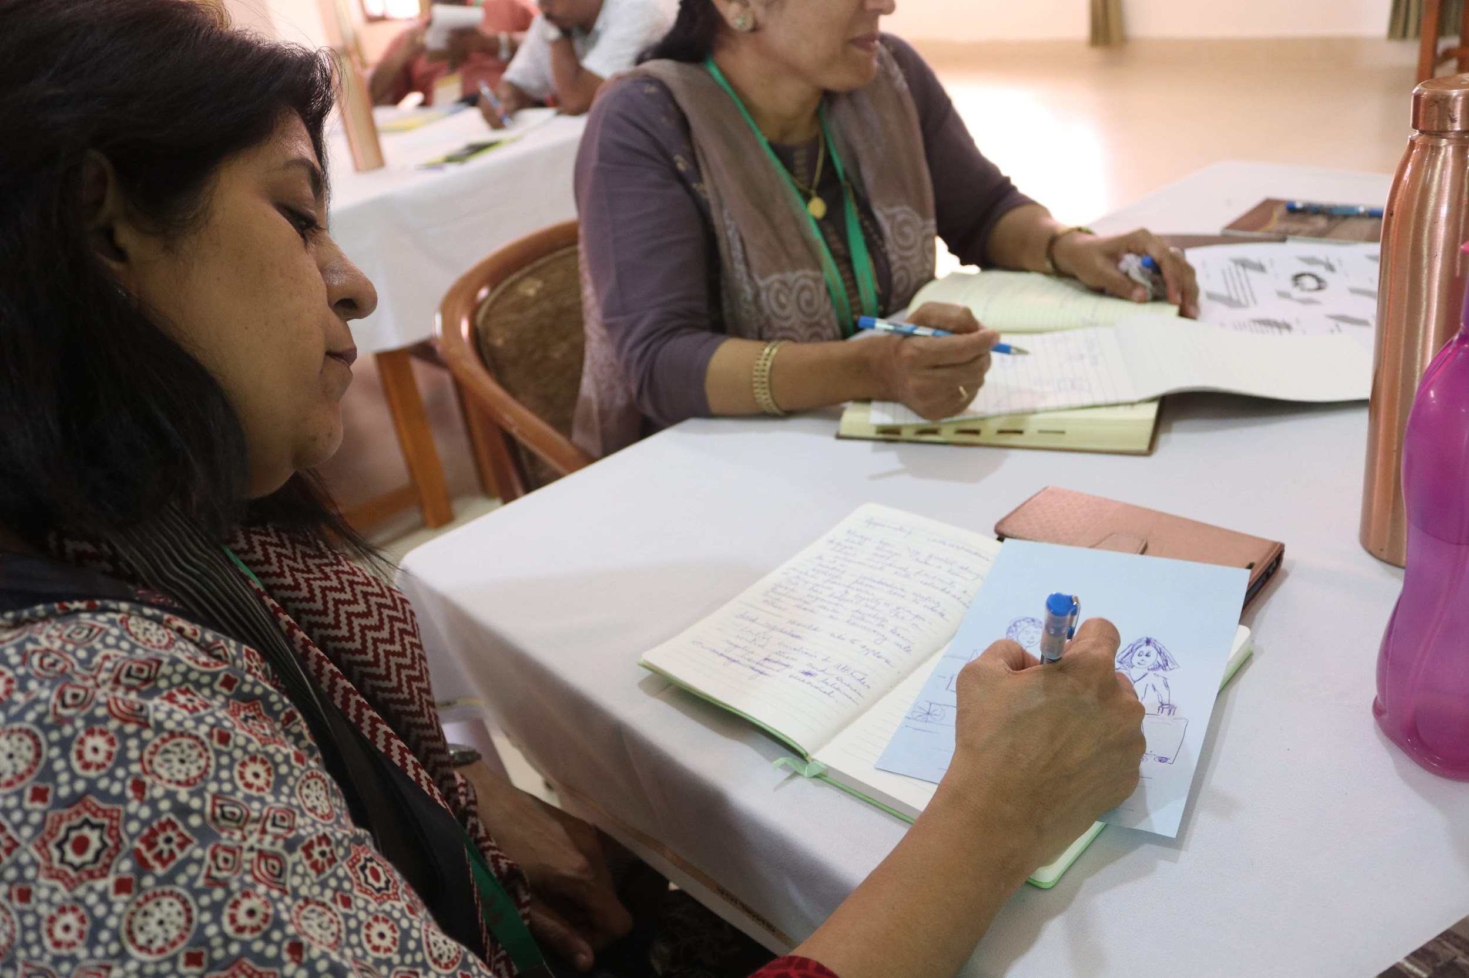
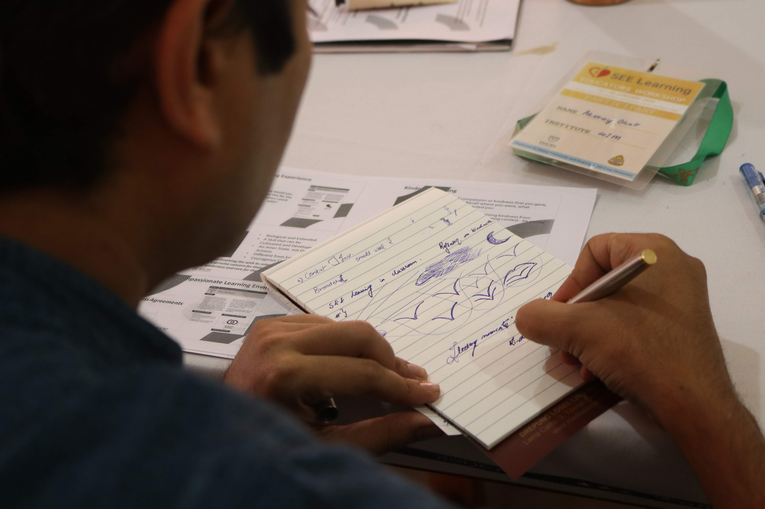
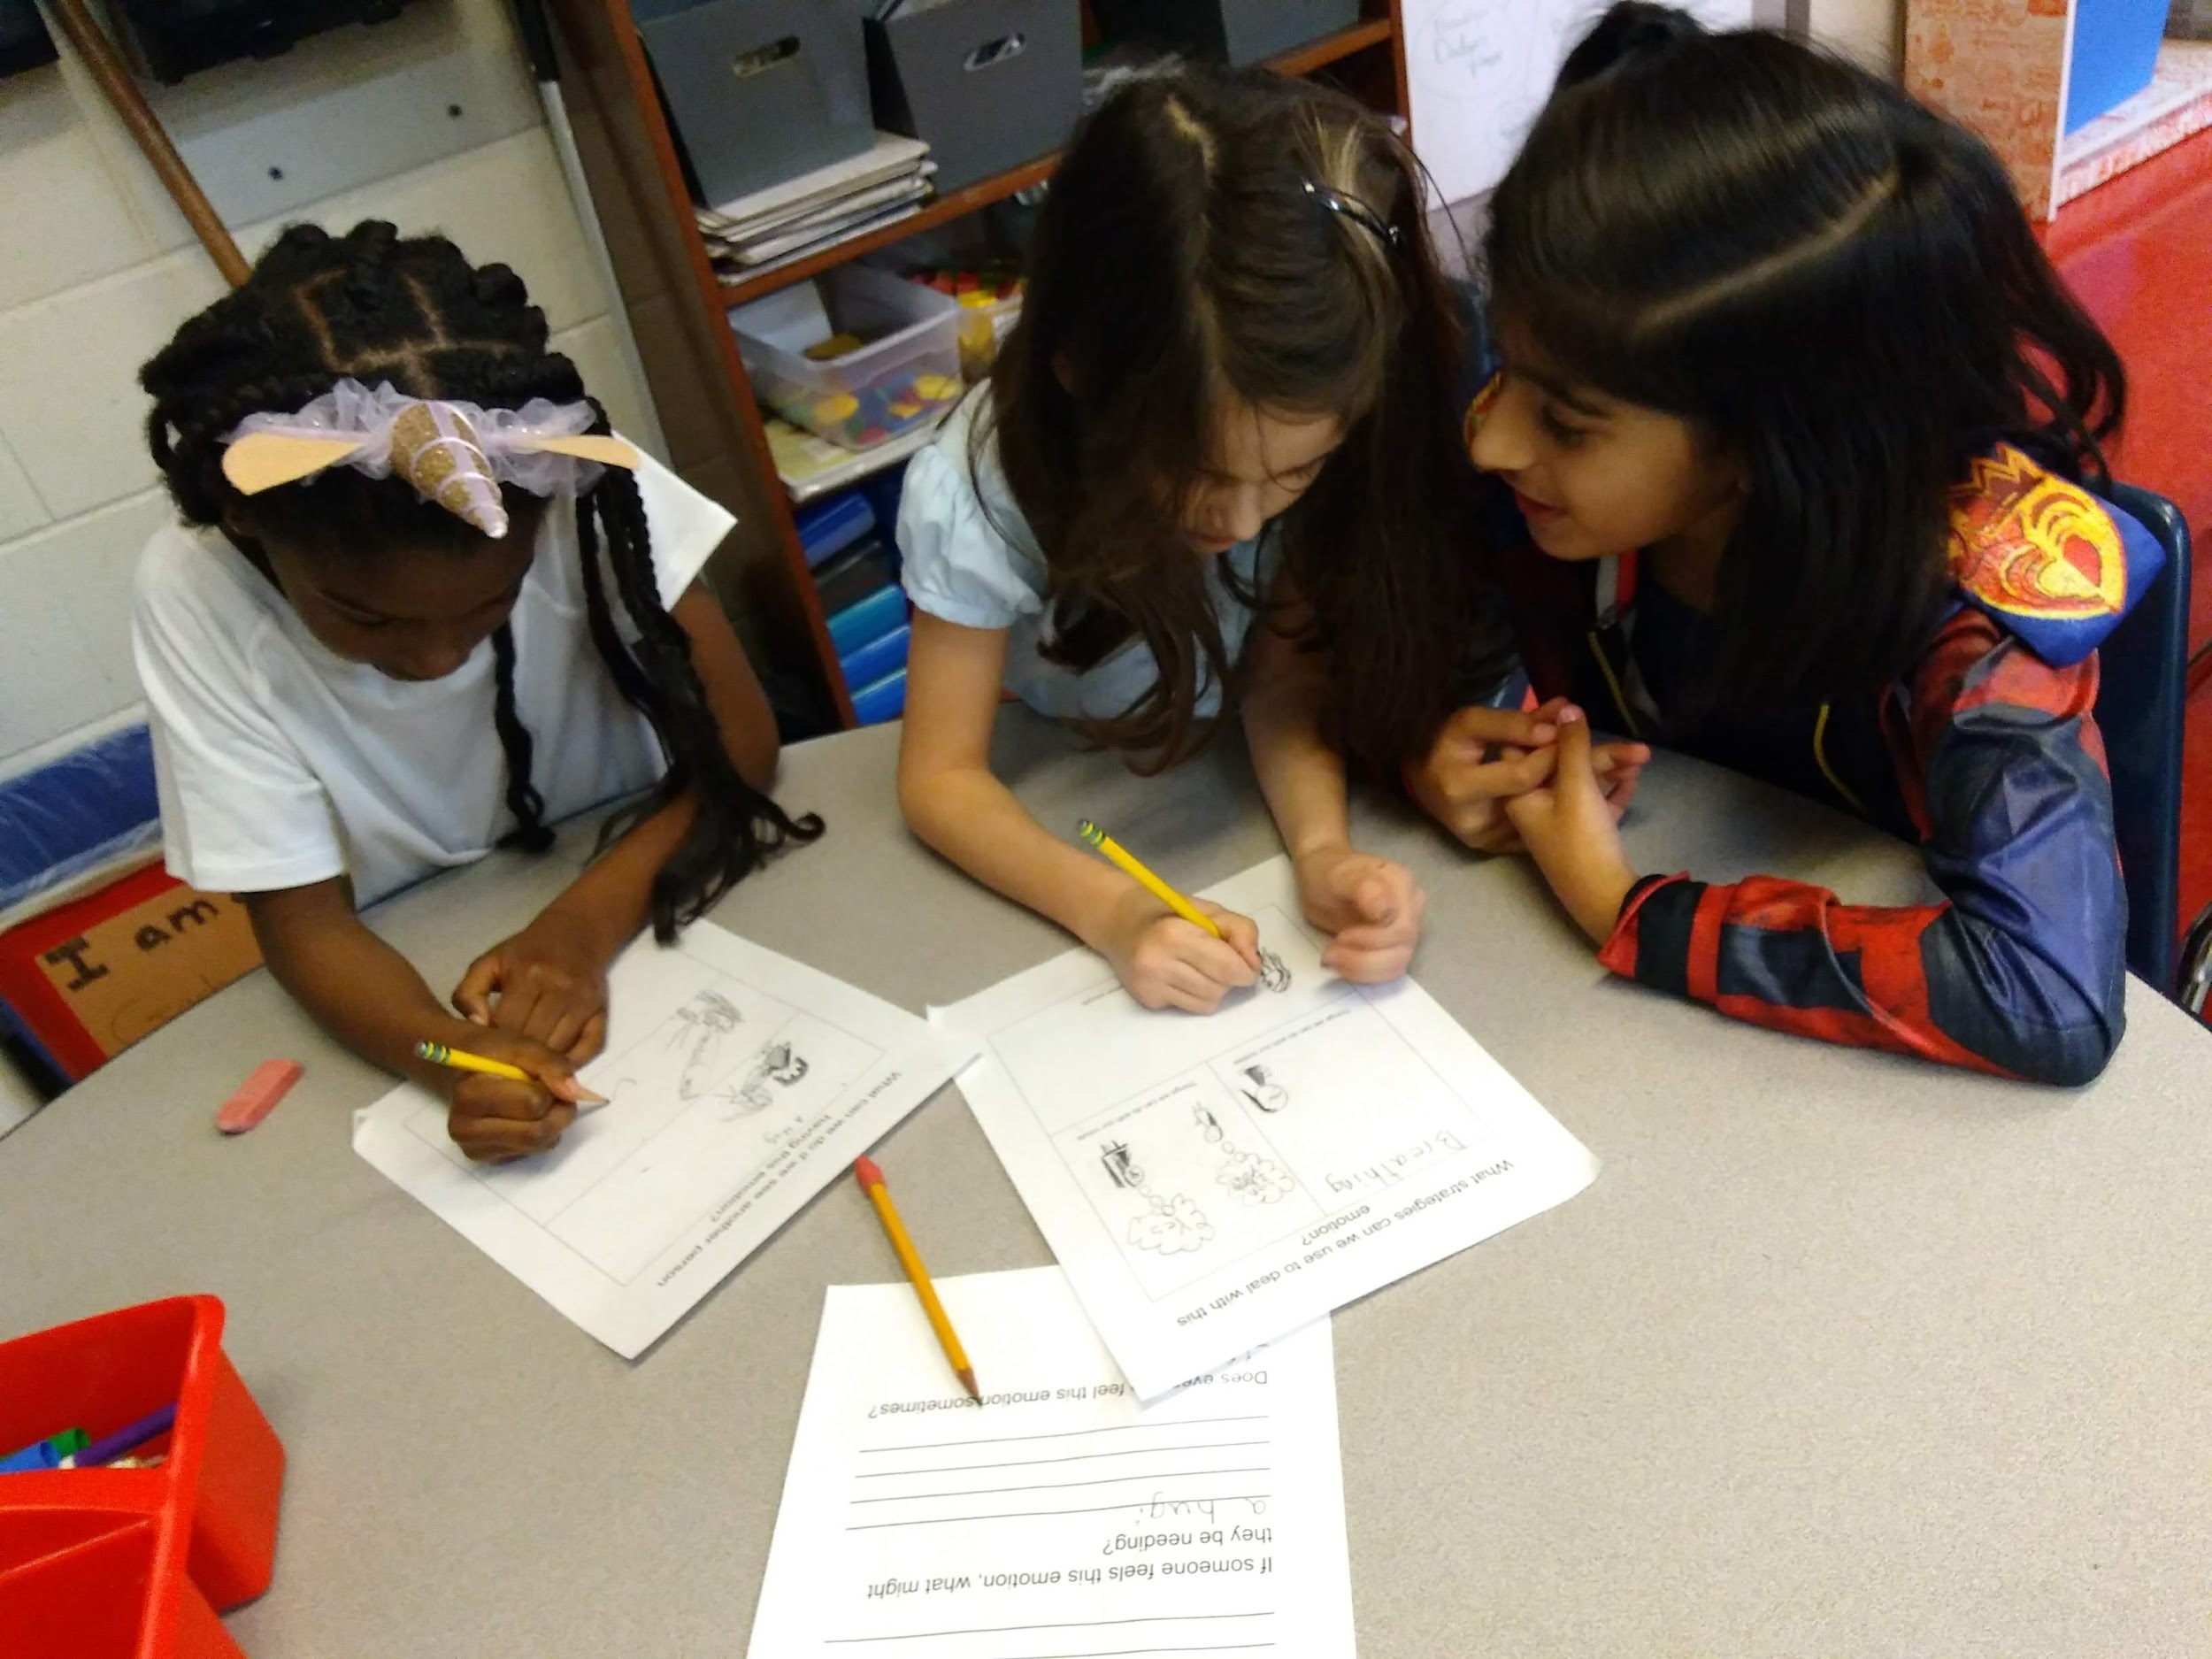
Mindful Writing

Slide 7

Mindful Writing
What zone do you feel in right now?
What sensations do you notice in your body? Has your breathing changed?
Was it hard to pay attention to all 26 letters? What does your handwriting look like, is it different?
What other activities could we do together mindfully?

Slide 8
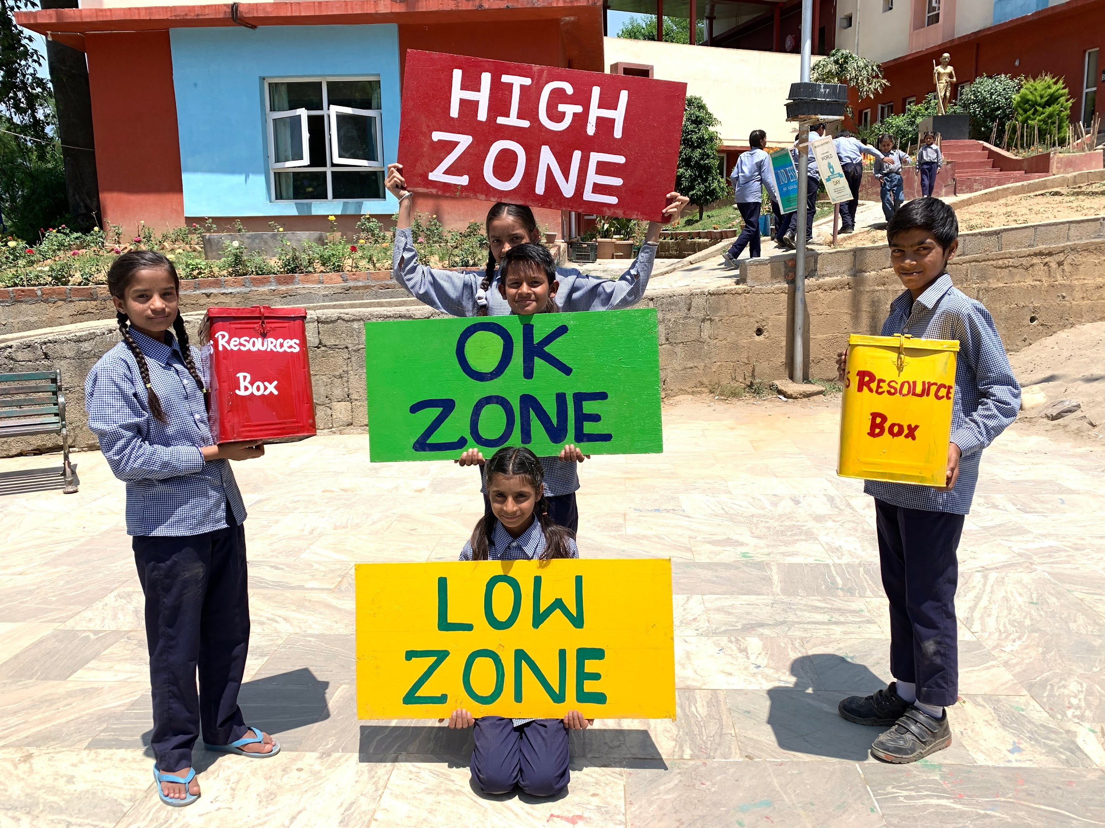
(Optional) Mindful Eating
What are some things you notice about your snack just by looking at it?
After a few bites…
What do you notice on the inside?
What zone do you feel in right now?
Did you notice any acts of kindness while doing mindfully eating or passing out snacks?
Do you think you could do mindful eating with other foods or at other times?

Slide 9
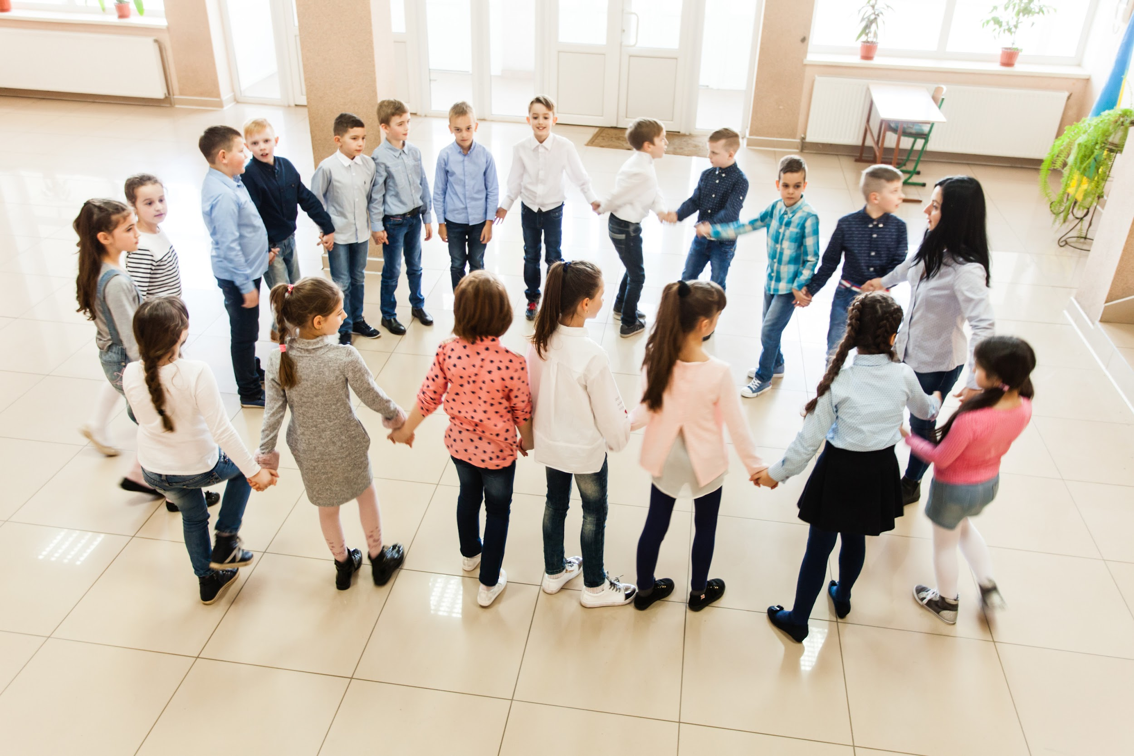
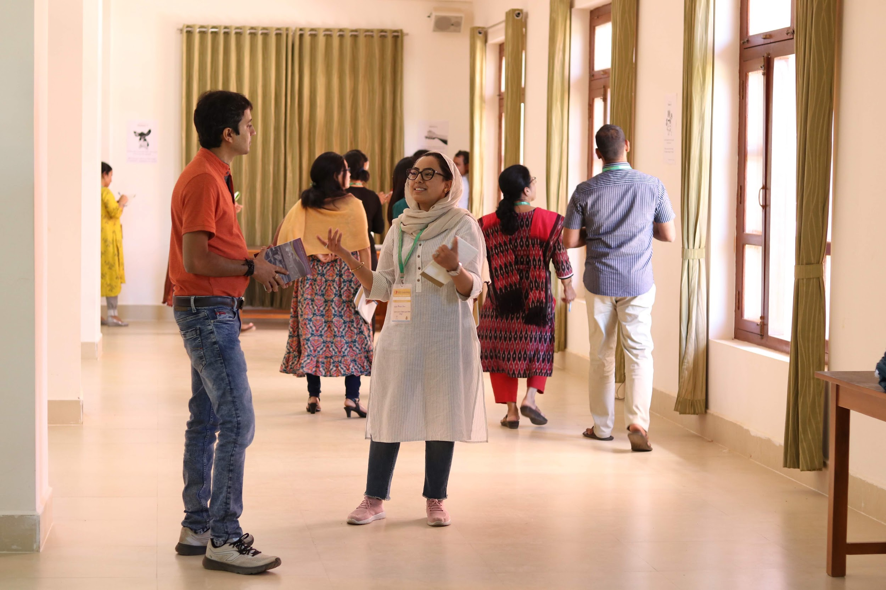
(Optional) Mindful Walking
What do you notice on the inside?
What zone do you feel in right now?
What else do you notice from doing mindful walking?

