Slide 1
Strengthening Attention & Self-Awareness
Cultivating Attention in Activities: Part 1

Slide 2
Checking In

Slide 3
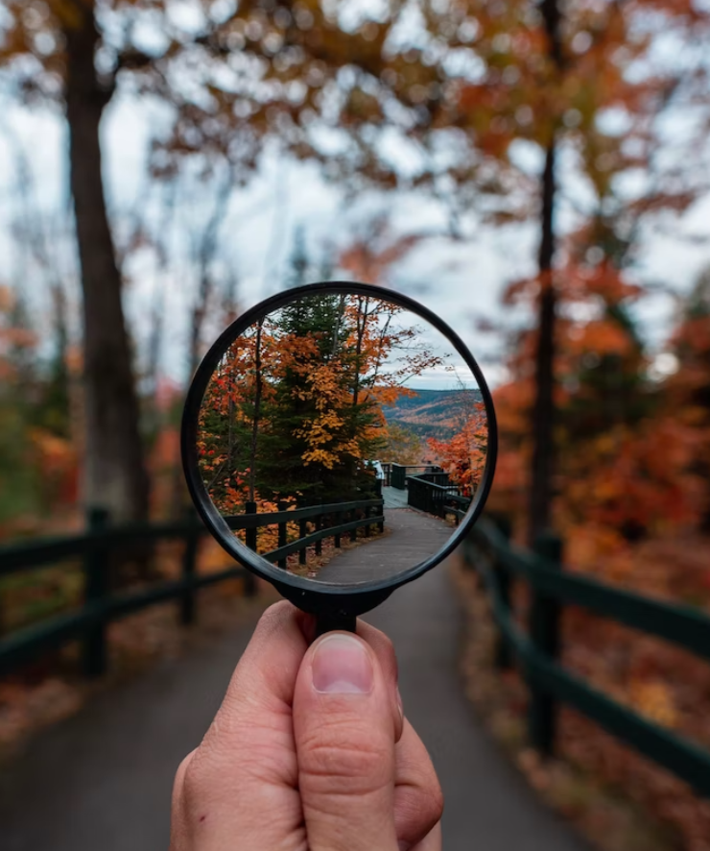
What is Attention and What is it For?
What do we mean when we say “pay attention”?
What are things on the outside that we can pay attention to?
What do we use to pay attention to those things?
What are things on the inside that we can pay attention to?
What do we use to pay attention to those things?
Notes:
https://unsplash.com/photos/mq8QogEBy00

Slide 4
The Story of Ben
What happened in this story?
Who was Ben talking to when he said, “Stop! Thief! I’ve caught you!”?
At what moment did Ben become aware that he was doing something that might get him into trouble?
What was Ben heedful of? Did it work?
Brainstorm a list of things it’s good to be heedful of or careful about.
Select two or three ideas from your list and write about why would it help to be heedful of those things

Slide 5
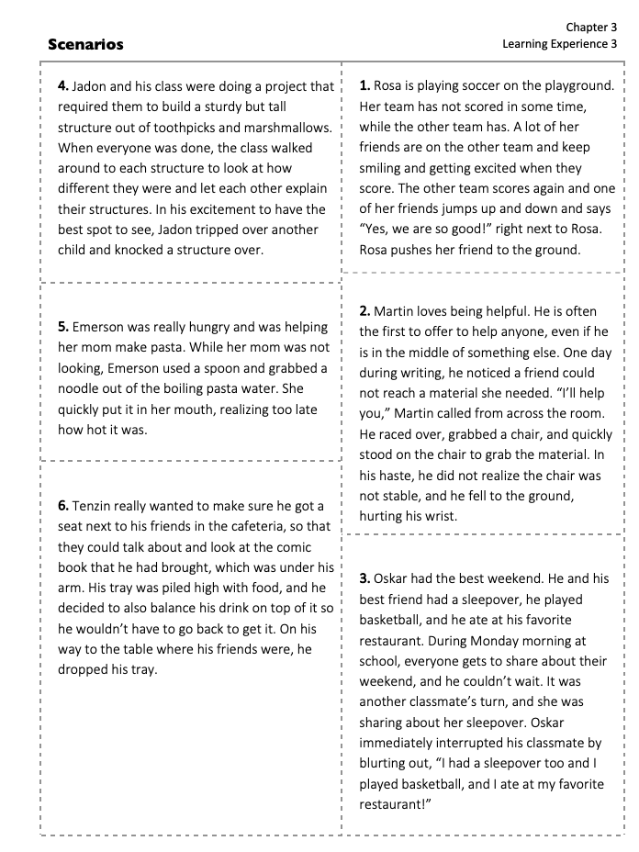
Using Heedfulness and Awareness for Different Outcomes Pt. 1
• Read the scenario together as a group.
• What happens in the scenario?
• At which points could the character have practiced heedfulness?
• What could the character have done instead of what they actually did?

Slide 6
Using Heedfulness and Awareness for Different Outcomes Pt. 2
• Take 4 minutes to create a skit for your scenario
• Observers: Where did a character practice heedfulness?

Slide 7
Settling the Mind with a Resource
To help us concentrate, close your eyes and sit up straight but in a comfortable way
Bring one of your resources to mind and see if you can pay attention with our mind for a few moments
Whenever you notice that you got distracted, you can bring your mind back to your resource
What did you notice this time, when we paid attention to our resource a bit longer?

Slide 8
Debrief
What did you notice this time, when we paid attention to our resource a bit longer?
Were you able to pay attention?
What did you do when you lost your attention or got distracted?
Is it getting easier or harder to pay attention as we practice? Do you notice any changes?
Do you notice any difference in the class as a whole when we practice?

Slide 9
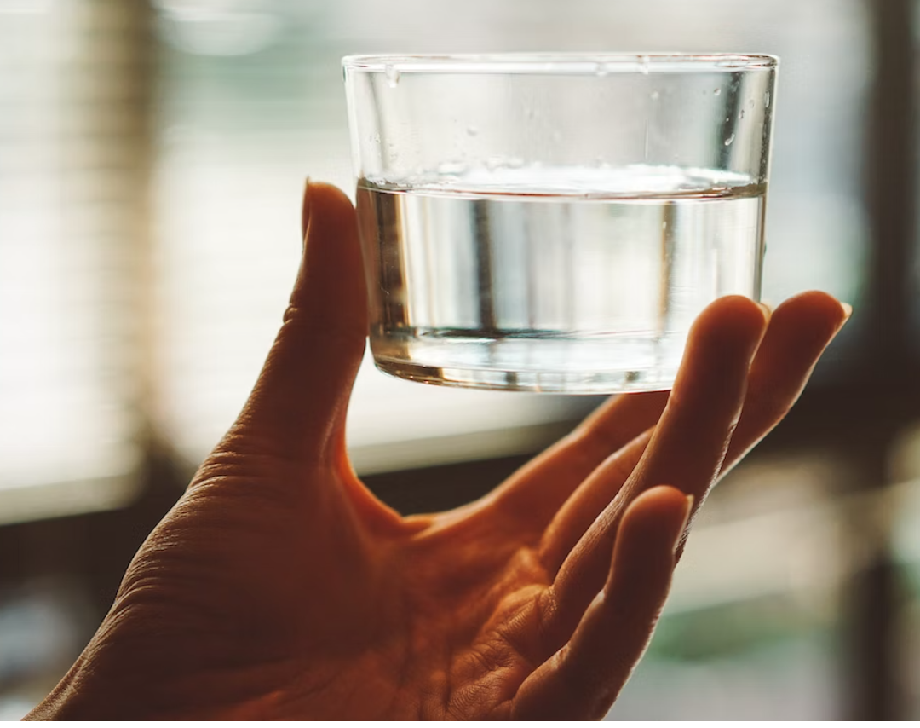
(Optional) Pass the Cup
Try to keep your mind on the cup → mindfulness
As you watch the cup going around the circle, see if you can notice how your body and mind reacts as it gets closer to you → awareness
Try not to spill any of the water from the cup, but if you do, that’s ok! → heedfulness
Notes:
Noncopyright: https://unsplash.com/photos/12Kb5ynfxso

Slide 10

(Optional) Mirroring
Divide into pairs and choose a Partner A and B
When Partner A moves, Partner B mirrors & pays close attention with mindfulness
What was happening in your body and mind? What were you aware of?
This game is really good practice for other things that need our attention. Can you think of some?
Notes:
Noncopyright: https://unsplash.com/photos/--O3nODu2KQ

