Slide 1
Strengthening Attention & Self Awareness
Exploring Attention

Slide 2
Checking In

Slide 3
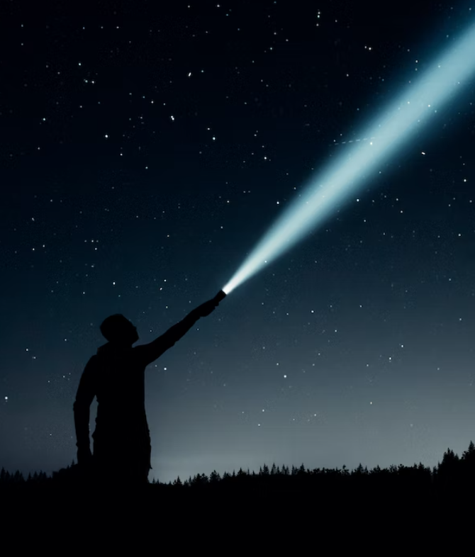
Attention with a Flashlight
What happens when we pay attention? Does anything happen in our bodies?
How can we use our minds like a flashlight? Can we pay attention to certain things closely?
Do you think it’s useful to be able to pay attention when you want to? Why?”
Notes:
Non copyright image: https://unsplash.com/photos/GewlrE-mkk4

Slide 4

I Notice, I Wonder
We’ll pass around an object, but don’t name it until the end!
Share something you notice or wonder to the group
Challenge will be to not repeat what someone else already said!
Notes:
Noncopyright: https://unsplash.com/photos/oZuBNC-6E2s

Slide 5
Discussion
Did someone say something you hadn’t noticed or wondered about yourself?
There were no wrong answers … why do you think that is? Do you think there’s a right or wrong way to experience this object?
Did you ever lose attention for a moment? Were you able to bring your attention back to the group and the object?

Slide 6
Individual Practice with Writing
Take 5-10 minutes to…
Examine your object
Write 1 thing you notice about it
Write 1 thing you wonder about it
Try to write 1 more sentence when you’re finished!
Discussion: Did you notice your attention wandering? How did you notice it? How did you bring it back?”

Slide 7
Settling the Mind with a Resource
To help us concentrate, close your eyes and sit up straight but in a comfortable way
Bring one of your resources to mind and see if you can pay attention with our mind for a few moments
Whenever you notice that you got distracted, you can bring your mind back to your resource
What did you notice this time, when we paid attention to our resource a bit longer?
Notes:
Noncopyright: https://unsplash.com/photos/oZuBNC-6E2s

Slide 8
Discussion
Have you learned anything about attention that you found interesting?
How else might it help us if we practiced attention and got better at it?

