Slide 1
Strengthening Attention & Self-Awareness
Exploring the Mind

Slide 2
Checking In

Slide 3
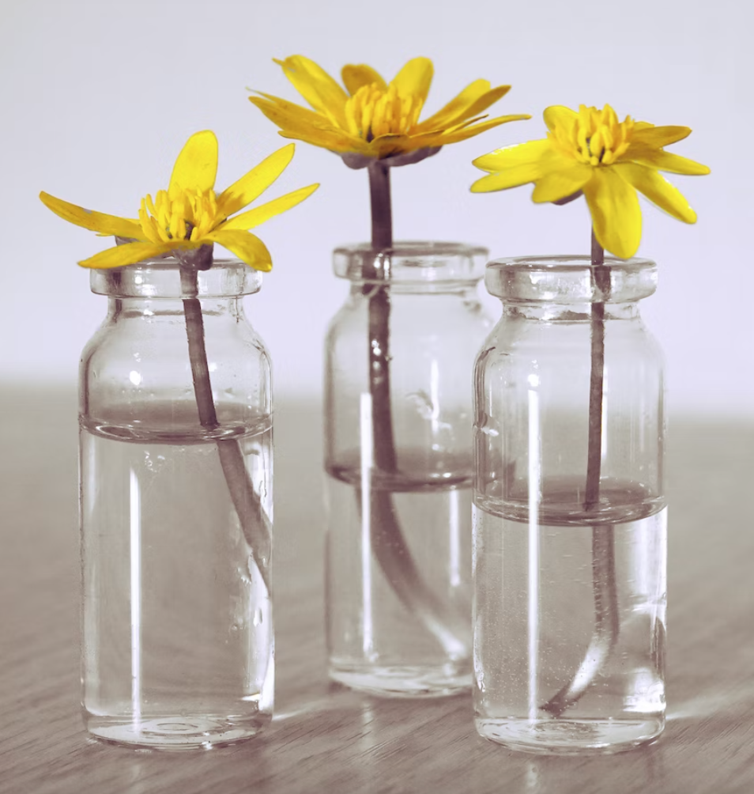
The Mind Jar
Jar represents Theresa’s mind
Can you see clearly through it?
Our code
Sand = neutral things
Pebbles = challenging things
Glitter = nice things
Notes:
Noncopyright image: https://unsplash.com/photos/wPEjA22-yxE

Slide 4
Debrief
How did Theresa feel at the beginning, middle and end?
What was challenging for her?
What was neutral for her?
What was pleasant for her?
What do we mean when we use the word “mind”?
What are some of the things that take place in our mind that we can’t see with our senses?

Slide 5
Settling the Mind
What do you notice in your body as we just watch the jar settle and keep our attention on it?
Notice how the mind jar just slowly settles and becomes clearer when no one is stirring it or disturbing it.

Slide 6
Debrief
What did you notice (in your mind or body) as you watched the jar settle?
Did anyone have a strategy that helped you stay focused on the Mind Jar?
Do you think it helps us if our minds are calmer and more settled? What does it help us do?

