Slide 1
Navigating Emotions
How Compassion and Safety Affect the Body

Slide 2
Checking In

Slide 3
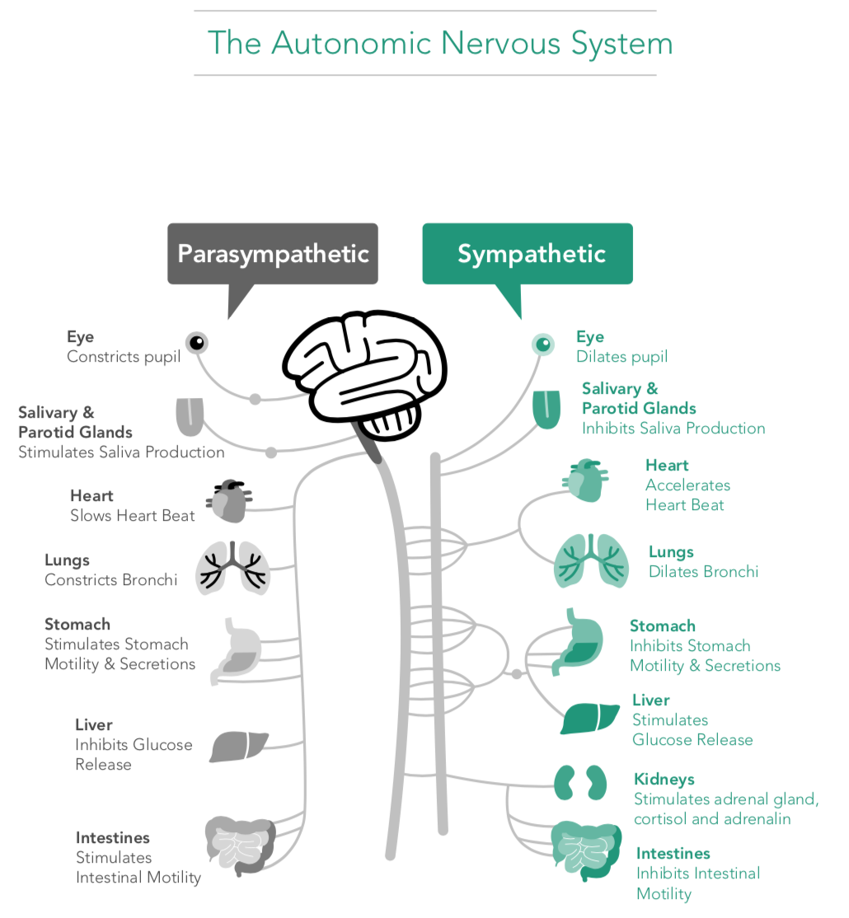
Discussion
What do you think happens inside our bodies when we are in our resilient zone? What about the high zone or low zone?
What are some things we need our nervous system to do?

Slide 4
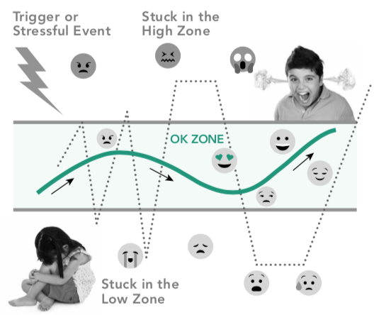
Discussion cont.
When we’re stuck in the high or low zone, what do you think happens to our heart? To our breathing? To our digestion? To our ability to rest?
What might we do that could help someone get back into the resilient zone if they were bumped out?

Slide 5
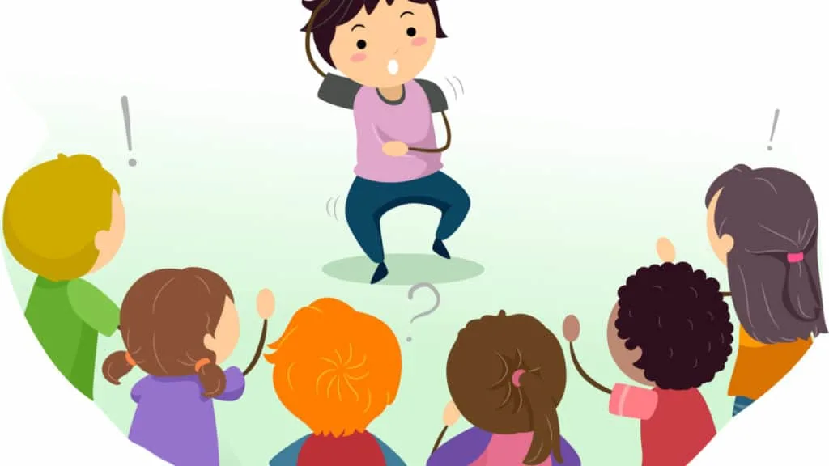
Acting out the Class Agreements with Tracking
Create a skit based on following or breaking one class agreement
When I say…
Go! -- Start / continue the story!
Slow! -- Slow down your actions and track sensations in your body!
What zone might the character be in?
End! -- Next skit!
Notes:
Non copyright image: https://www.shutterstock.com/image-vector/stickman-illustration-kids-playing-charades-478267204

Slide 6
Debrief
What did you learn today about our class agreements?
How do our class agreements affect our bodies?
Is happiness something we feel inside the body? How do we know that?
Is there anything you think we should now add to the class agreements?
Is there anything you learned or practiced about compassion that you might like to use again sometime?

Slide 7

Writing Extension
Let’s reflect in our journals about how we can help others feel safer. What actions can you try to do over the next week when you see a friend in need?
Notes:
Non copyright: https://unsplash.com/photos/333oj7zFsdg

