Slide 1
Building Resilience
Exploring the Resilient Zone through Scenarios

Slide 2
Checking In

Slide 3
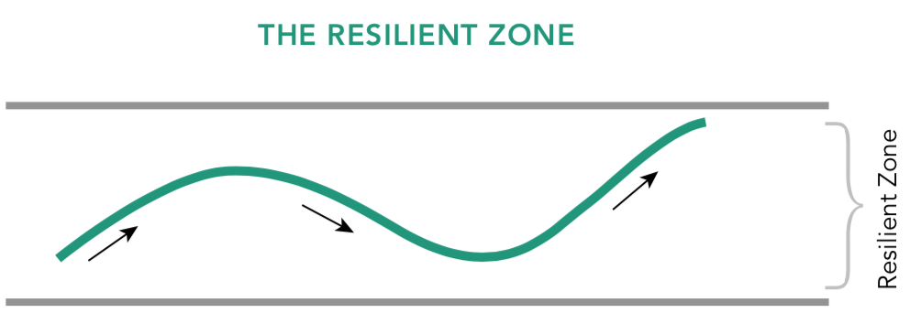
Exploring the Three Zones Through Scenarios
I will read a scenario…
Volunteers: If you were the character, where would you stand in the resilient zone? Why?
Observers: What could the character do to feel better?
Volunteers: Would you like to practice this skill? How would the character feel now?

Slide 4
Debrief
Let’s take a moment to bring to mind one of our resources.
Do you notice any sensations in your body?
What did you learn today that you want to remember because you feel it might be helpful sometime?”

