Slide 1
Building Resilience
The Resilient Zone

Slide 2
Checking In

Slide 3
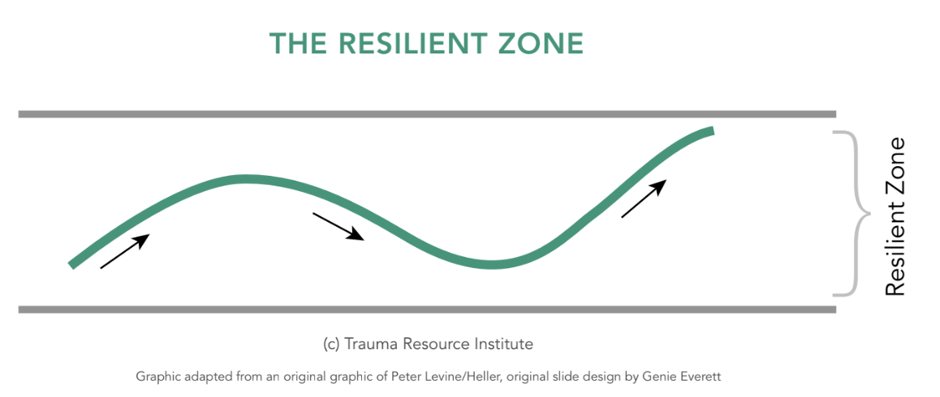
The Resilient Zone
How do you think Nelson feels in his body when he’s in the resilient zone?
Notes:
Used free stock image

Slide 4
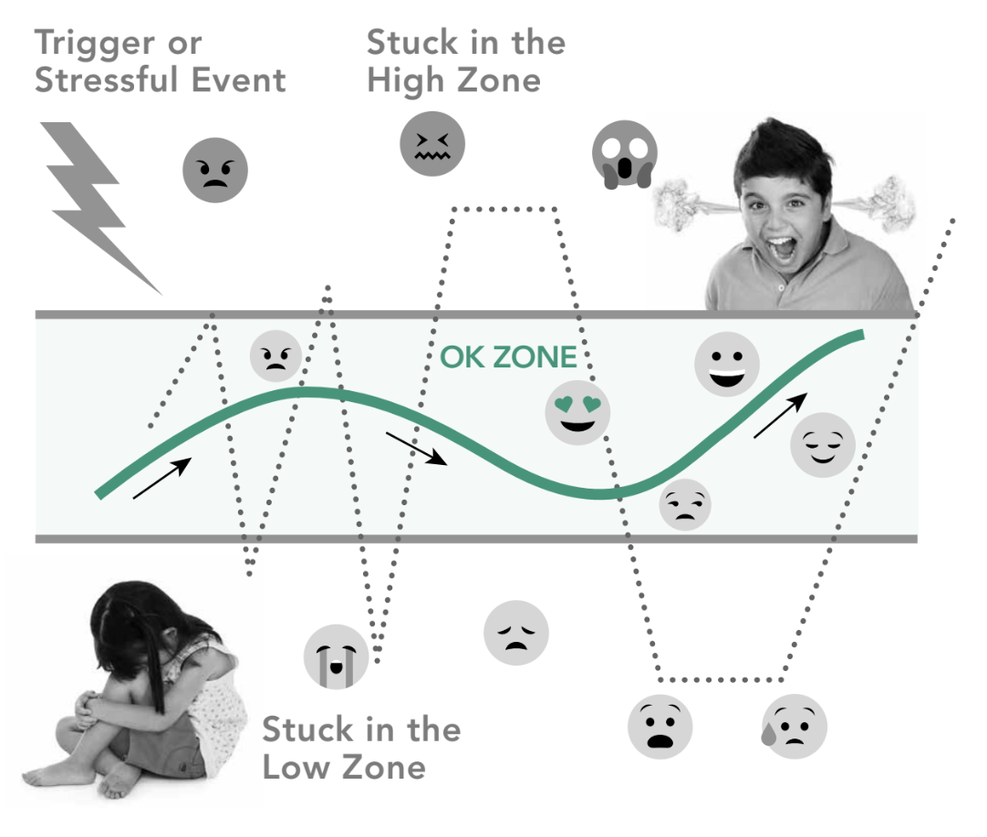
The Resilient Zone cont.
How do you think the boy on the graphic feels when he’s in the high zone?
How do you think the girl on the graphic feels when she’s in the low zone?
Notes:
Used free stock image

Slide 5
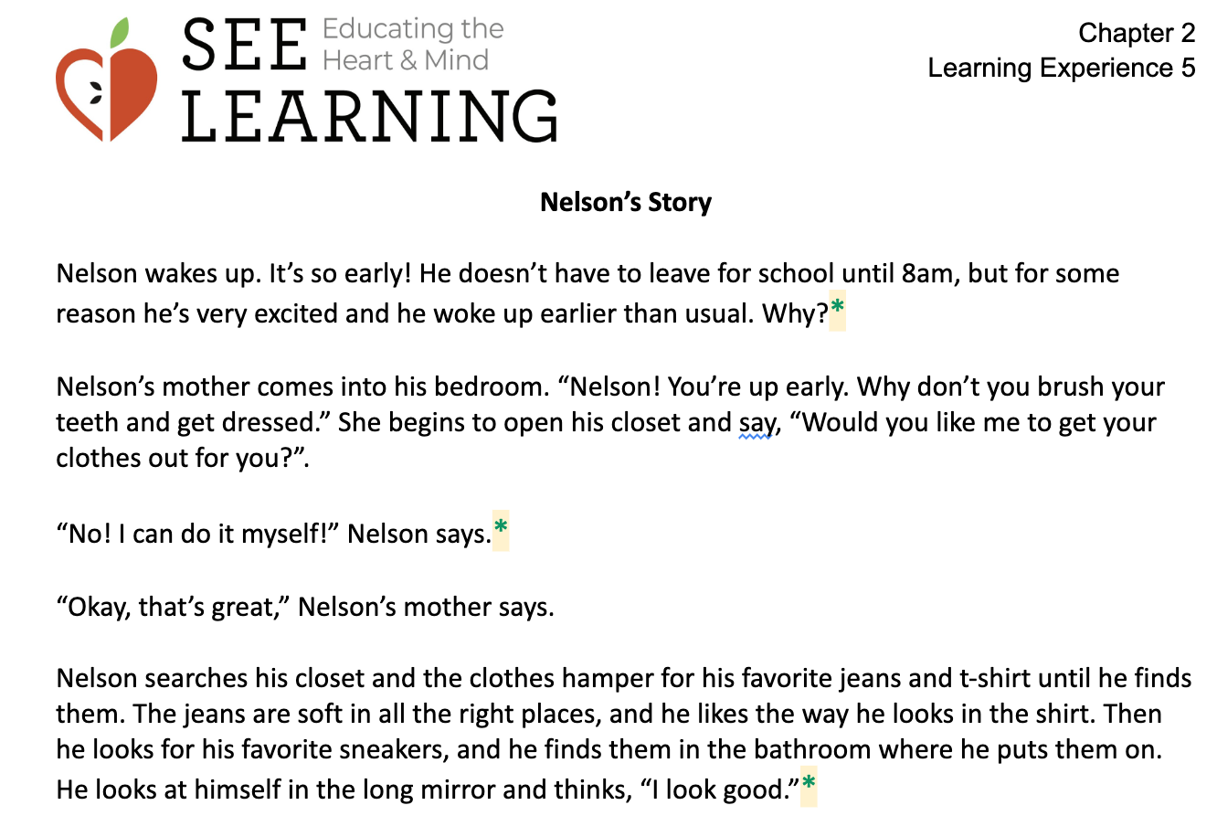
Nelson’s Day
For each asterisk (*) in the handout…
What sensations do you think Nelson is feeling right now in his body?
Where is Nelson in his three zones?
What could Nelson do to calm himself or make himself feel better?

Slide 6
Debrief
Can anyone explain the drawing of the resilient zone?
How do you think we'd know if someone else was in their high zone? What about their low zone?
Are there other words we could use to explain resilience?
Do you think most people have been stuck in the high zone some time? What about the low zone?
What did you learn today that you want to remember because you feel it might be helpful sometime?
Notes:
Used free stock image

Slide 7
(Optional) Practice Naming Sensations and Zones with Stories
In pairs or trios
Read a story together and chart a character’s experiences with the three zones
We will share as a group
Notes:
Used free stock image

