Slide 1
Building Resilience
Grounding

Slide 2
Checking In

Slide 3
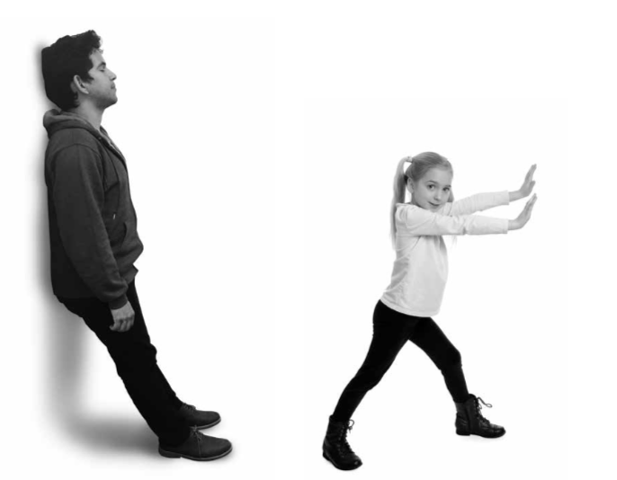
Grounding with One’s Stance
Stand up and get in a comfortable position!
What sensations do you feel?
Sitting vs. Standing?
Pushing the table vs. wall?
This is “Grounding”, which makes our bodies feel safe

Slide 4

Grounding with an Object
Now, chose an object which you feel comfortable holding.
Everyone, take a seat and start to feel the object and see what sensations we feel in our body.
This is also “Grounding”.

Slide 5
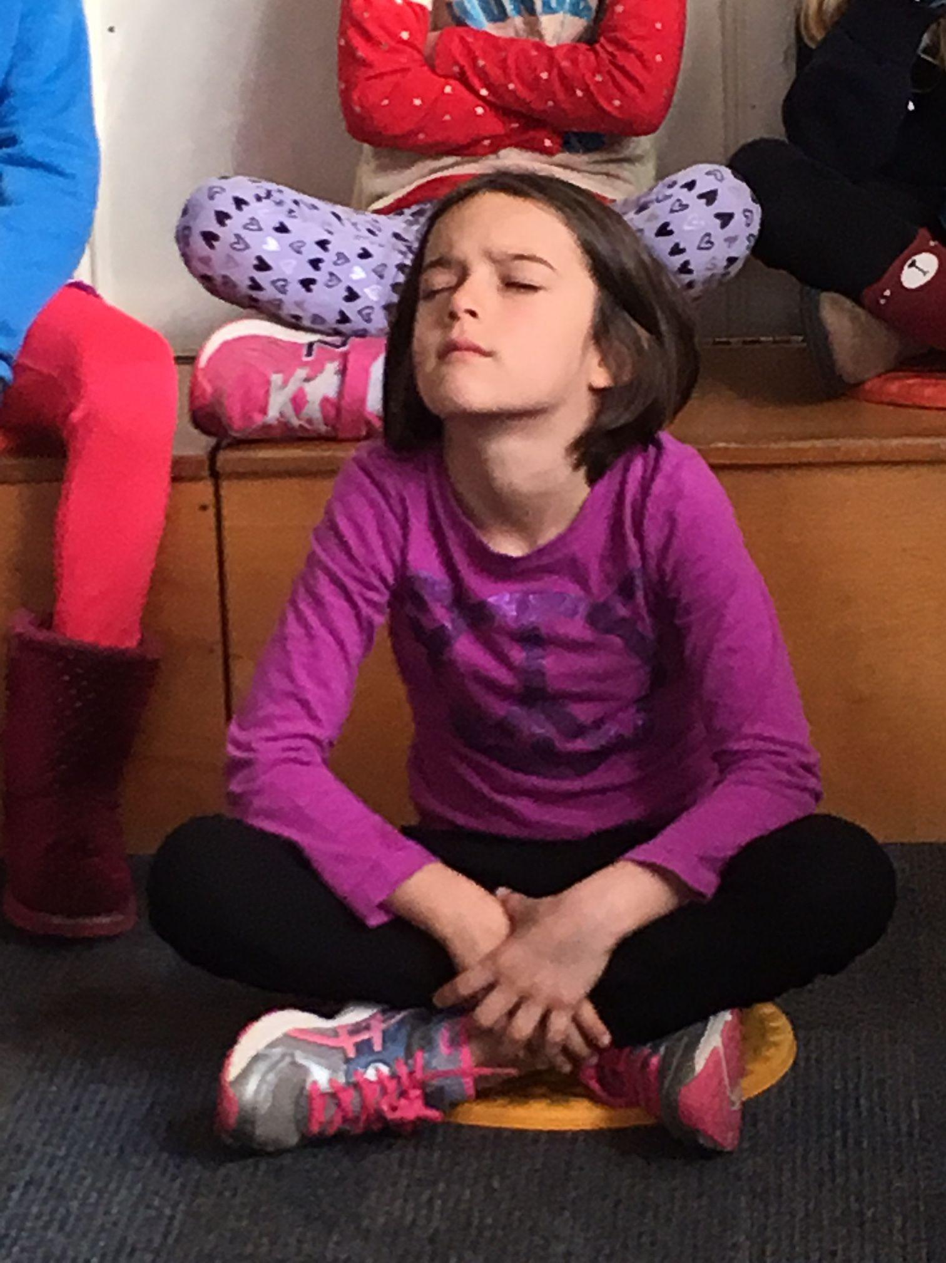
Grounding with a Part of the Body
We will also try grounding with our body
Everyone, place your hands on the wall and try to see where you feel sensation MOVE around your body!

Slide 6
Debrief
Which grounding practice has been the best one for you (i.e. which has given you pleasant or neutral sensations)? Which one did not work for you?
Does anyone remember a sensation that they felt or heard someone else share?
When do you think you could use grounding?
Notes:
Used free stock image

