Slide 1
Building Resilience
Creating a Resource Kit

Slide 2
Checking In

Slide 3
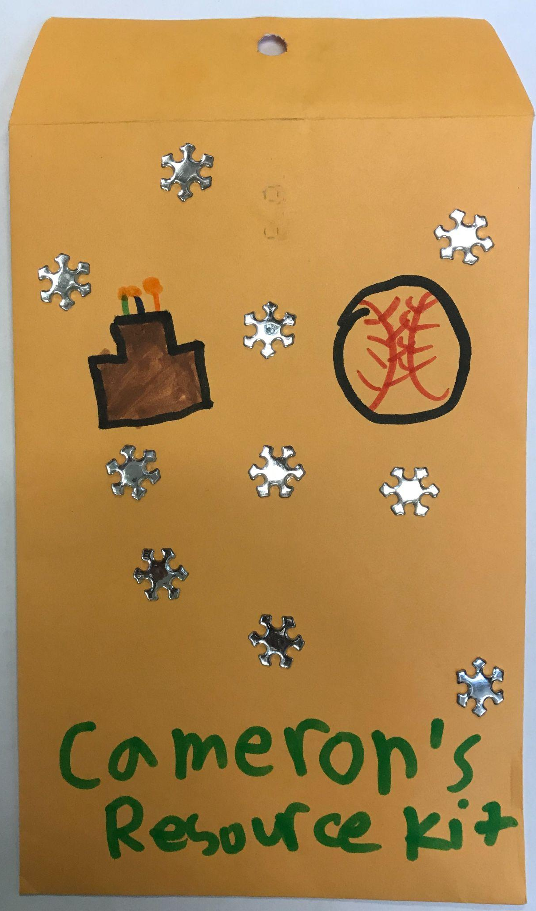
Creating a Resource Kit of Personal Resources
We will be making a Resource Kit!
A resource is something that is useful and special to us
Take some time to draw out some things that can be a personal resource for you!
Let’s all come together and share one of your resources and why you added it!

Slide 4
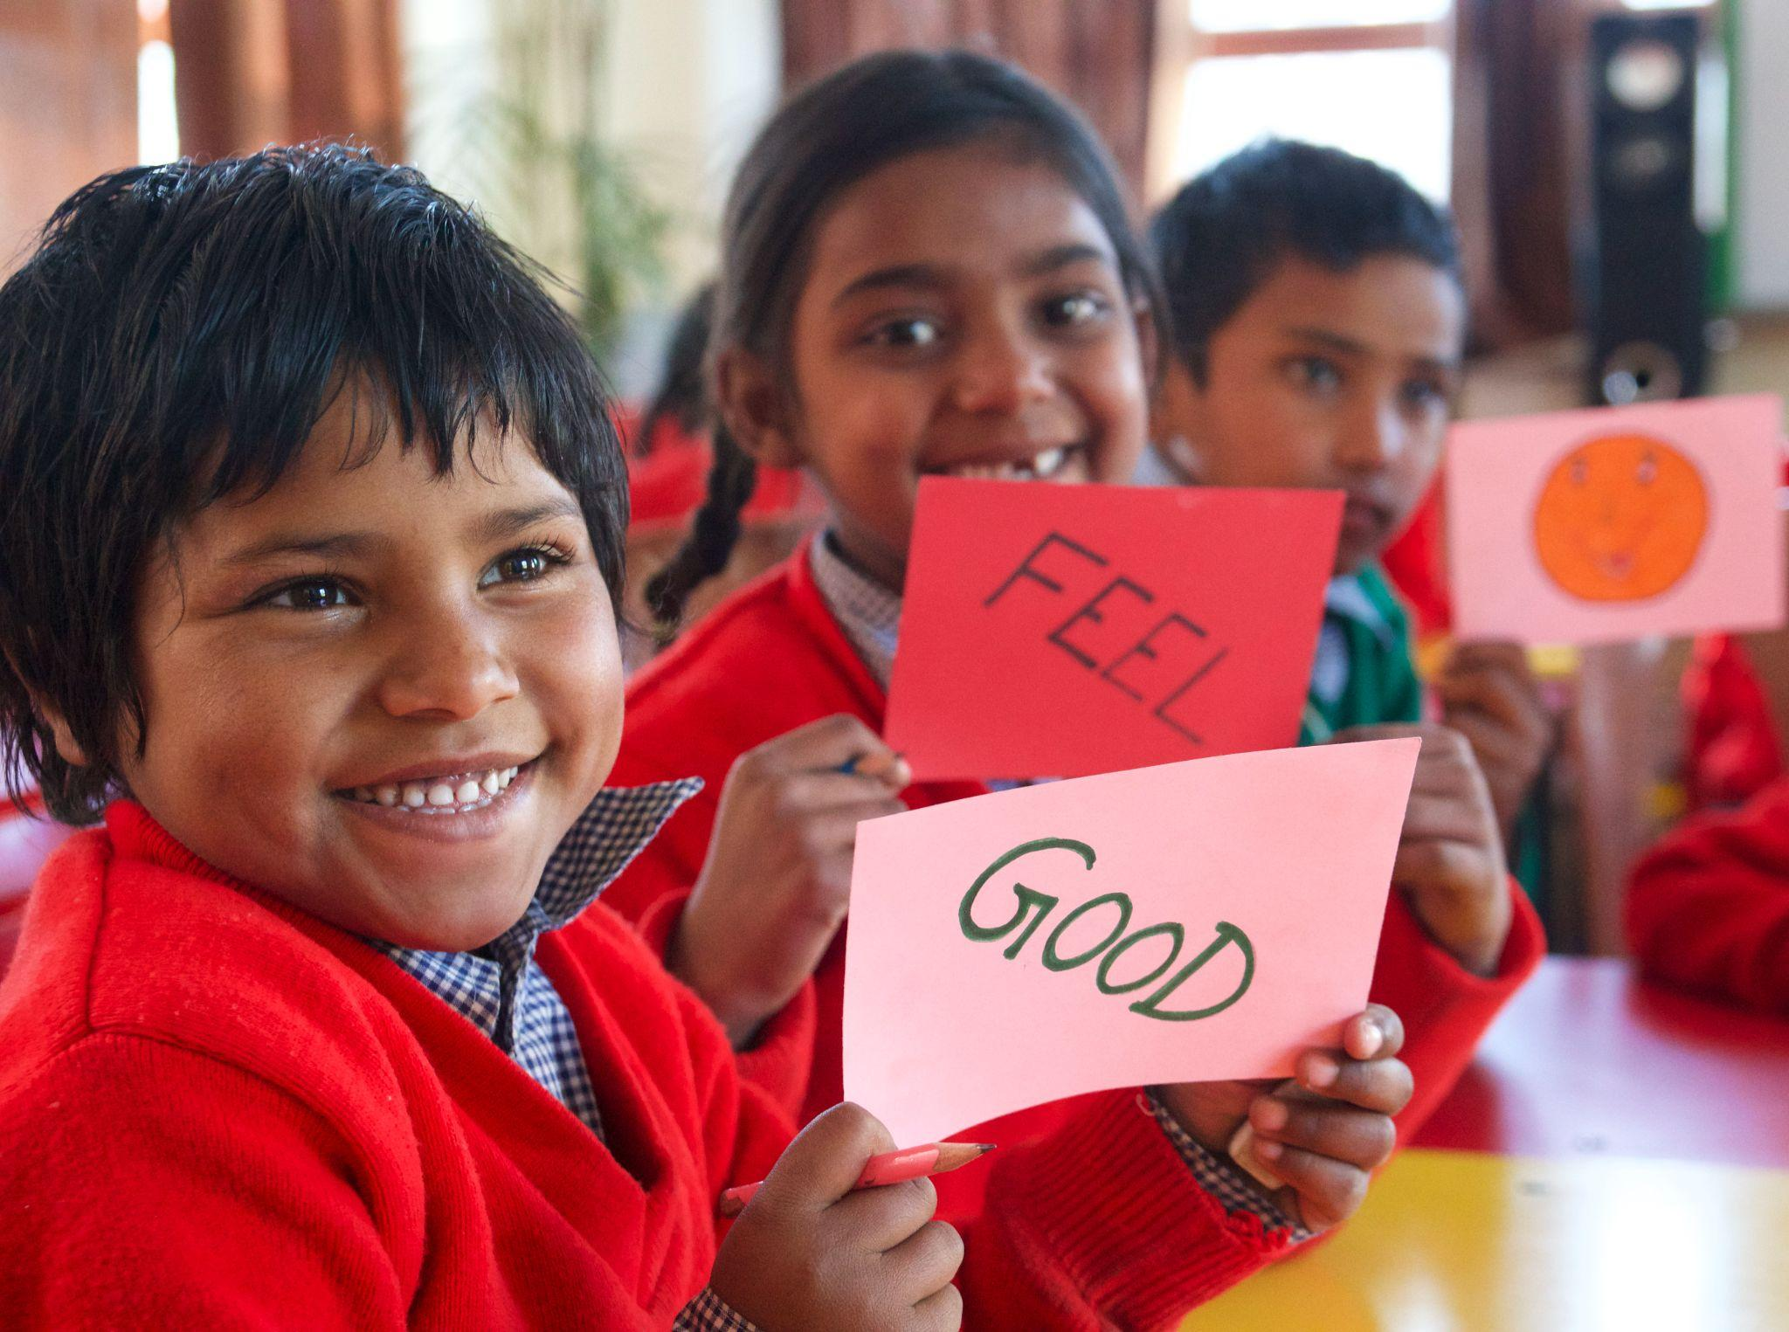
Practicing Resourcing and Tracking
Now, everyone take a moment to choose your favorite resource and think about how it makes you feel inside
Is it a pleasant, unpleasant or neutral feeling?
Let’s track where in out body we can feel these “sensations”

Slide 5
Debrief
These resource kits are for you to use to help you whenever you need to feel more safe, calm, and peaceful.
What kinds of sensations came when we looked at our personal resources?
Do you think we could come up with more personal resources in the future?
When might you want to use your resource kit?”

Slide 6
(Optional) Resource Stone
Everyone please get into a Circle!
Now, everyone will get to choose a small stone/crystal/item from the bag
Keep this special treasure in your resource kit as a reminder to feel calm and safe. This will be our resource stone
Now, take a moment to thinking about something we are thankful for and then give your resource stone a little squeeze

