Slide 1
Building Resilience
Resourcing

Slide 2
Checking In

Slide 3
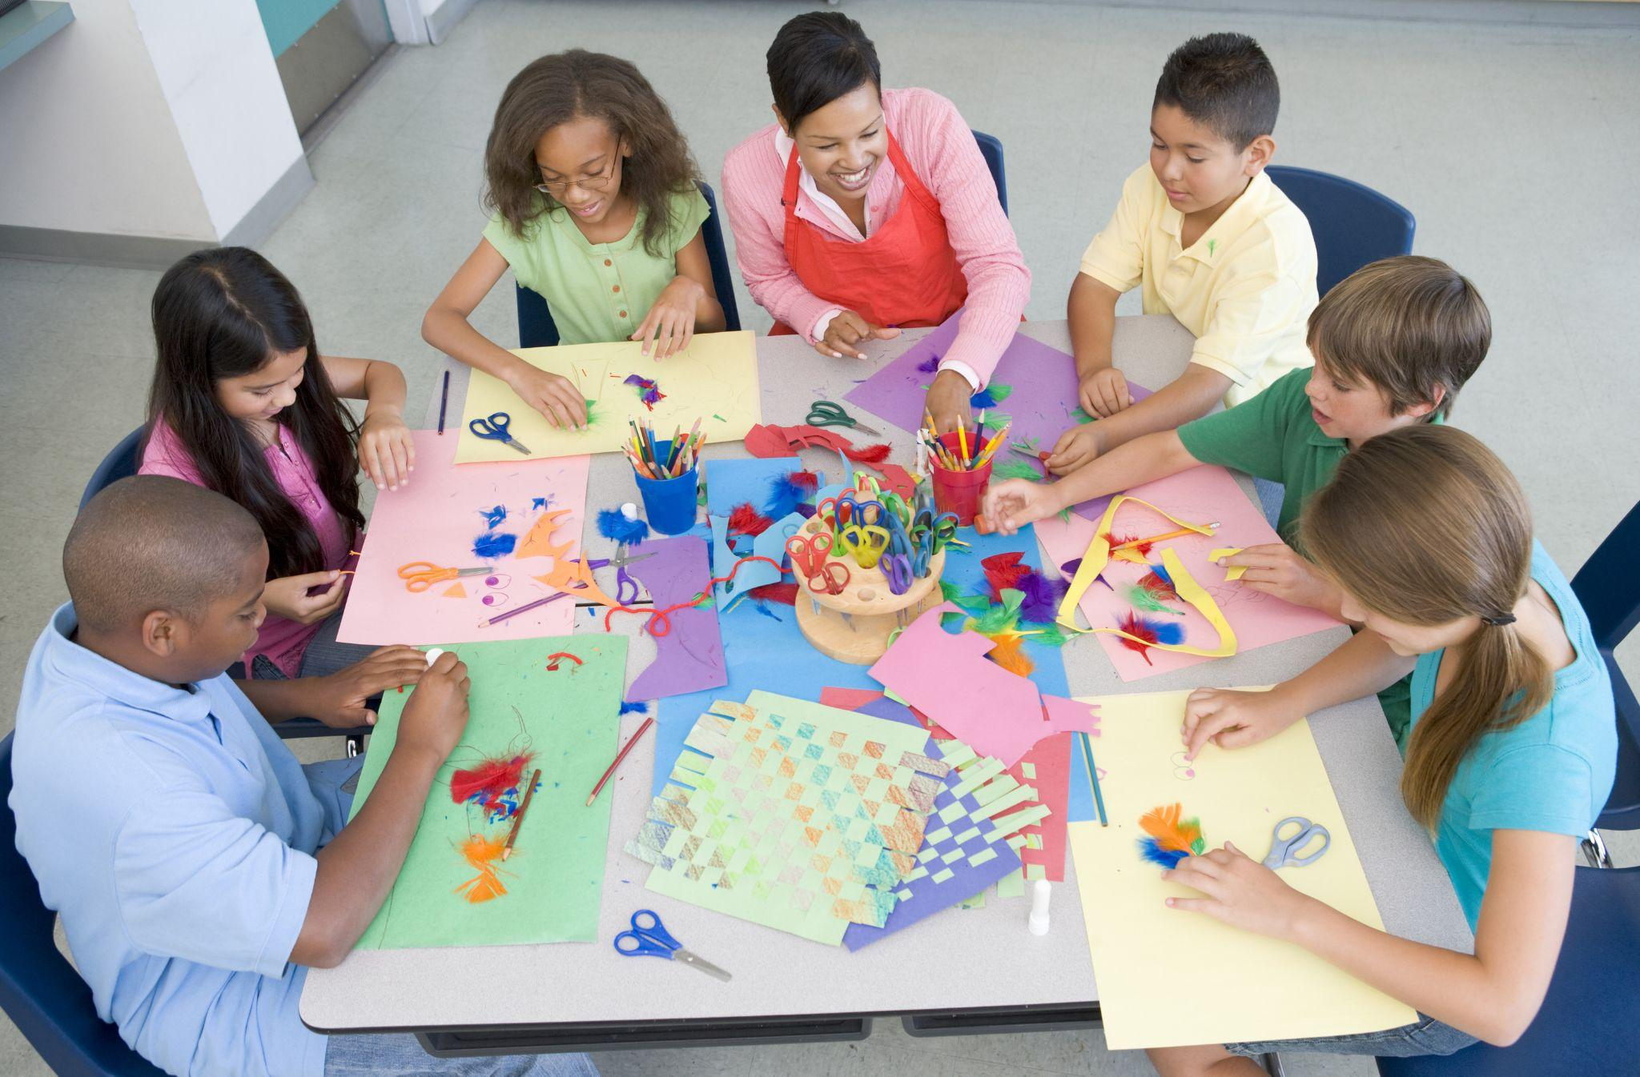
Using Your Compassion Drawing as a Personal Resource
We are going to dive deeper to discuss what sensations we can feel!
Take out your compassion drawing and point to the part that catches your eye
Does anyone feel any “sensation” of feelings on your body: pleasant, neutral, unpleasant?

Slide 4
Debrief
Debrief
What did we discover about personal resources and sensations?
What kinds of sensations came when we looked at our personal resources?
Where in our bodies did we feel those sensations?
Do you think we could come up with more personal resources in the future?
If you ever feel unpleasant, do you think you could use one of your personal resources to help your body feel better?

Slide 5
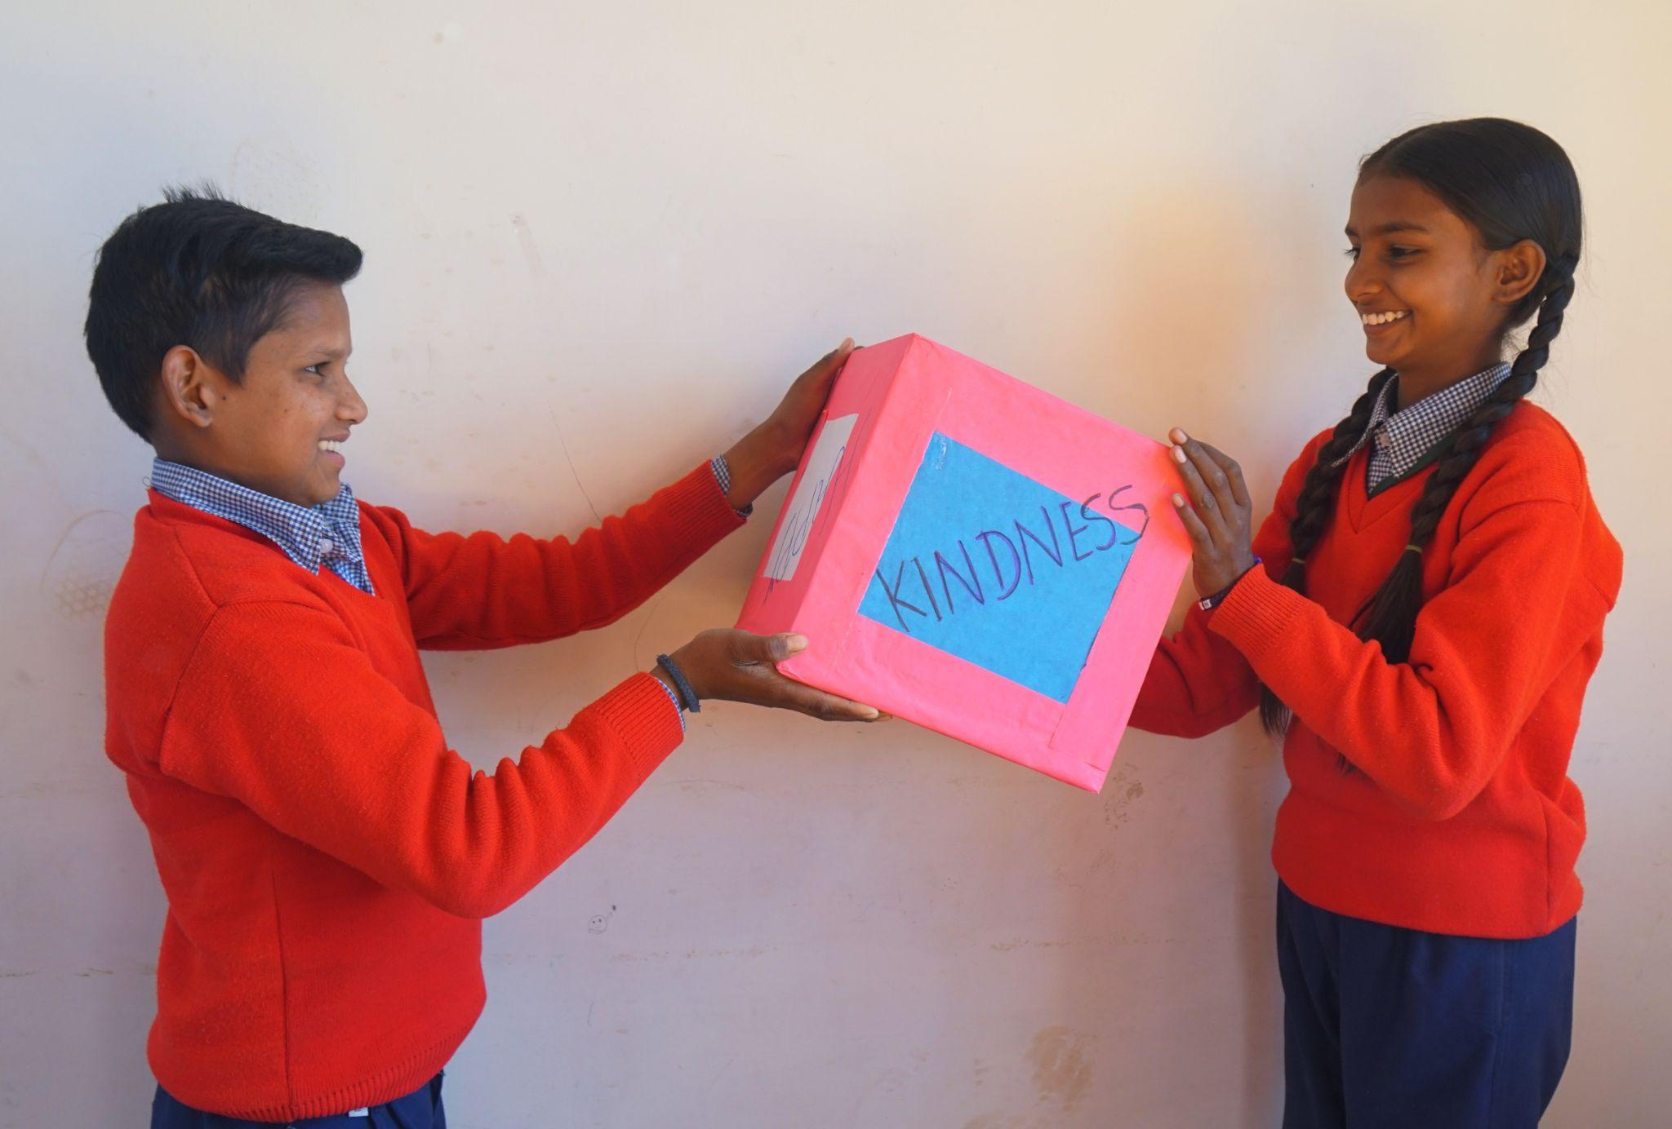
Writing
Write about a time when you resourced using a positive/kind memory or when you used a Help Now! strategy and what the positive or neutral sensations felt like in your body.

