Slide 1
Creating a Compassionate Classroom
Recognizing Compassion and Exploring Interdependence

Slide 2
Checking In

Slide 3

Recognizing Compassion
How many "compassionate acts” do you think you encounter in a day?
Do you think there might have been compassion that we didn’t even know about or notice?

Slide 4
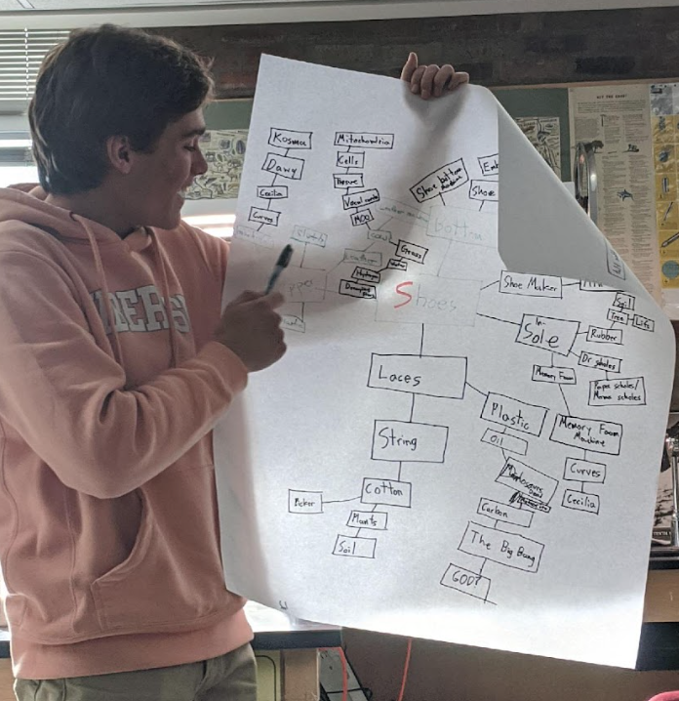
Recognizing Interdependence
Draw an important accomplishment/event or object shared in common in the middle
Make a first circle by drawing anything the subject depends on
Make a second circle by drawing anything that the items in the first circle depend on
Keep making circles by identifying what any item depends on!

Slide 5
Recognizing Interdependence cont.
How many people in total are needed for your subject?
Count and add up the number of items on your paper!

Slide 6

Recognizing Interdependence in One’s Life
Choose something important in your life: what does it depend on?
Draw an interdependence web/ write in your journal for 5 minutes.
Notes:
Non copyright: https://unsplash.com/photos/h7dl6upIOOs

Slide 7
Debrief
Look at your personal web of interdependence or your group’s web. What does it feel like to think of yourself as a part of this web? What do you think about this idea?
How might reflecting on interdependence lead us to feel grateful? How is interdependence related to compassion?

