Slide 1
Creating a Compassionate Classroom
Compassion as an Inner Quality

Slide 2
Checking In

Slide 3
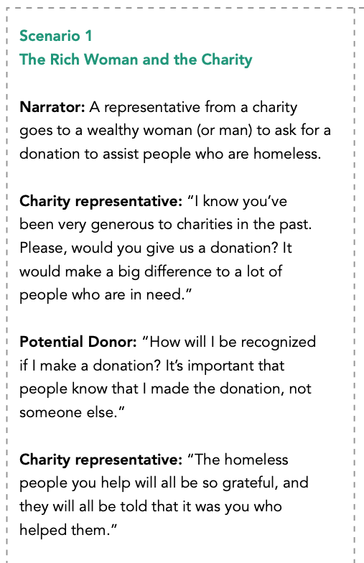
Scenarios
How do you think the different people in the scenario were feeling?
Did you see examples of kindness or compassion in the story?
Is compassion just the outer action or is it also something inside us?
Can you think of other examples where someone pretends to be kind, but their intention is not compassionate?
What about the reverse? Could something that looks unkind on the surface really be compassionate?

Slide 4
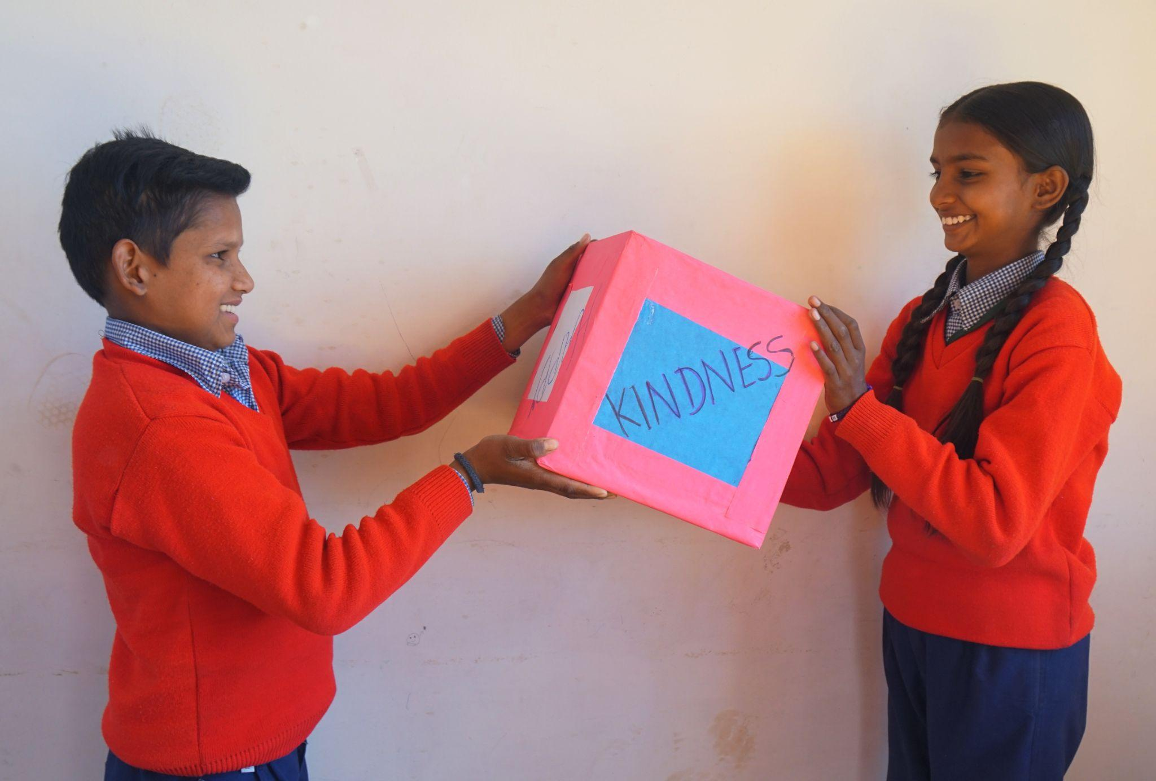
Making and Reflecting on a Definition of Compassion
What does compassion mean?
In groups, come up with words that are like compassion or explain what compassion is
Individually, write one sentence that defines compassion

Slide 5
Debrief
What is something you learned about compassion today?

