Slide 1
Creating a Compassionate Classroom
Exploring Happiness

Slide 2
Checking In

Slide 3

Stand By Your Experience
When I say something you agree with, move to the YES side.
When I say something you disagree with, move to the NO side.
Talk with your neighbors and share your thoughts.

Slide 4
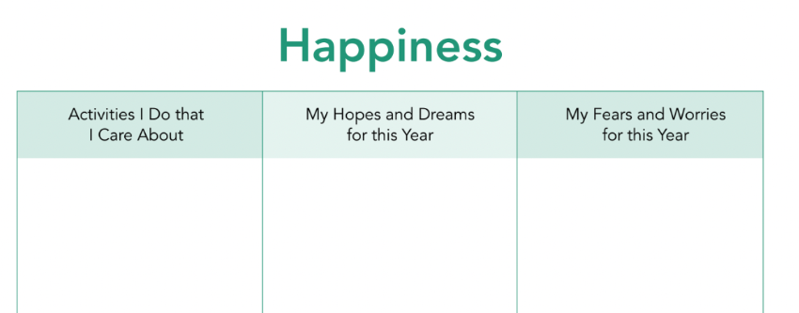
Our Aspirations and Our Wish for Happiness
Take a look at the three categories on the sheet.
Write down ideas for each column:
  What activities we like and are important for us
  Our hopes and wishes for the year
  Worries and concerns

Slide 5
Debrief
Is there anything that you realized or heard that has stuck with you or seemed particularly important?
  If so, you can share it in a single word as we go around one by one. If not, you can pass.
Is there anything that you still have a question about or would like to talk more about next time?
  If so, you can share it in a single word, or you can pass.

