Slide 1
Creating a Compassionate Classroom
Practicing Kindness and Compassion

Slide 2
Checking In

Slide 3
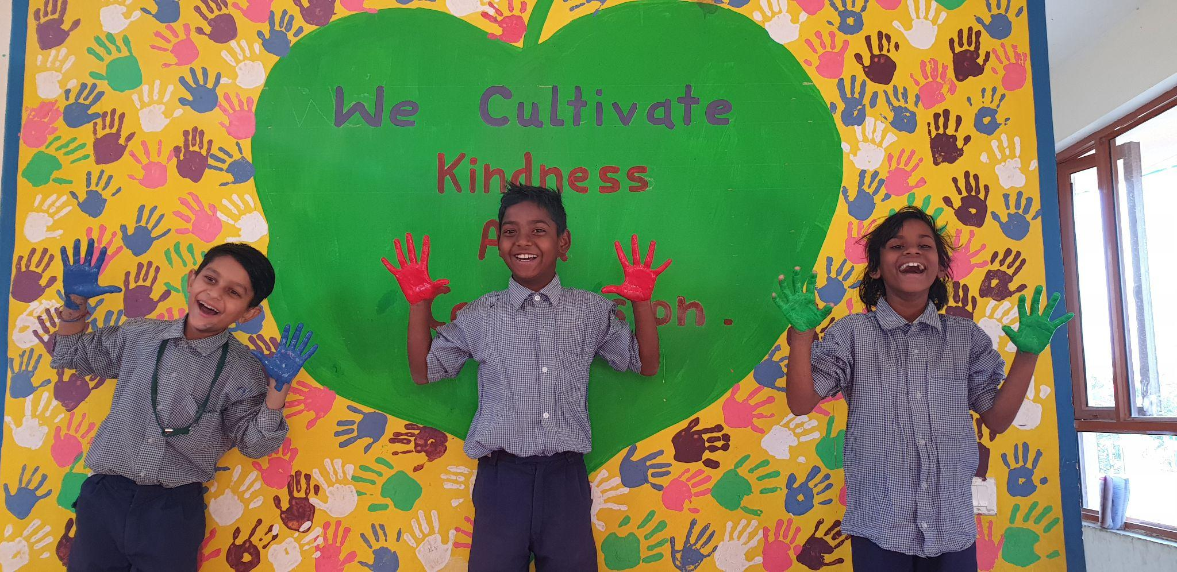
Turning Class Agreements into Helping Actions
What class agreement is being acted out? Guess!

Slide 4
Debrief
Did you notice how you felt when you saw people needing help or getting help?
Is there anything you learned or practiced about kindness or compassion that you might like to use again sometime?
Is there anything you think we should add to the class agreements after what we did today?

