Slide 1
We’re All in This Together
Learning Experience: Feedback Loops

Slide 2
Checking In

Slide 3
Feedback Loops
Feedback loop: when something goes around in a circle and grows bigger and bigger unless something stops it. A loop means a circle. "Feedback" is because it keeps feeding on itself and growing and growing.
Read The Cupcake Story Part 1
What was Alice feeling when she began giving out cupcakes? What was Kofi feeling?
What might happen if they keep feeling hurt and doing unkind things to each other?
Where do you think they are in their zones ­high zone, low zone, or OK zone?
What do they need?
What risky emotions might they be feeling?
Read The Cupcake Story Part 2
How should we draw the positive feedback loop?

Slide 4
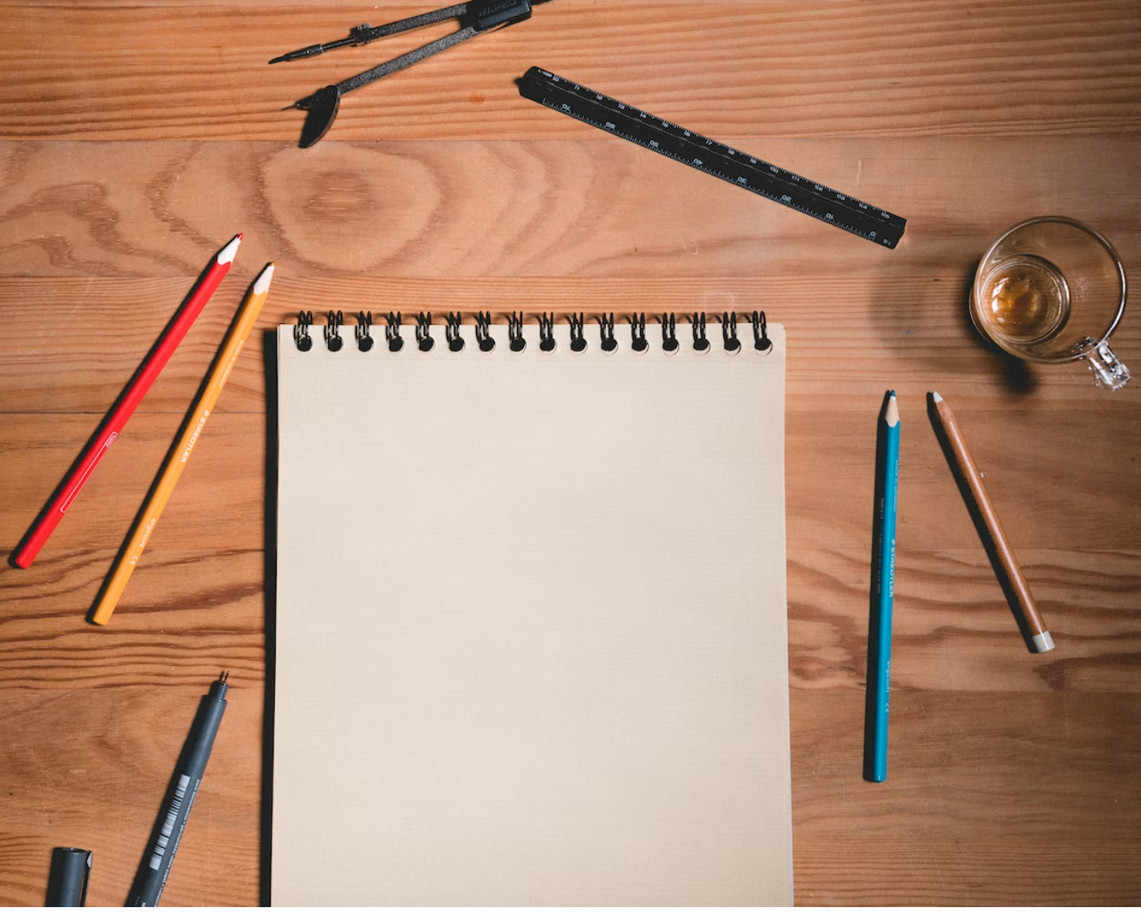
Changing a Negative Feedback Loop into a Positive One
Pretend you are Alice or Kofi in the story.
Imagine what you could have done to change the negative feedback loop into a positive one.
Draw your ideas.

Slide 5
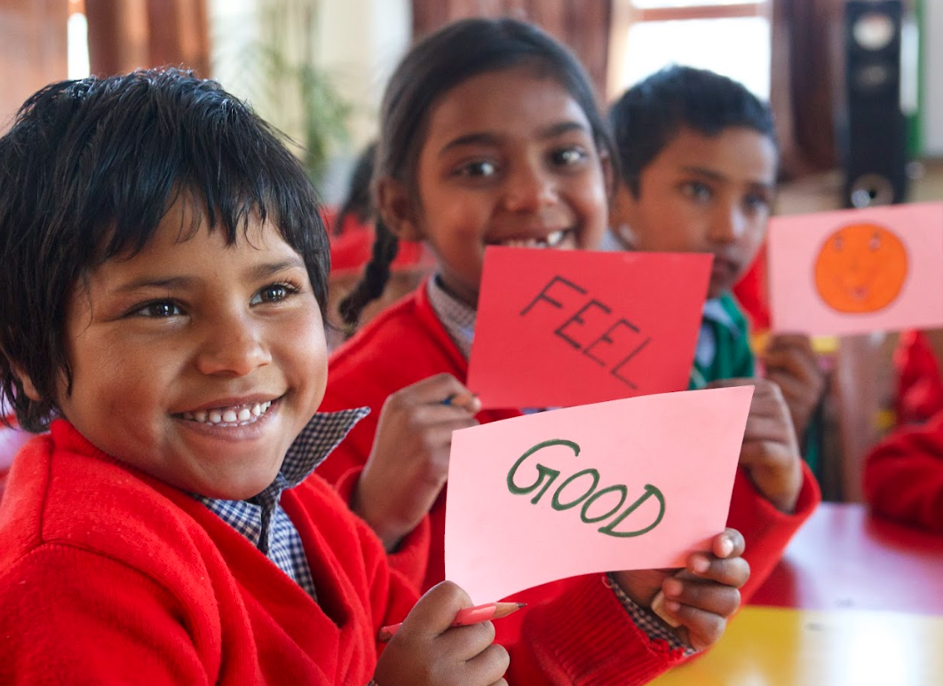
Debrief
Have you seen positive feedback loops in our classroom?
Have you ever been part of a positive feedback loop?
How can we create more positive feedback loops in the classroom?

