Slide 1
We’re All in This Together
Learning Experience: Exploring Systems Thinking

Slide 2
Checking In
Notes:
Posture
Comfortable and upright
Keep eyes open or closed
Resource
Choose from your kit or think of a new one
Focus quietly on your resource or do grounding
Sensations
Notice any sensations or feelings
Shift to a better feeling place if necessary
Breathing
Pay attention to breath entering and leaving your body
Return to your resource or grounding if uncomfortable
Count your breath if necessary

Slide 3
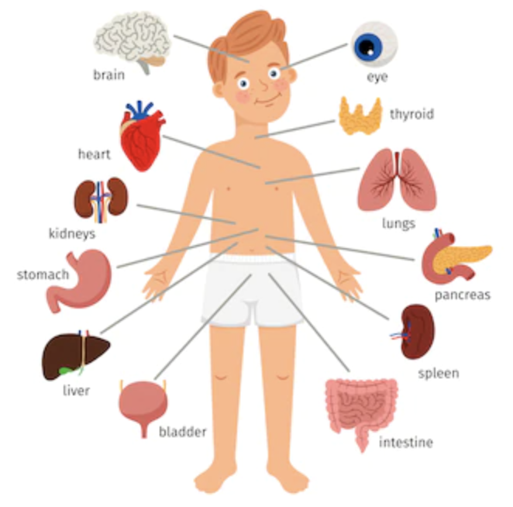
What is Systems Thinking?
Systems Thinking Checklist
Does it have parts and what are they?
Are the parts connected to each other? How?
If we change one part, does it affect other parts? How?
Are the parts connected to other things on the outside?

Slide 4

Seeing the School as a System
Who are the people who make up our school?
How are the people in this system connected?
In what ways are they similar to the students? In what ways are they different?
What if we were to change one part of this system?

Slide 5
Debrief
Thinking about systems helps us realize how important each part is and how important each person is, because each person's actions affect other people.
Who are the people you affect?
Who is affected by your actions and your decisions?

