Slide 1
We’re All in This Together
Learning Experience: It Takes a Village

Slide 2
Checking In

Slide 3
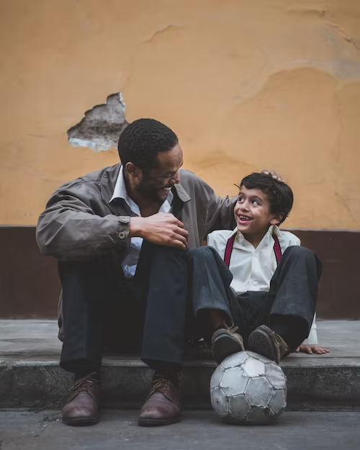
What is Caring and How Have We Experienced It?
What does it mean to "care" for something?
What are some examples of caring acts?
What are some of the reasons we care for something or someone?
How have we ourselves ever been cared for? By whom and what did they do?
Do you think you could count up how many people have cared for you in your whole life?

Slide 4
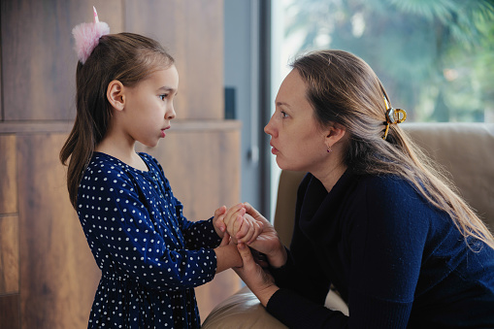
Insight Activity
Draw & label all the people that care for the child.
Write and draw all the things & experiences you can think of that are needed for the child to be provided for, protected, fed, clothed, and cared for.
What is expected back in return from the child for all of this care?

Slide 5
Reflective Practice
Write your name or draw yourself on the center of sheet of paper
Write/Draw all the people who have cared for you
How did it feel in your body while you did this activity? Did you feel any pleasant or neutral sensations?

Slide 6
Debrief
What was it like to think and talk about caring today?
How can you show caring and kindness throughout the rest of the day?

