Slide 1
Exploring Active Compassion
Chapter 6 Learning Experience 4

Slide 2
Check-In
Comfortable and Upright Posture
  Keep eyes open or closed
  Choose a resource from your kit or think of a new one
Focus on Your Resource
  Bring it to mind and focus quietly
  Notice any sensations or feelings
Become Aware of Your Breathing
  Pay attention to your breath as it enters and leaves your body
  If uncomfortable, return to your resource or grounding
  If distracted, return to the breath or count your breath

Slide 3
Discussion - Active Compassion is Strength
Alice Climbs a Tree
What did you find interesting in this story?
Why was Albert unhappy when he heard they couldn't climb trees?
Why did the school make a rule to stop students from climbing trees?
Why didn't Theresa want to tell Alice she couldn't climb trees?
Why did Theresa change her mind and decide to tell Alice the school rule?
Do you think Theresa cares about Alice? Why or why not?

Slide 4
Insight Activity - Practicing Active Compassion Through Role Play
Students will choose one of four roles: Alice, Theresa, Ms. Kelly, or Albert.
What can Theresa say to Alice?
What might Alice say in return?
How do you think Theresa feels right now?
How do you think Alice feels right now?
What do you think Theresa needs right now?
What do you think Alice needs right now?
Is Theresa being kind to Alice?

Slide 5
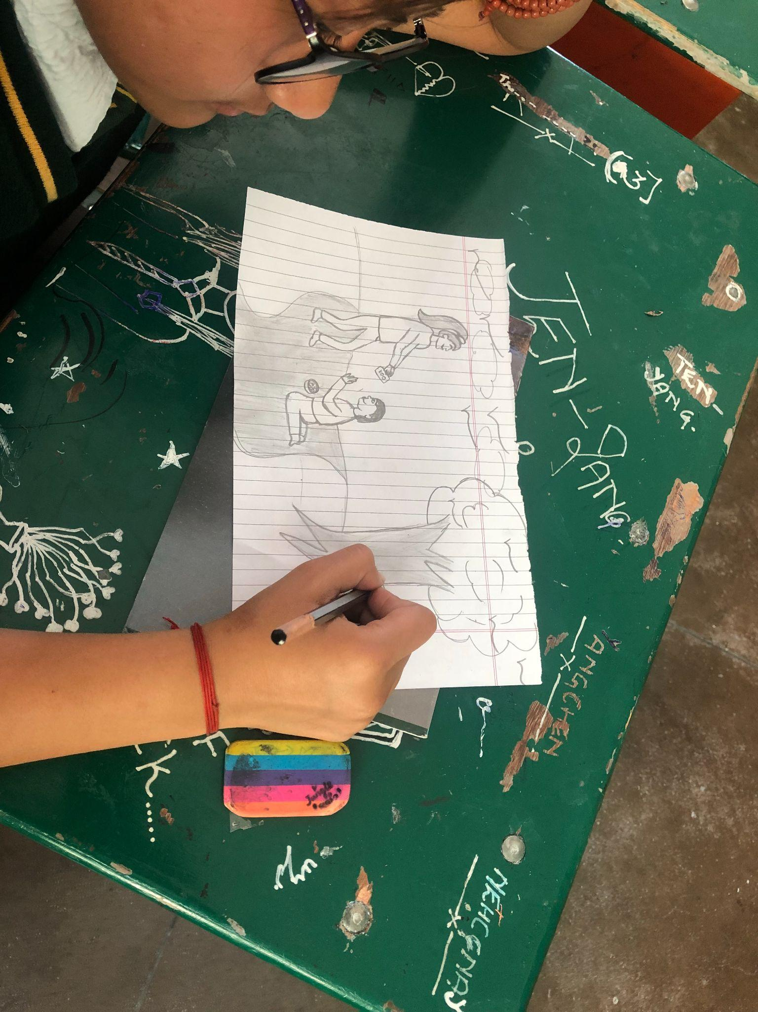
Reflective Practice - Remembering Active Compassion
Think of an example of active compassion from your own life or an imagined one
Draw or write about it!

Slide 6
Debrief
Why is it important for people to watch out for and help take care of each other?
Can you think of a time when you were upset because someone said no to you, but later you realized they were being kind?
What have you learned or thought about today that you'd like to remember?

