Slide 1
Compassion for Self and Others
Learning Experience: Exploring Kindness to Oneself Part 2

Slide 2
Checking In

Slide 3
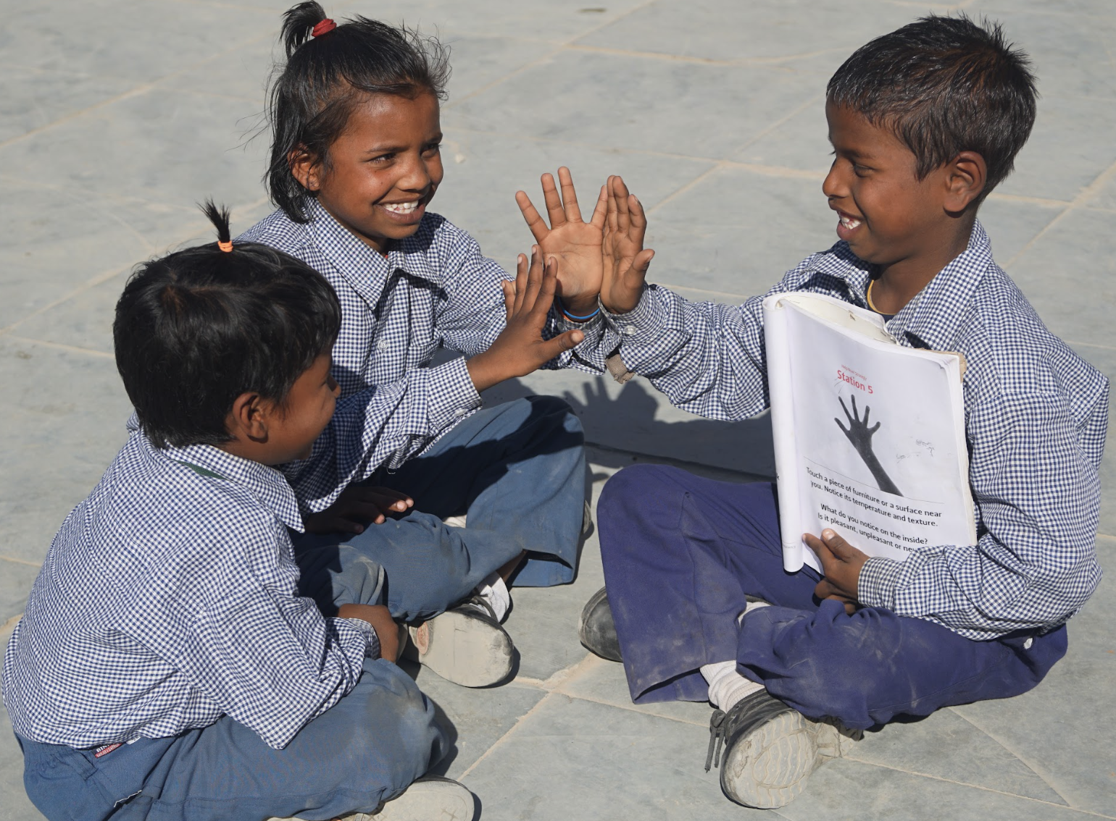
Being Kind to Ourselves Like a Friend
How would you treat a friend with kindness if they were sad or were facing a difficult challenge?
Give an example of something you would feel, say, or do for your friend.
Which of those could you do for yourself if you were sad and a friend wasn’t around?

Slide 4
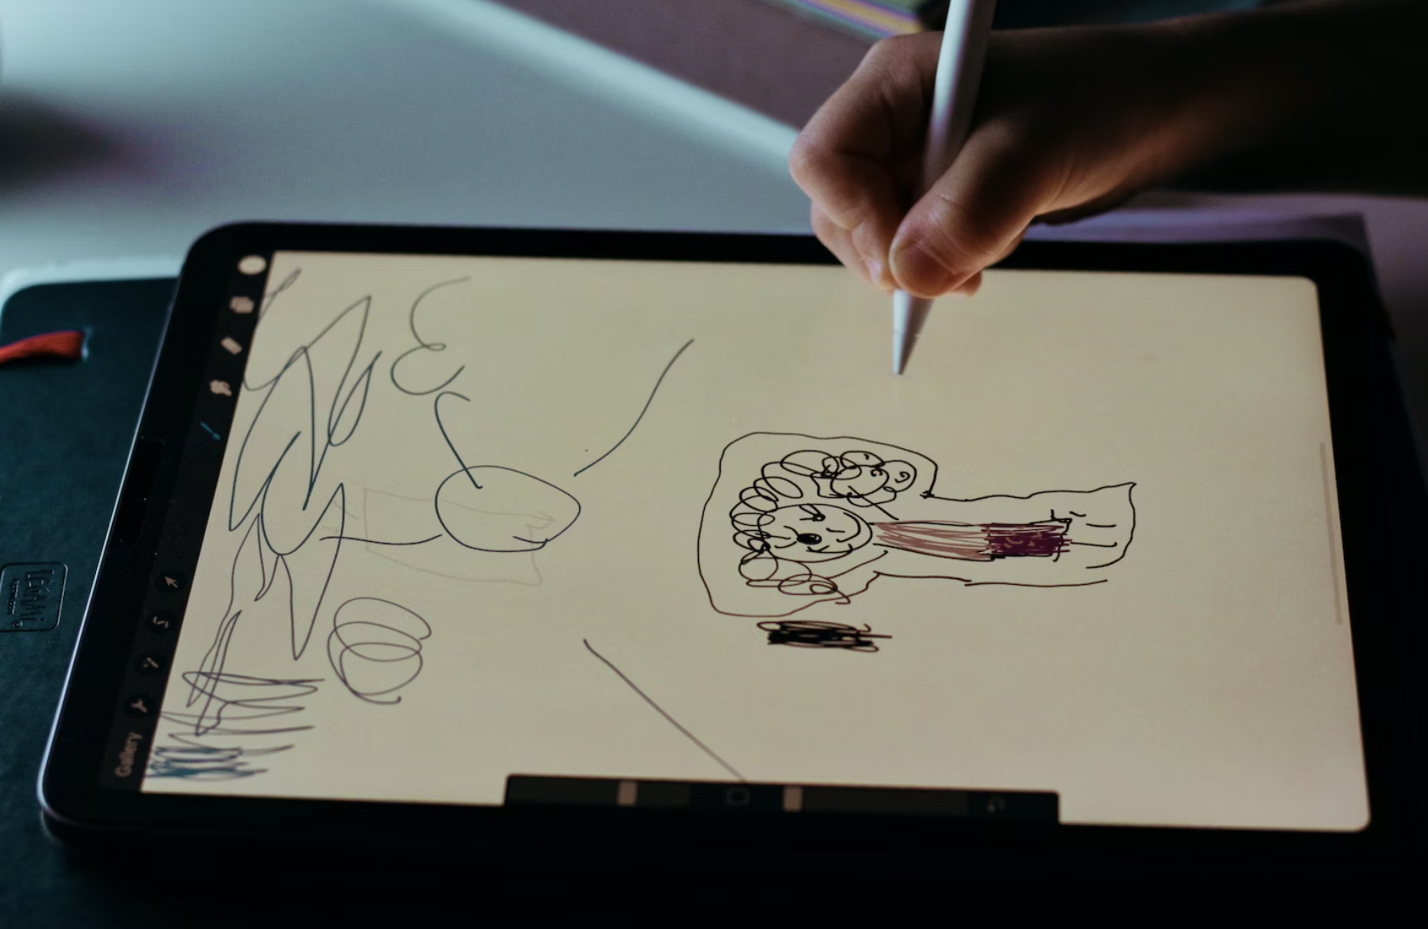
Being Kind to Ourselves
Draw a time when you needed to use positive self talk.
Draw a thought bubble and write what you said to yourself then.
What would you say to yourself in the future?

Slide 5
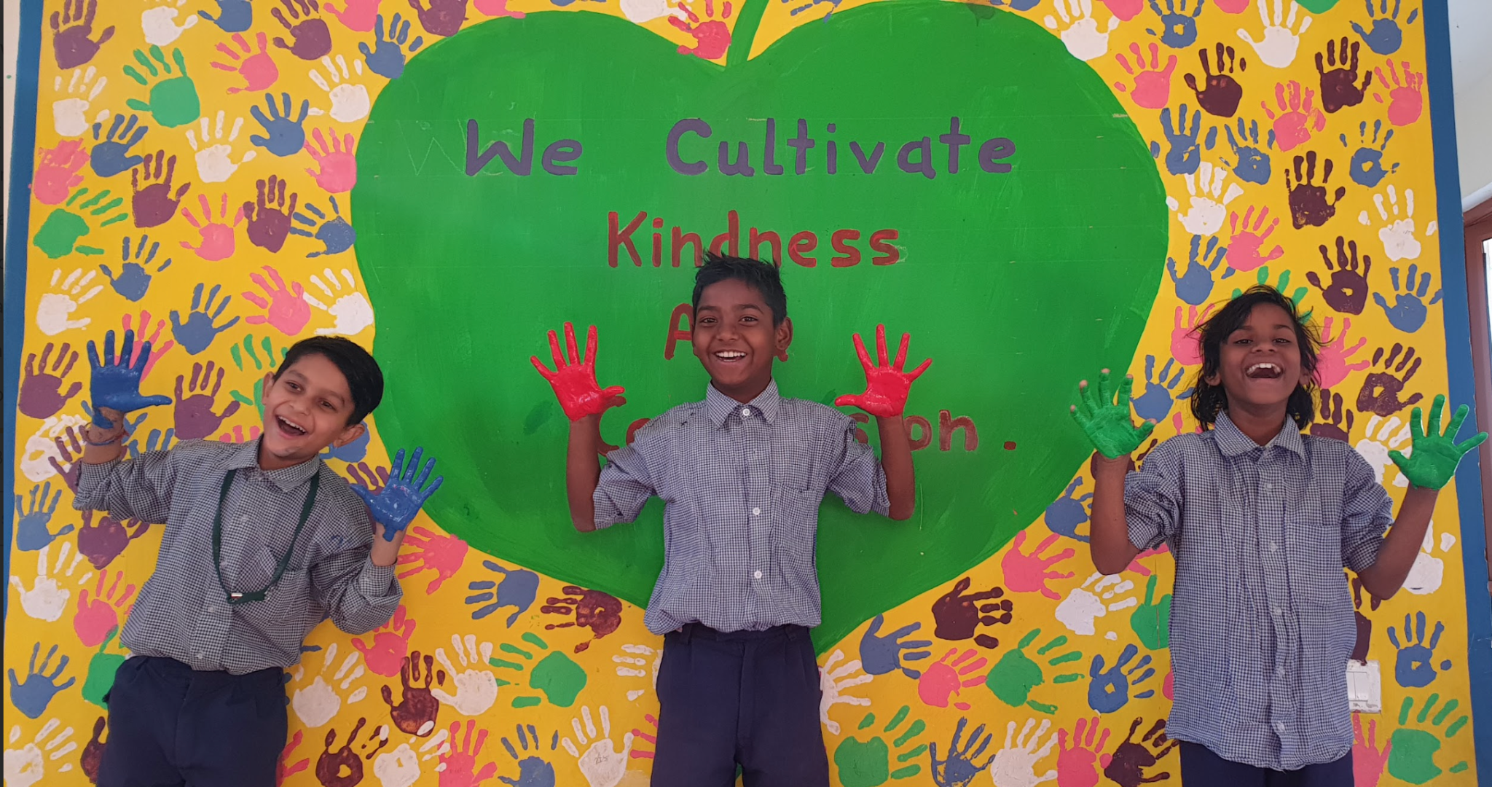
Debrief
What are some things we could do to be kinder to ourselves?
What did you learn that you would like to remember?

