Slide 1
Compassion for Self & Others
Learning Experience: Exploring Kindness to Oneself Part I

Slide 2
Checking In

Slide 3
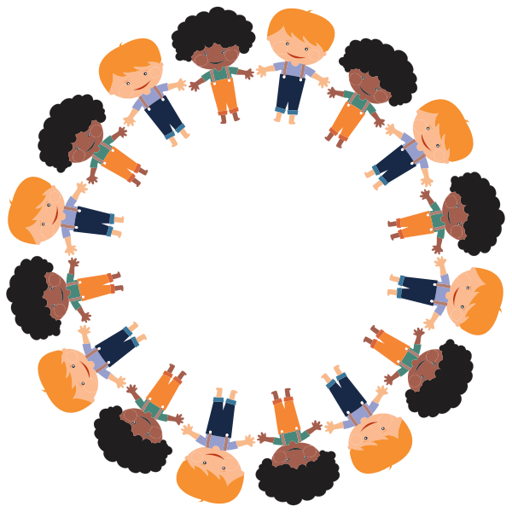
Positive Talk
What is positive talk?
What might we say to someone who is sad to help them to feel less sad?
How might we try to encourage them?
What helping activities could be useful?
Negative talk: discourage someone or say things that are mean or not helpful to them
Do you think we could have positive and negative talk towards ourselves?

Slide 4

Nelson the Photographer
Why did Nelson think he could never become good at photography? Why did Theresa think Nelson could become good?
What did Nelson think when the pictures he took came out blurry? What did Theresa she say?
What would the kindest person in the world say to Nelson?
If Theresa or the kindest person in the world weren't there to encourage him, how do you think Nelson could encourage himself? What could he say to himself?

Slide 5
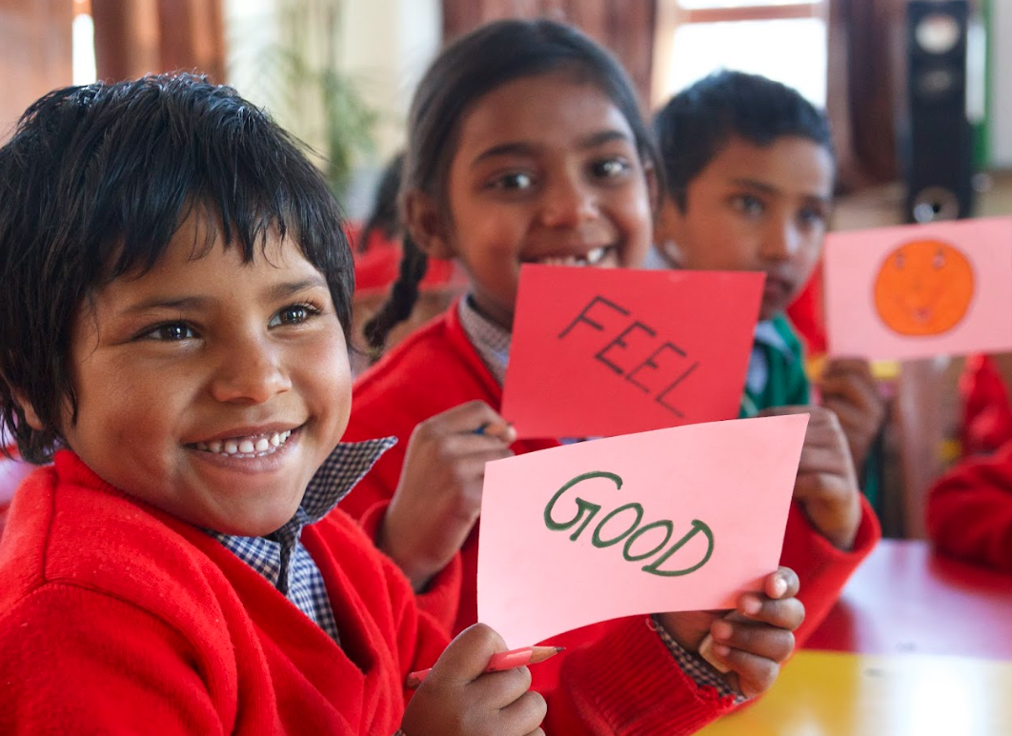
Debrief
Let's all think of something that was really difficult at first, but you became better at it with practice and time?
What encouraging things could we say to ourselves when we have difficulties?
What would you like to remember from what we learned today?

