Slide 1
Learning about and From one Another
Chapter 5, Learning Experience 1: Understanding Others Emotions in Context

Slide 2
Checking In

Slide 3
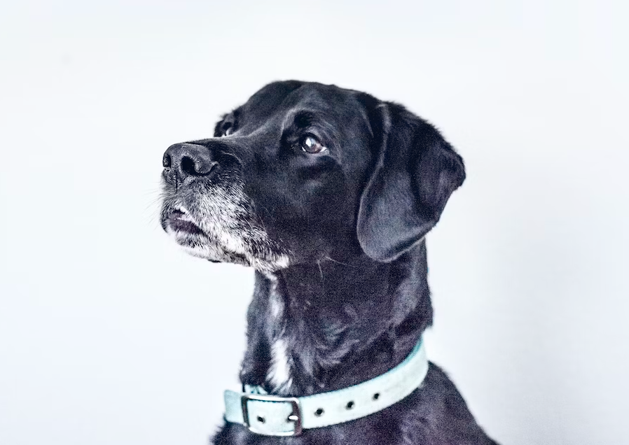
Alice and Albert See a Dog
What was Alice feeling in the story?
  Why do you think she was feeling that way?
How was Albert feeling?
  Why do you think he was feeling this way?
Why were Alice and Albert feeling different things in the same situation?
Think about questions you can ask to find out what others are thinking and feeling.

Slide 4
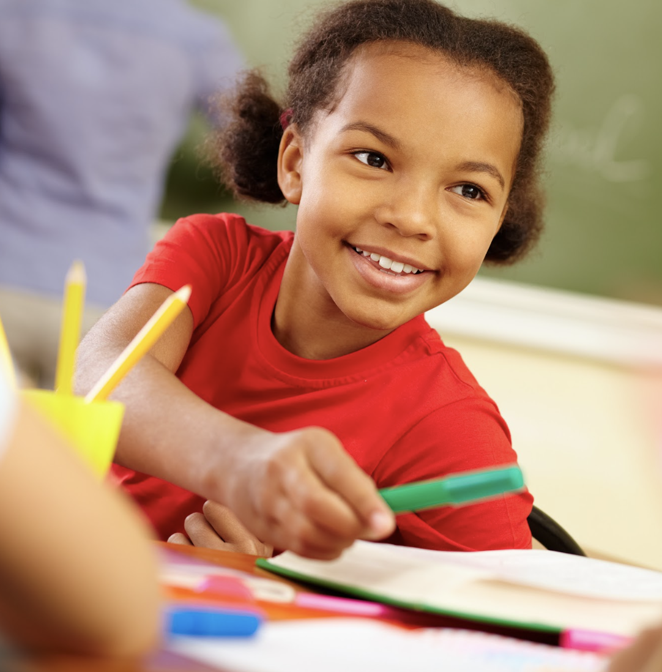
We Can Experience Things Differently
Think of a time you were really excited about something.
Draw yourself in this moment, including what you were excited about.
Add a couple friends or family to your drawing.
  Would they also be excited?
  Why might they feel differently?
Include someone who may not be excited.
  Why might they not be excited?

Slide 5
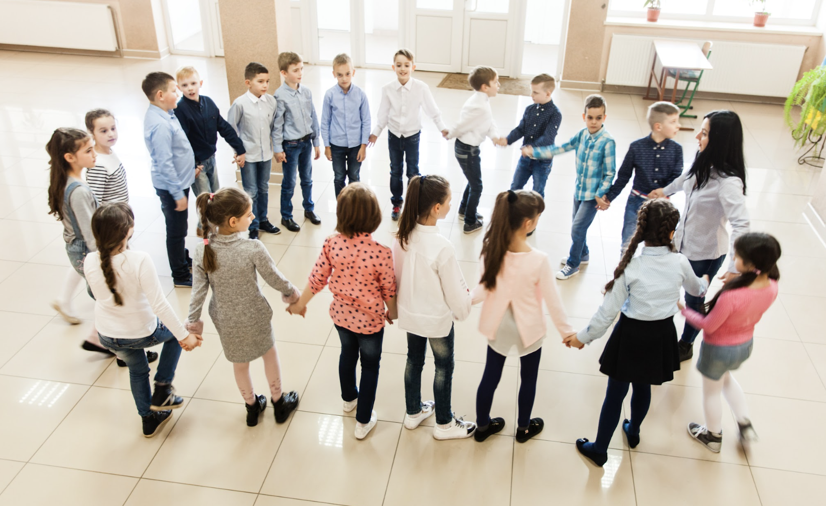
Debrief
When something happens, like Albert and Alice seeing the dog, why do you think we sometimes feel the same way but sometimes we feel differently to each other?
If someone is feeling differently to us, what questions could we ask them to make sure?

