Slide 1
Investigating Risky Emotions
Chapter 4 Learning Experience 5

Slide 2
Checking In

Slide 3

Investigating Risky Emotions
Frustration
Impatience
Discouraged
Anger
Anxious
Irritated
Annoyed
Unkind

Slide 4
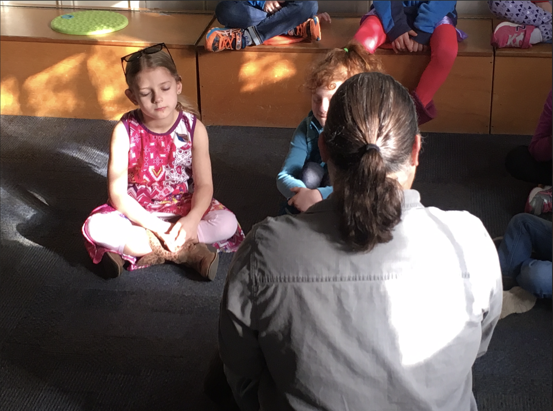
Observing the Mind for Emotions
Focus on your breath then watch any thoughts or emotions that pass through your mind.
What did you notice? Could anyone watch thoughts coming and going? What was that like?
Did anyone notice a feeling or emotion?
Do you think you'd be able to notice emotions if they happened during the day?

Slide 5
Debrief
What did we learn about risky emotions?
How do we know if an emotion is risky or not?
What might happen if we noticed risky emotions quickly?
Have we learned anything that could help us notice risky emotions?

