Slide 1
Navigating Emotions
Learning Experience: Emotion Families

Slide 2
Checking In

Slide 3

Creating Emotion Families
Form groups of 3-5 students at each station.
Each group will receive a “parent” emotion
  Happy, Kind, Sad, Angry, Afraid
Work in teams to match the “family member” emotions to the parent card at each station.

Slide 4

What Emotions Do I Notice Most In People Around Me?
Can you think of a time you noticed ______ emotion in someone else?
Take a few minutes to draw or journal or write about the emotions you tend to notice in other people.
Think about what needs people with those emotions might have.
  Write or draw about these underneath your picture.

Slide 5
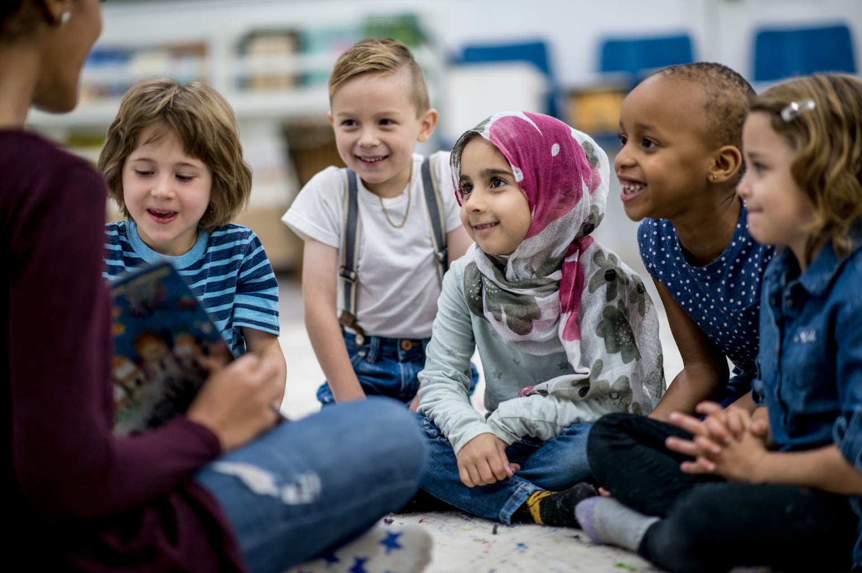
Debrief
• What happens when you notice someone else's emotions and needs?
• Can you think of a time when you noticed what someone in your family needed? How did it make you feel? How did they feel?
• Why might it help us if we knew more about emotions?
• Why might it be useful to notice other people's emotions and needs?

