Slide 1
Strengthening Attention and Self-Awareness
Learning Experience: The Mind Desk

Slide 2
Checking In

Slide 3
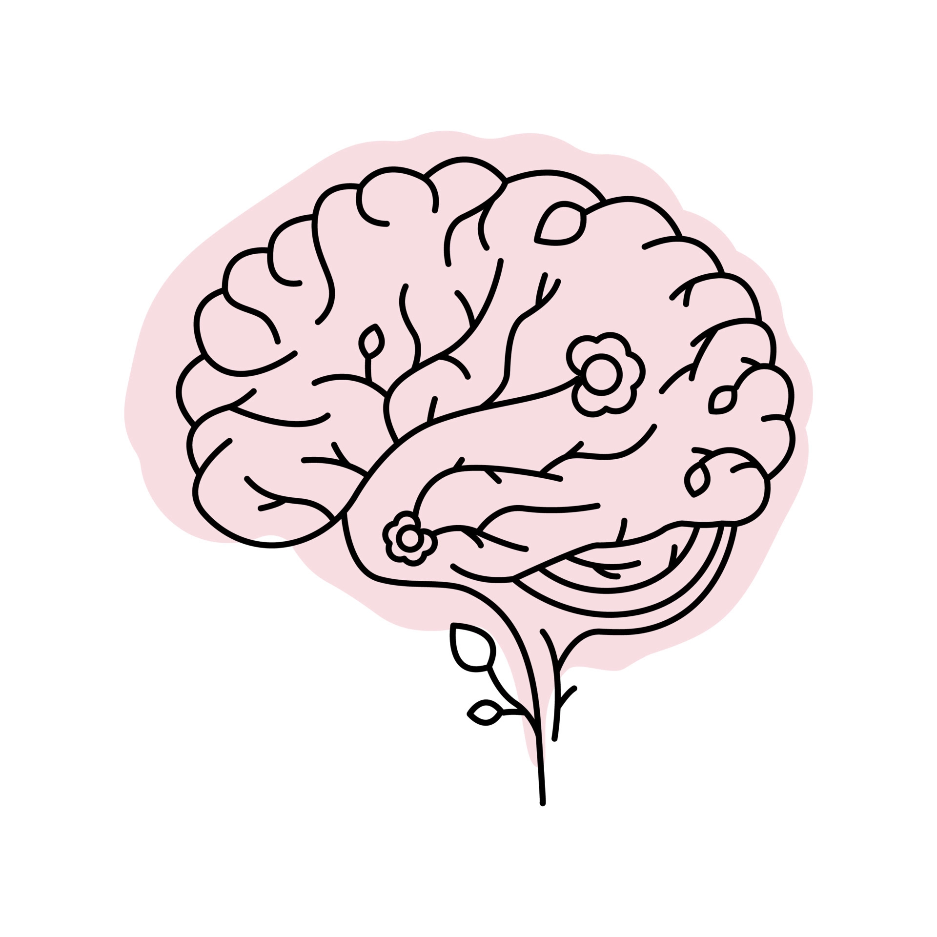
The Mind Desk
What do you notice about Theresa’s “desk?” What is her mind like? How and when might it change?
What do you notice about Desmond’s “desk?" What does his mind feel like? How and when might it change?
Whose attention will feel stronger, Desmond or Theresa's? Why? Who has more space for learning or the present?"

Slide 4

Reflective Practice: Observing the Mind
Focus on grounding
Focus on your breath:
What do you notice? Were there a lot of things on your mind desk?
What have you learned about the mind that you find most interesting or most helpful?
How might it help us if we learned to watch what's on our mind desk

Slide 5
Debrief
What have you learned about the mind that you find most interesting or most helpful?
How might it help us if we learned to watch what's on our mind desk?
Do you think you could spend a moment watching your own mind desk sometime in the next few days and share what you notice?

