Slide 1
Strengthening Attention & Self-Awareness
Learning Experience: Cultivating Attention on an Object

Slide 2
Checking In

Slide 3
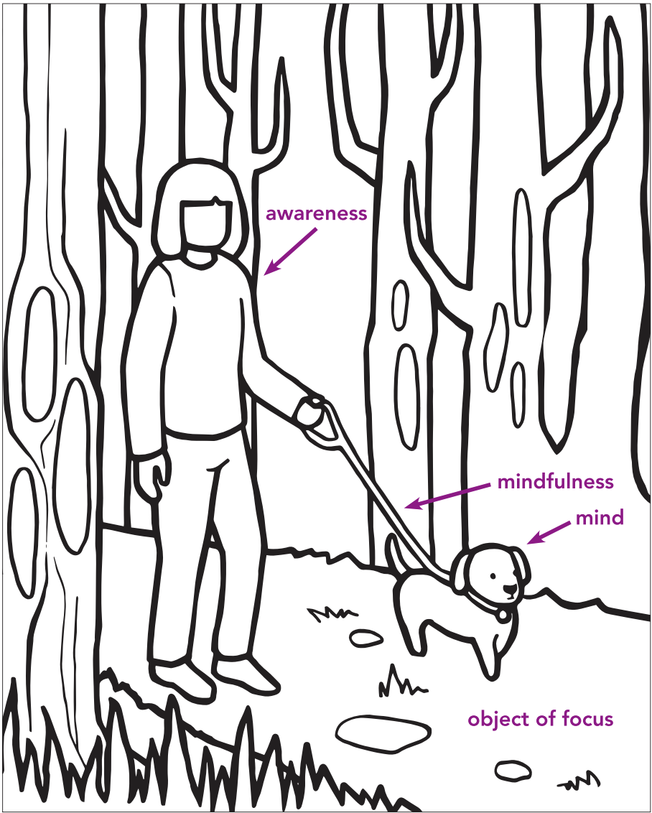
Cultivating Focused Attention
Mindfulness = keeping your mind on a chosen object without forgetting it.
Awareness = noticing what takes place in the mind.
The puppy = the mind
The path = the object of focus
The leash = mindfulness
The kind owner = awareness

Slide 4

Focused Attention on the Breath
Pick a body part where you can see your breathing (nose, chest, belly)
or
Pick an object that is steady and not moving
When your attention wanders, bring it back to your object
If you get uncomfortable, return to grounding, resourcing, or stop the activity

Slide 5
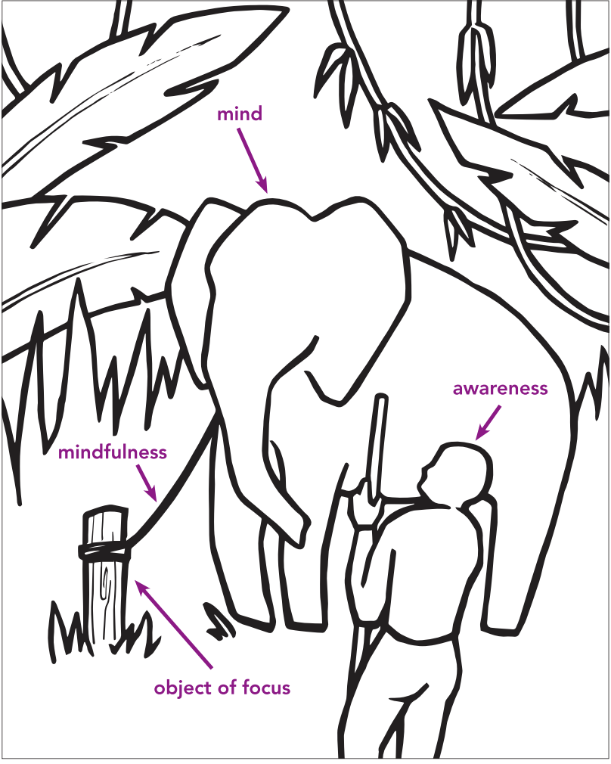
Drawing Attention Training
Draw one thing you have learned about attention.
Write a word on your drawing that explains what you are trying to show.

Slide 6
Debrief
Have you learned anything about attention that you think you could use?
Have you noticed any change in your ability to pay attention?
Do you think your attention would grow stronger if we practiced more? Would that be helpful?

