Slide 1
Strengthening Attention and Self-Awareness
Learning Experience: Cultivating Attention in Activities - Part 2

Slide 2
Checking In

Slide 3
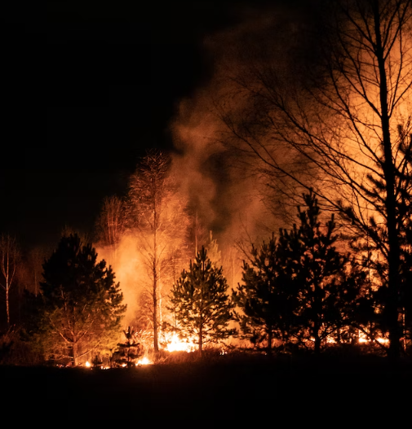
The Spark and Forest Fire
What happened in the story?
What was the spark?
What could happen if he didn’t catch the spark?
How can he catch the spark?
How can we benefit from catching the spark?
How can we help others catch our sparks?

Slide 4
Mindful Listening
Can you find the farthest sound?
What sounds do you hear in your own body?
How do you feel?
What sensations do you notice in your body?

Slide 5
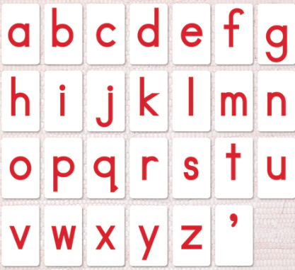
Mindful Writing
Notice how you are holding your pencil.
Write the lowercase alphabet.
Notice the movement of your hand.
Notes:
https://www.maitrilearning.com/products/red-movable-alphabet

Slide 6
Mindful Eating
What do you notice about your snack?
Pay attention when eating it.
What do you notice inside?
What zone do you feel?
Did you notice any acts of kindness when during mindful eating?

Slide 7
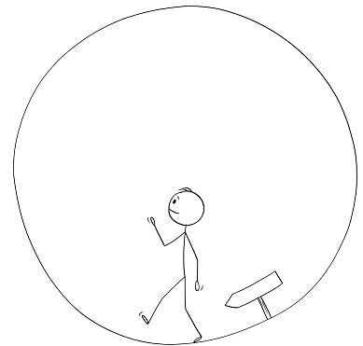
Mindful Walking
Let’s get in a circle.
Keep your eyes on the feet of the person in front of you.
Try to keep the same distance as you walk.
What do you notice inside?
What zone do you feel right now?
What else do you notice?
Notes:
https://www.istockphoto.com/vector/vector-cartoon-illustration-of-man-or-businessman-walking-in-circle-business-gm1192965665-339148357

