Slide 1
Strengthening Attention & Self-Awareness
Learning Experience: Cultivating Attention in Activities: Part 2

Slide 2
Checking In

Slide 3
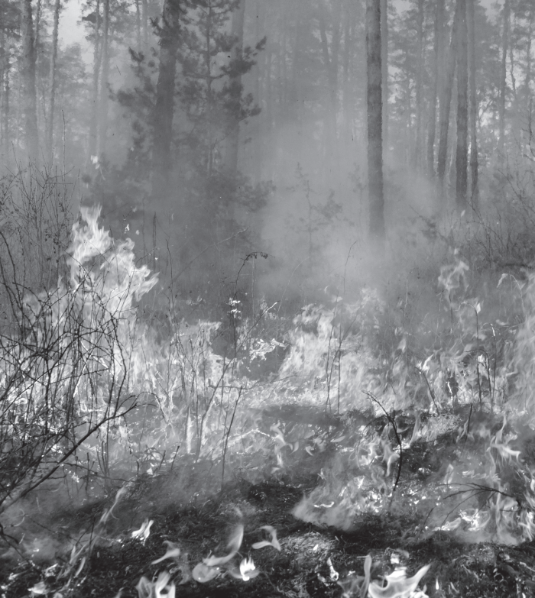

The Spark and the Forest Fire
How might our feelings be like a spark that turns into a forest fire?
Can you think of a time when you caught a spark before it became a forest fire? What did you do to help yourself?

Slide 4

Mindful Listening
Finally, bring your hearing in as close as possible, what sounds do you hear inside your own body?
Finally, bring your hearing in as close as possible, what sounds do you hear inside your own body?
Open your eyes, and come back: How do you feel? What zone do you feel in right now?
What sensations do you notice in your body? Has your breathing changed?

Slide 5
Debrief
What other activities could we do together mindfully?

