Slide 1
Strengthening Attention & Self-Awareness
Learning Experience: Cultivating Attention in Activities - Part 1

Slide 2
Checking In

Slide 3

What is Attention and What is it For?
What is attention?
What can we pay attention to?
What do we use to pay attention?
What are the benefits of attention?

Slide 4
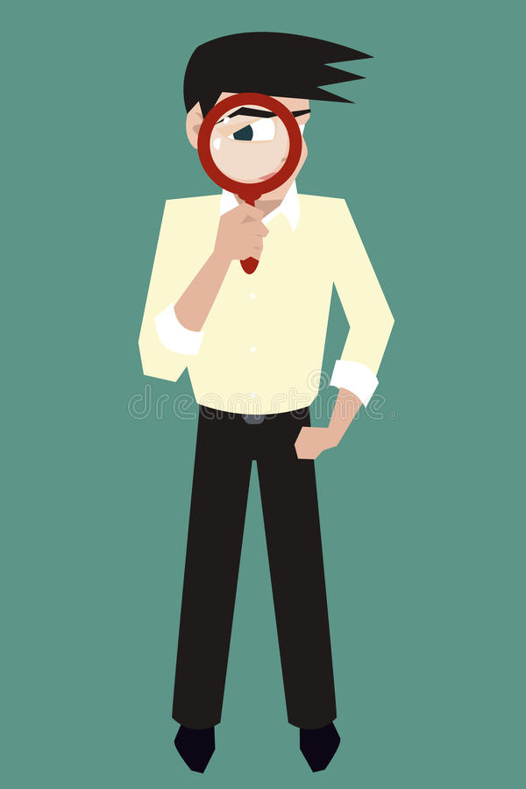
The Story of Ben
What happened in the story?
At what moment did Ben become aware that he was doing something that might get him into trouble?
What was Ben heedful of? Did it work?
Brainstorm a list of things it’s good to be heedful of or careful about.

Slide 5

Using Heedfulness and Awareness for Different Outcomes
What happens in the scenario?
At which points could the character have practiced heedfulness?
What could the character have done instead of what they actually did?
Act out the scenario with heedfulness

Slide 6
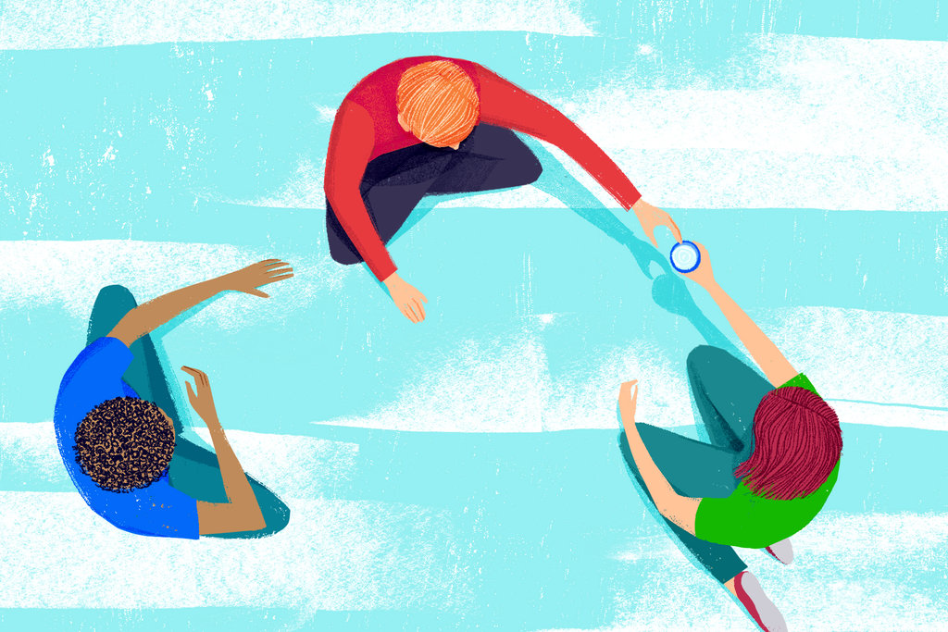
Pass the Cup
Pass the cup hand to hand around the circle
What sensations do you feel as the cup comes closer, it’s your turn, or when your turn is over?

Slide 7
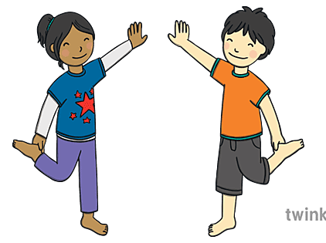
Mirroring
Partner A: Move one hand very slowly
Partner B: Use mindfulness to follow and mirror the movement

Slide 8
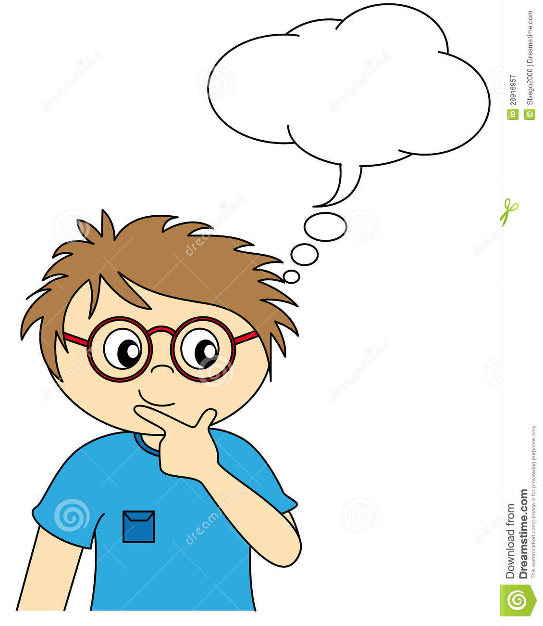
Settling the Mind with a Resource
Choose one of your resources from your resource kit
Now let’s just pay attention to our resource with our mind for a few moments quietly
Discussion:
What did you notice when we paid attention to our resource a bit longer?
Were you able to pay attention?
What did you do when you lost your attention or got distracted?

Slide 9

Debrief
Is it getting easier or harder to pay attention as we practice? Do you notice any changes?
Do you notice any difference in the class as a whole when we practice?

