Slide 1
Strengthening Attention & Self-Awareness
Learning Experience: Exploring Attention

Slide 2
Checking In

Slide 3
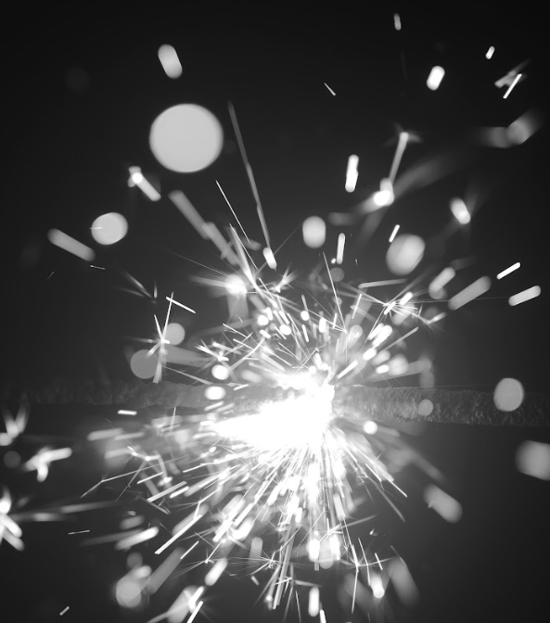
Attention with a Flashlight
Describe an object or part of the room in the dark
Discuss how different it looks when we shine light on it

Slide 4

I Notice, I Wonder
Pay close attention and observe an object
Say something you “notice’ or “wonder”

Slide 5
Discussion Questions
Did anyone hear someone else say something that you were thinking too?
Did someone say something you hadn't noticed or wondered about yourself?
Who can add one more thing they notice? Or wonder? Could we keep on noticing and wondering about more and more things?
I noticed there were no wrong answers. Why do you think that is? (We're describing our own experiences, not opinions or judgments.) Do you think there's a right or wrong way to experience this object?
Did anyone get distracted? Did you ever lose attention for a moment? Were you able to bring your attention back to the group and the object?
Write or share as a whole group what this felt like:
Where did you feel sensations in your bodies?
What were these sensations?
Why might this activity be helpful when thinking about attention or why did we do it?

Slide 6

Individual Practice with Writing
Write something you notice or wonder about the object

Slide 7
Reflective Practice
Choose one of their resources from their resource kits and focus your mind on it for a few moments

Slide 8
Debrief
Have you learned anything about attention that you found interesting?
How else might it help us if we practiced attention and got better at it?

